Slide 1
Improving Use of CMC Using a QI Approach for Medical Patients Admitted to Barnet Hospital

Slide 2
Team
Kristin Goffe (Registrar)
Jo Wilson (Consultant Nurse, Palliative Care)
Tim Gluck (Consultant Geriatrician)
Jo Brady (Consultant, Palliative Care)
Adrian Burns (Operations Manager)
Geetika Singh (Patient Safety CPG Programme Manager)
Core Group: Carmel Bergbaum, Hannah Petra, Molly Stewart, Eleanor Wilson, Beth Crocker
Thanks also to Goreti Duarte, Medical Staffing team, Medical Education team.

Slide 3
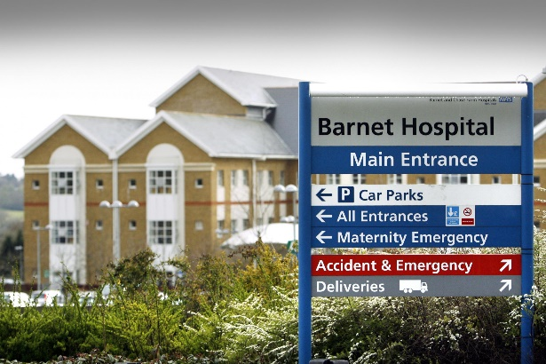
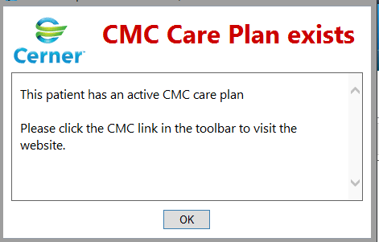
Introduction
Acute hospital serving a large older population
CMC in use in our area and it is integrated into the hospital electronic patient record
CMC not consistently accessed on admission, nor updated on discharge
→ A risk of ignoring patient wishes and documented care plans
An unmet need amongst our patients
We used a quality improvement approach to increase use of CMC

Slide 4
Project scoping
Explored current practice and barriers and mapped the patient pathway
Key issues:
Access
Experience, confidence and training
Time
Baseline data and user validation
Driver diagram

Slide 5
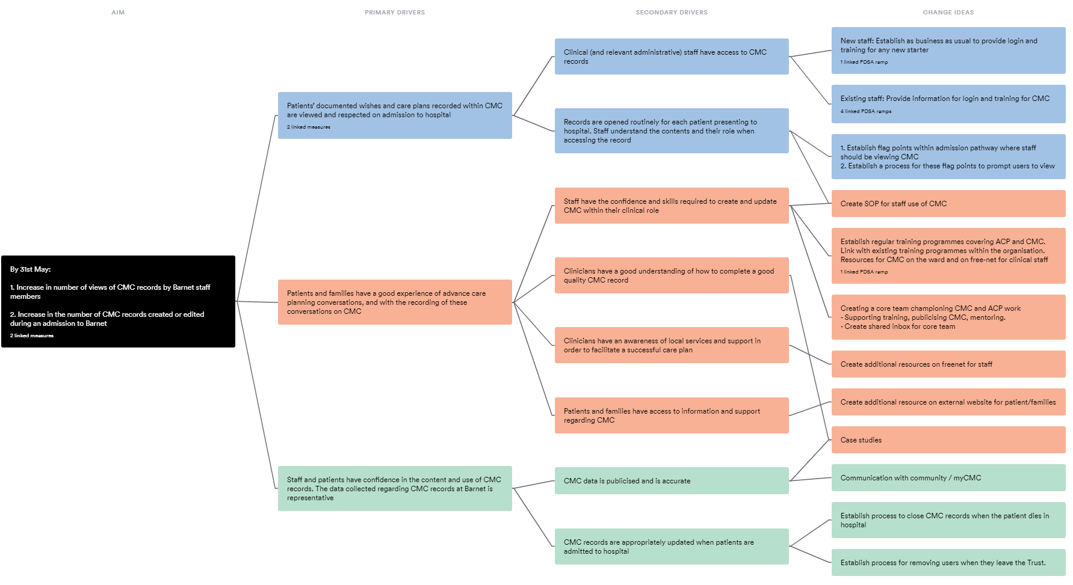

Slide 6
Measures
Outcome measures:
Views of CMC (monthly)
Publish and updates (monthly)
Process measures:
Number of users
Number of users logging in per month
Number of people trained

Slide 7
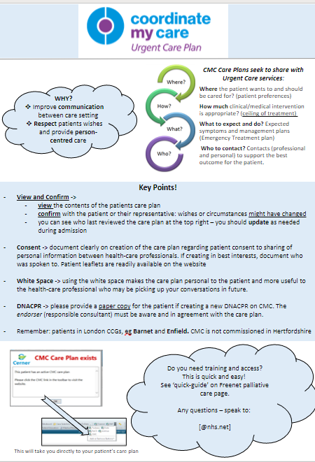
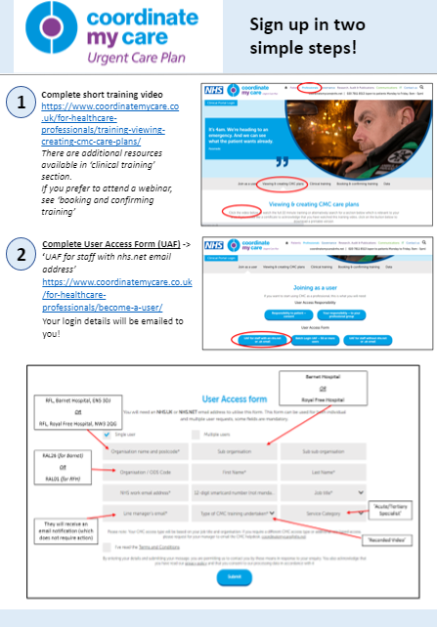
Interventions
Jan Feb Mar Apr May Jun
Local teaching
Drop-ins
Quick-guide to gain access
Mentoring
Posters
Ward surveys and support
Core Group:
Carmel Bergbaum, Hannah Petra, Molly Stewart, Elle Wilson, Beth Crocker

Slide 8
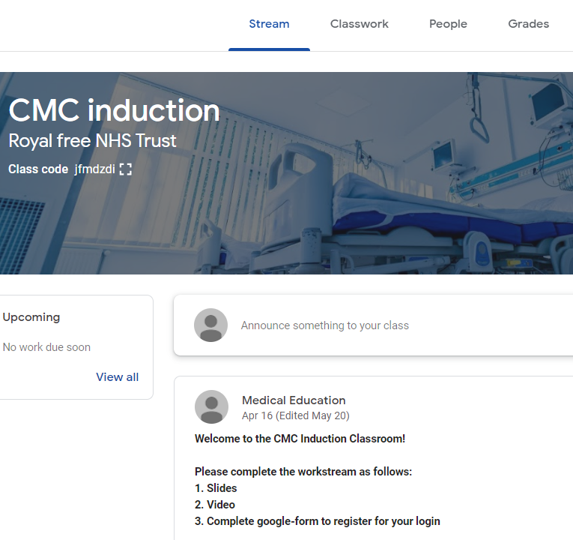
Processes
Embedding training for new starters
e-classroom
face-to-face at induction
Trust guideline
Closing of records
Managing reporting and user lists

Slide 9
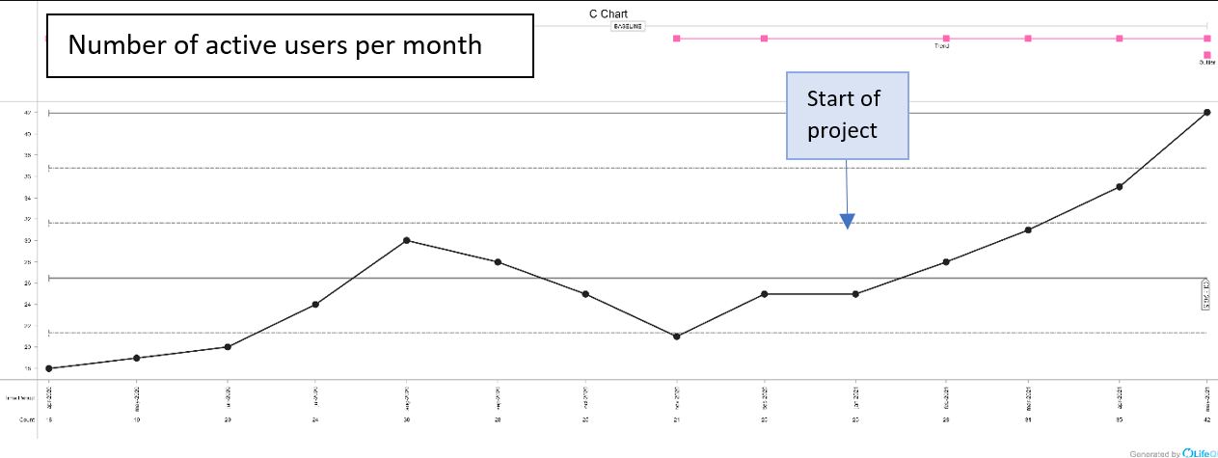
Results
53 people attended departmental teaching and drop-ins.
The number of users actively utilising their accounts showed a steady increase (25->42 users)
Spot check surveys of staff in the Department of Medicine (N=45-60)
percentage with access to CMC increased from 37% to 53%
68% reporting having accessed the system within the last two months.

Slide 10
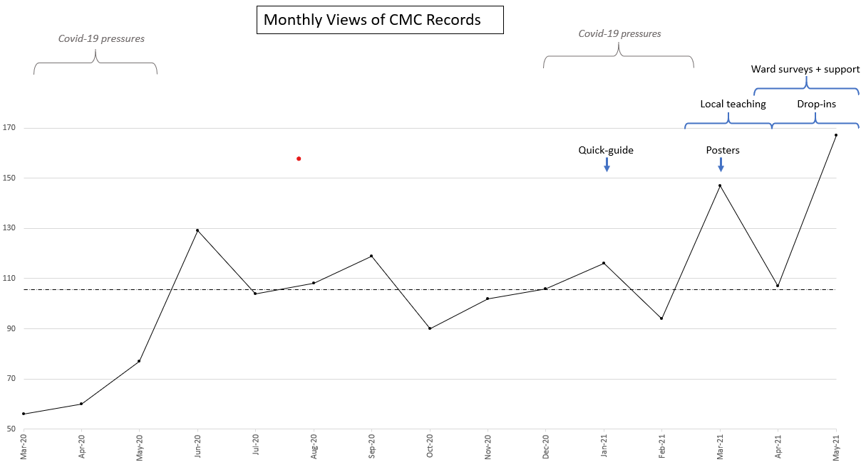

Slide 11
Learning and Future Actions
Face-to-face training and user support
Understanding the barriers for users
Involving different teams and disciplines, including operations team to embed interventions
Extremely helpful to have funded time for this role to concentrate on such an important aspect of care for our patients.
A complex problem needing ongoing efforts to make and sustain change.
Further training sessions including in the emergency department, junior doctor changeover, allied healthcare professionals
Evaluation of new e-classroom and induction training – is this effective to sustain change?
Mentoring and supporting CMC champions
Exploring barriers further and patient feedback
Simulation training courses in Advance Care Planning ‘The Elephant in the Room’ for 120 healthcare professionals. Aiming to Increase skills and confidence. An opportunity to build relationships and learning between specialties and disciplines.

