Slide 1




Success factors in improving use and quality of advance care plans across the acute trust during a pandemic
Alison Drew
CMC Facilitator
Heather Wright
Team Leader for Palliative and End of Life Care
Dr Lucy Pain
Palliative Care Consultant/EOLC Clinical Lead

Slide 2
Barking, havering and redbridge university trust
A large, acute trust situated in East London
Bordering Essex
Situated across two acute hospital sites- Queens and King George’s
Population 750,000
7,500 staff and volunteers
Diverse community

Slide 3


Accelerator Project
Aims
Changing from paper to digital ACP
Stop using all other ACP documents and use CMC alone
Increasing the use of CMC
Development of quality assessment tools
Guidance for quality of Emergency Treatment Plan
Key Performance Indicators
Daily logins to CMC system by BHRUT staff.
Urgent Care views of CMC care plans created at BHRUT
Number of CMC care plans published and revised at BHRUT
Non-urgent care views of CMC records created at BHRUT

Slide 4
Background
"View and Update" CMC piloted for use in Emergency Department from June to August 2020
CMC and paper ACP was in use at BHRUT
CMC adopted as only ACP in December 2020
All other Advance Care Planning was withdrawn in December 2020

Slide 5
Stakeholder engagement
Initially- Teams meeting to engage stakeholders in change over to CMC
Secondly- Establish-
What a good quality Emergency Treatment Plan looks like
What is most valuable information to those attending in a crisis situation
Involve-
London Ambulance Service, GPs, community nurses, care-home managers, Marie Curie and patient experience partners in the content required

Slide 6

Good Foundations
Quick login from Apps
Alerts
Standard Operating Procedure developed
Organisational subgroups
Emergency Treatment Plan Guidance developed
Quick guides
Audit tool developed to measure the essential fields in the Emergency Treatment Plan
Audit of CMC records March 2021
Trust ACP leaflets
Podcasts

Slide 7
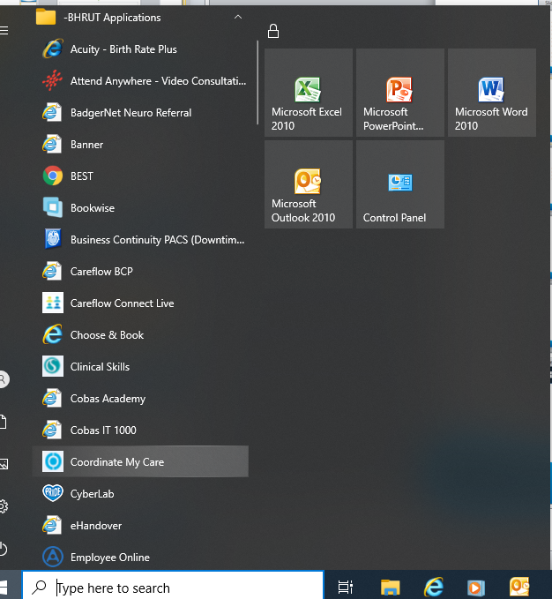
Quick Access via BHRUT apps

Slide 8

Alerts
Early identification of patients with a CMC record
Manually added by EOLC admin

Slide 9
Implementing CMC at BHRUT
Develop organisational subgroups to
guide quality improvement work:
Emergency Department
Acute Hospital
Specialist Palliative Care
Paediatrics

Slide 10
Standard Operating Procedure
Safe and effective implementation of CMC
Ensures clear guidelines
Clearly states roles and responsibilities
Expectation of who should have a CMC record-
All patients leaving hospital in the last weeks or short months of their lives (i.e. GSF Amber or Red)
Expectation of who should have an ETP-
All patients leaving hospital in the last weeks or short months of their lives (i.e. GSF Amber or Red)
May also be appropriate for patients with a longer prognosis if complex needs
Notes:
Prognostic indicators

Slide 11

Impact
The impact is assessed using key performance indicators-
Daily logins to CMC by BHRUT staff to the CMC system
Urgent Care views of CMC care-plans created at BHRUT
Number of CMC care-plans published and revised at BHRUT
Non-urgent care views of CMC records created at BHRUT

Slide 12
Daily Logins

Slide 13
ED Views
Department Name | Financial Year | Grand Total
 | 2020/21 | 2021/22
 | 2020/21 Total | 2021/22 Total
BARKING HAVERING AND REDBRIDGE UNIVERSITY A and E DEPARTMENT | 303 | 168 | 471

Slide 14
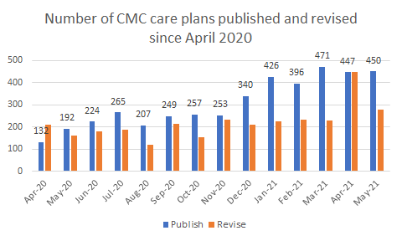
Published and Revised

Slide 15
Non urgent care views

Slide 16

Concerns
Lack of guidance on the suggested content of the Emergency Treatment Plan
Variable quality of guidance for health professionals and practical advice for patients/families

Slide 17
What is the Emergency Treatment Plan?
Crisis guidance for registered healthcare professionals who may not be familiar with the patient
Specific, individualised clinical advice
NOT simply guide the viewer to seek advice elsewhere
NOT aimed at other carers or family members, although they should be involved in preparation of this section and aware of its content
NOT intended to document the patient’s wishes and priorities in relation to non-medical aspects of personal care (should be documented in the Preferences section under Patient Wishes. e.g. dietary requirements, favourite music etc)

Slide 18


Guidance for creating an EmergencY Treatment plaN
The guidance is aimed at -
Registered health care professionals (primarily doctors and Clinical Nurse Specialists) creating or updating the Emergency Treatment Plan (ETP)

Slide 19
Audit Proposal objective
A retrospective digital case note audit.
To establish the number of CMC records created at BHRUT during the research period
To establish the quality of CMC records created at BHRUT during the research period
Audit 50% of all the notes created or edited at BHRUT in March 2021, up to a maximum of 30 sets of notes
Proposal registered with the audit department
No direct comparison audit to compare against
Expectation to identify themes
Use for training needs analysis

Slide 20
Audit of mandatory fields
Preferred Place of Care
Preferred Place of Death (first choice)
CPR patient discussion
CPR family discussion
CPR decision
Clinical recommendation

Slide 21
Anticipated Symptoms and Problems audited
Crisis management
Breathlessness
Nausea and vomiting
Pain
Terminal restlessness
Worsening mobility and falls
Worsening oral intake of food and fluids

Slide 22
% of all patients with an ETP (24/27)
Notes:
Includes those who may be GSF Green, therefore not expecting BHRUT staff to complete.

Slide 23
Patients recommended to have an etp
Notes:
Of the patients expected to have an ETP, ie Red and Amber GSF . 96% COMPLIANCE

Slide 24
Evaluation of audit and actions
Themes identified – mostly well written but a tendency to lack non pharmacological advice
Actions- Guidance to write an ETP cascaded

Slide 25
Janet, Specialist Haematology Nurse
“I was alerted (via my subscription) that my patient was in ED, I went down to see her and found that she was dying. I knew that she did not want to die in hospital; I could organise for her care in the community and to facilitate her discharge. She died comfortably the next day”.
https://youtu.be/7YDM9xDUCiQ
Notes:
Anecdotal evidence

Slide 26
Mark, Consultant at Saint Francis Hospice/sessional Consultant at BHRUT
“…The value (of CMC) is in improving outcomes for patients, who are more likely to die in their preferred place of death if they have a CMC record in place” and that “unwanted admissions to hospital have been avoided”.
https://youtu.be/ecxeFeNTW0Q

Slide 27
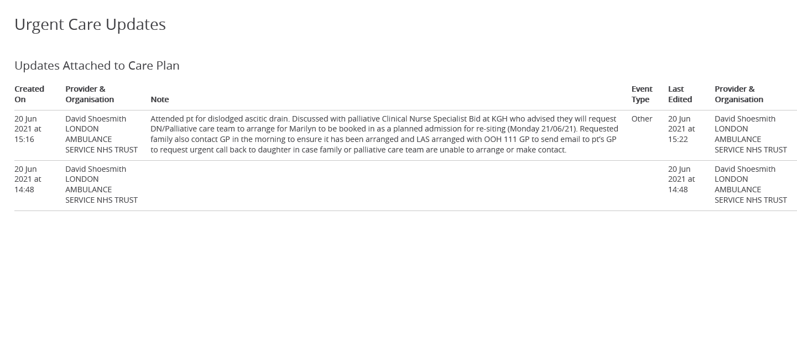
LAS admission avoidance
Notes:
Admission avoidance evidence, one example.
Urgent care updates viewed

Slide 28

Conclusion
Challenges
Lack of interoperability between internal and external IT systems
CMC not being available for patients who live outside of London

Slide 29
To embed CMC and make its use sustainable it is necessary to:
Dedicate a Facilitator to leading on the implementation of CMC
End of Life Care Facilitators to continue to train staff in the use of CMC
To monitor logins
Cleanse data to ensure it is accurate
Regular auditing of the CMC records to ensure high quality
Enlist CMC Champions in departments
Seek solution for interoperability of system i.e. in context link
Ensure there is a stringent alternative process for patients who live outside London

Slide 30
Next Steps
Standard Operating Procedure to be reviewed in January 2022
Re-audit of CMC records to deduce whether the introduction of the ETP Guidance has improved the content of the free text boxes and the quality of the CMC records
Raise CMC awareness at induction for doctors new to the trust (through a leaflet and publicity about CMC podcast), then incorporate CMC training into all junior and consultant doctors EOL education sessions
The podcast is available at-
https://clairebatestinkler.podbean.com/e/advance-care-planning-and-cmc/
It is acceptable for a patient with a needs-based score of Green to not be offered a CMC conversation during the acute admission, however recommend on the electronic discharge summary for the GP to discuss or to give myCMC leaflet
Notes:
To truly embed in the Trust

Slide 31

Thank you for listening

Slide 32

Any Questions?

