Slide 1
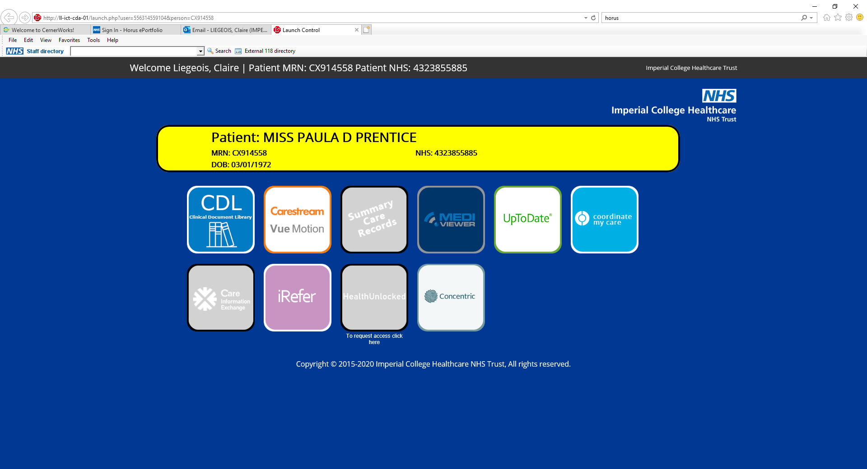
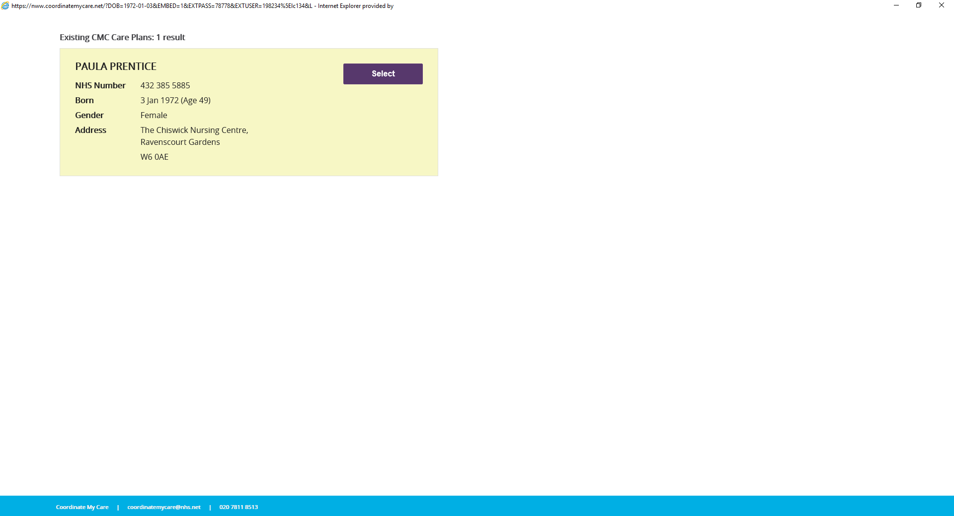
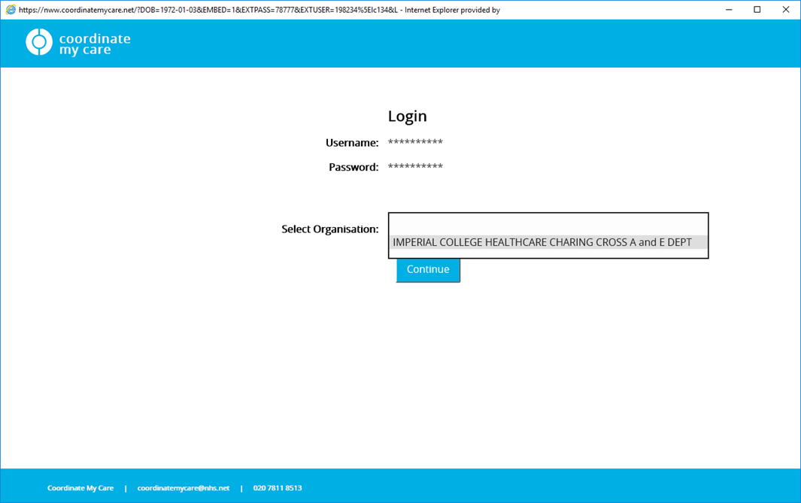
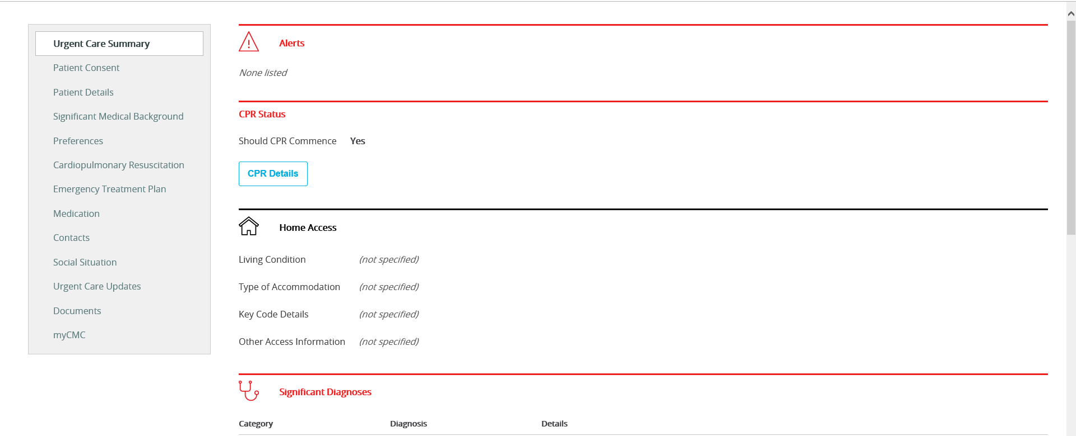
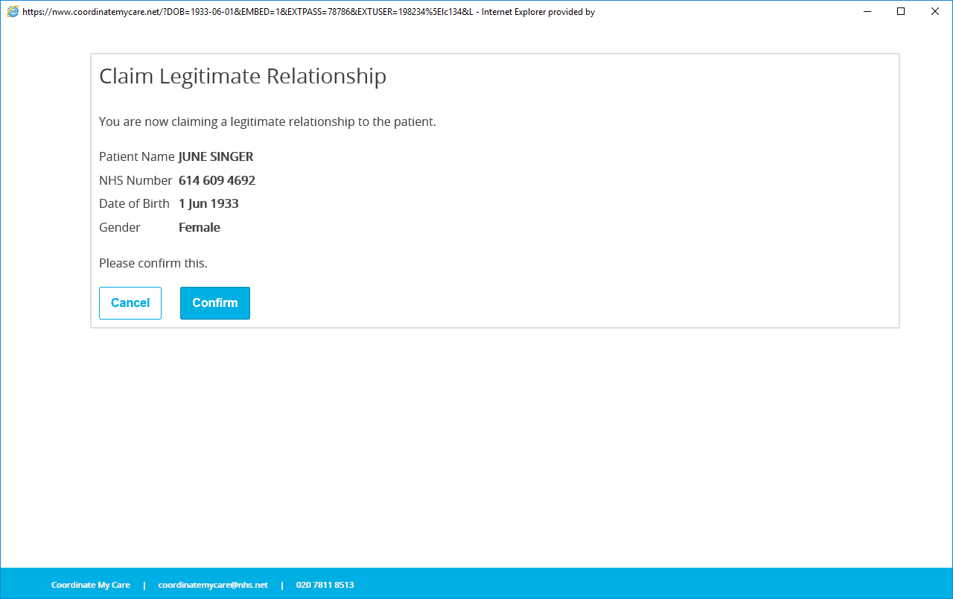
Coordinate my Care (CMC) “5 steps” Guide
4
1
Click !
Click !
2
5
Select !
Look !
3
Click !
Need Help ? Get in touch !
Claire Liegeois cliegeois@nhs.net
Frits Klinkhamer f.klinkhamer@nhs.net

