Slide 1
Croydon University Hospital CMCR Accelerator Project
Optimize the use of the Coordinate My Care records by community and hospital clinicians to facilitate sharing of patients’ preferences & needs: launch of a new in-context link between 2 EPR systems and CMC
S Whitehouse (CNS) Dr D Swann & K Curant
Palliative Care Team
6th July 2021

Slide 2
Outline
Setting
History to CMC in Croydon
Rationale for the CMC Accelerator project
Interim results
Challenges and Rewards to date
What next?

Slide 3
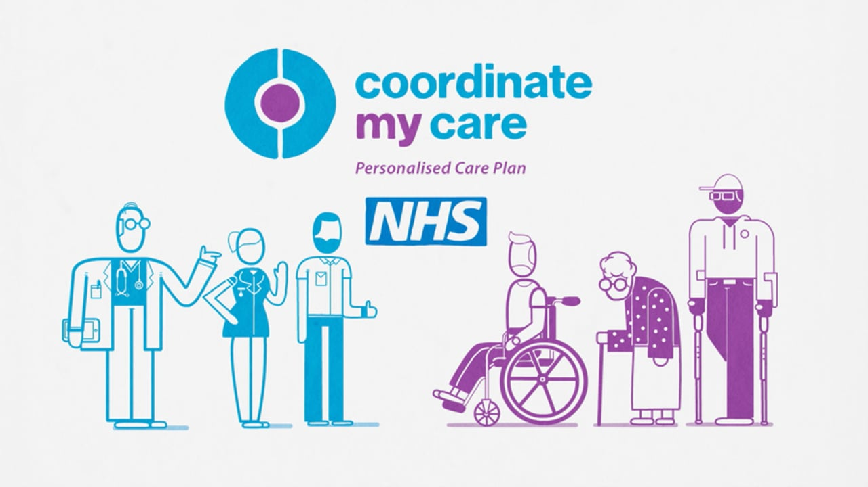
What is a Coordinate my Care Record (CMCR)?
https://www.coordinatemycare.co.uk/

Slide 4

Coordinate My Care:
CCGs
GPs
Out-of-hours
LAS
Community Nursing Team
Hospitals
Hospices
Care homes
Social Care
London NHS 111
Whole system
SERVICE
‘Wrap-around’ engages
Notes:
Therefore we can audit each contribution and report on this to understand and improve the service and outcomes.
4

Slide 5
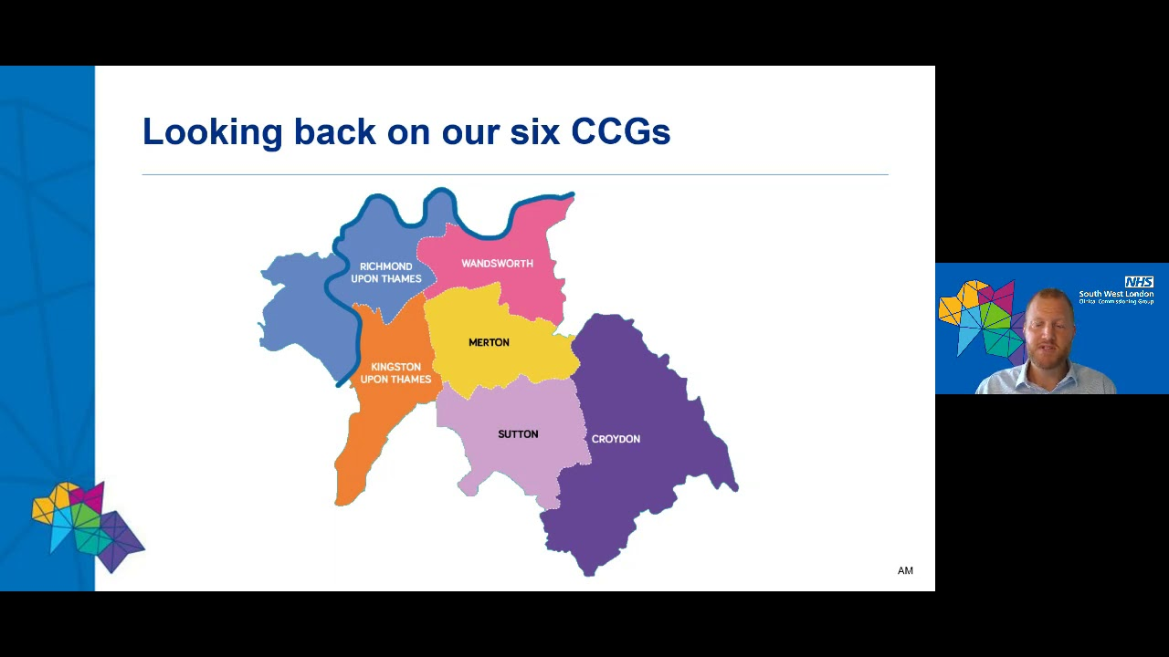
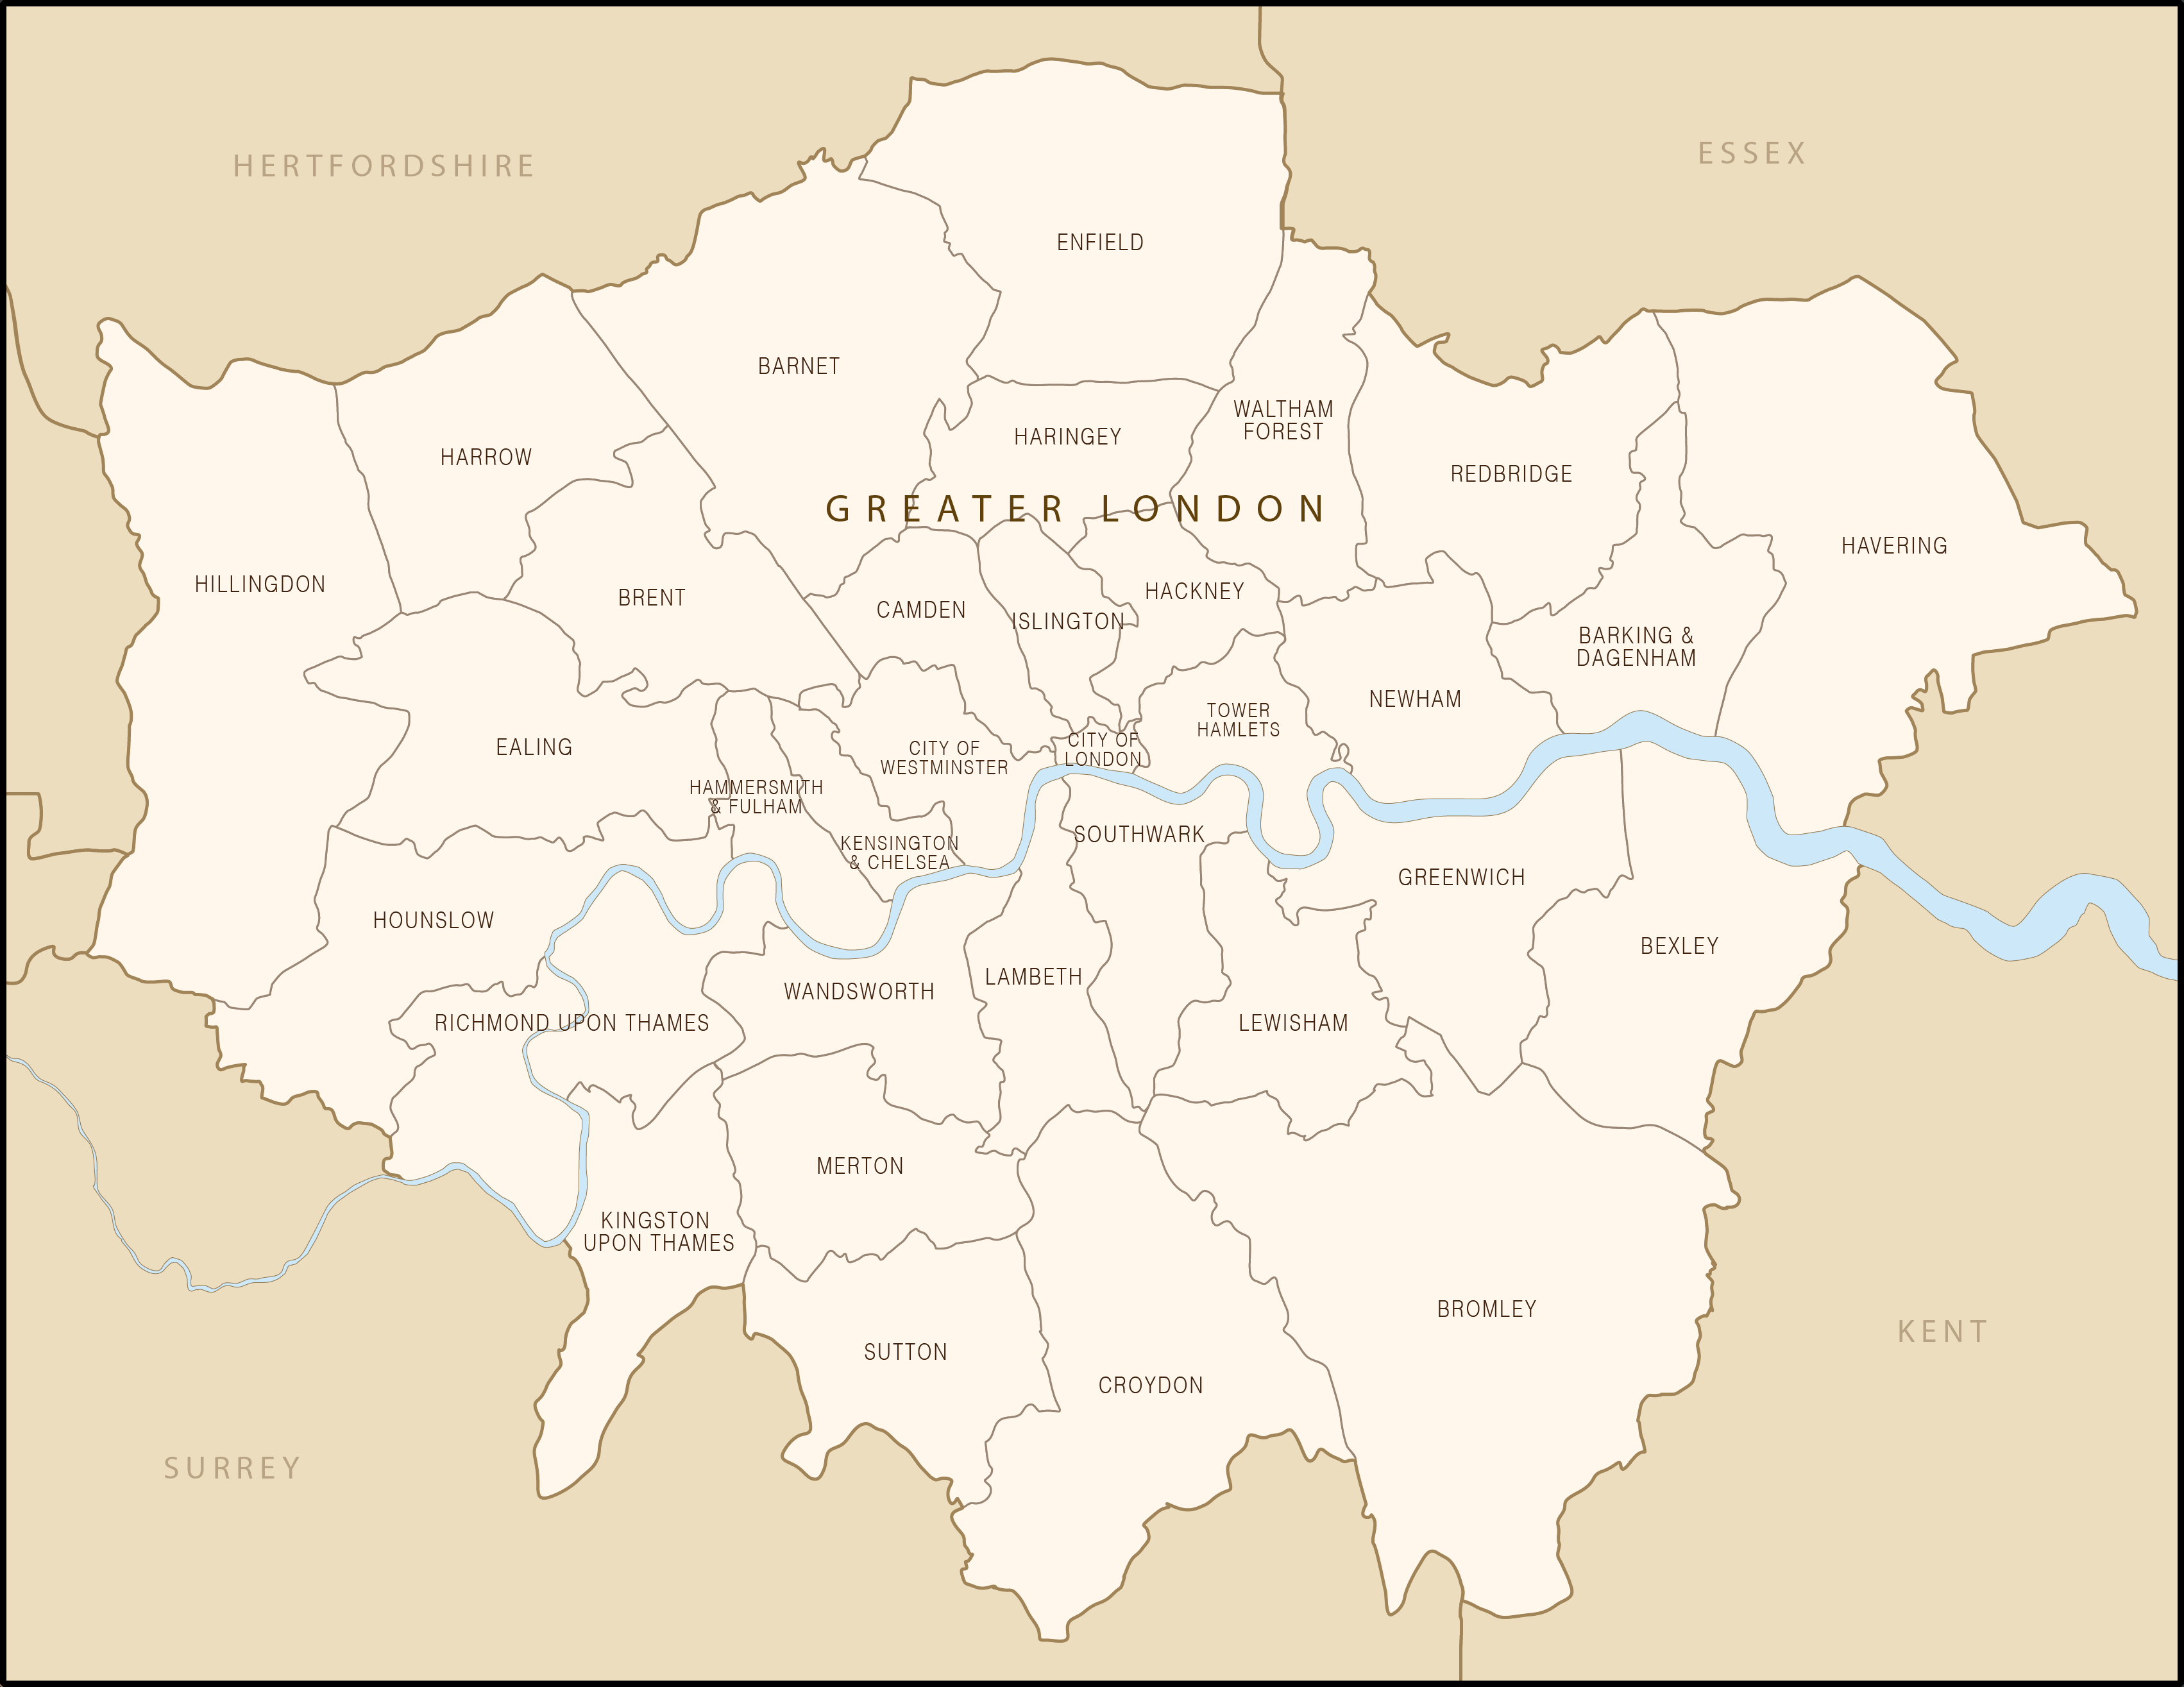
South West London Clinical Commissioning Group

Slide 6
London Borough of Croydon 2020
Population: 388,563
Males: 48.5% Ages: >65 14% 16-64 64%
Ethnicity:
  WB: 55% (85% Eng) (60% Lon)
  BAME: 45% ( EU 10.8)
Nationality:
  EU- 11%, S & SE Asian 4.6%, Sub Saharan Africa 1.5%, ROW 4.9%
Deprivation: 18.1% (69,576) of Croydon’s population are among the 20% most deprived nationally and most deprived of the six Southern region boroughs ( IMD- Indices of Multiple Deprivation 2019)

Slide 7
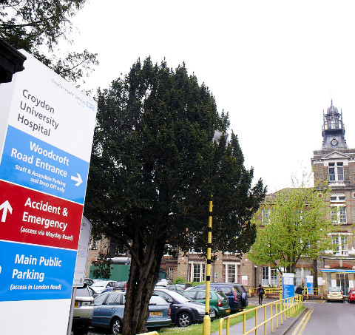
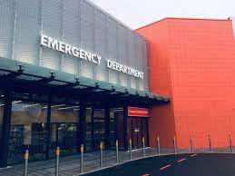
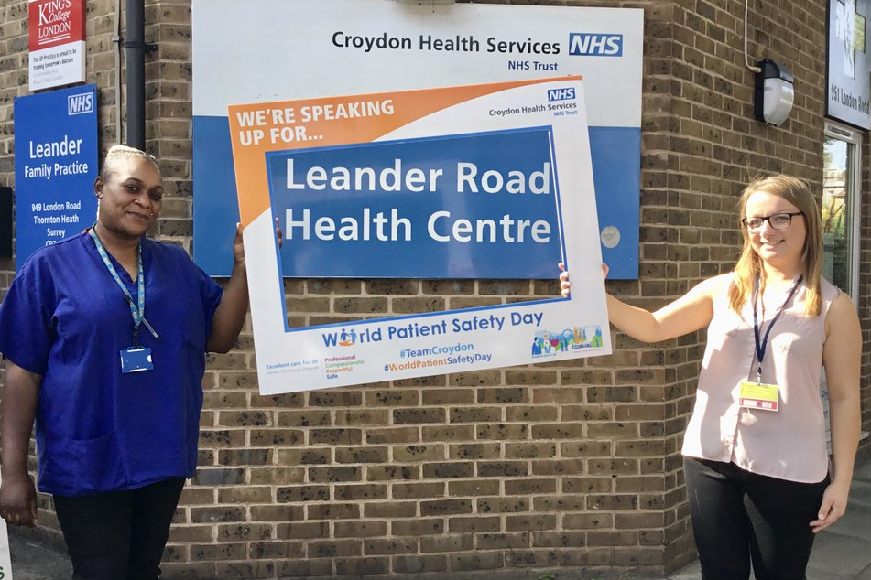
Integrated Trust

Slide 8
Croydon Health Services (CHS)
Integrated trust with acute and community services
Acute care: Croydon University Hospital (CUH) 670 beds
  27,000 Elective admissions
  41,000 Emergency admissions
  350,000 Outpatient episodes
  120,000 A&E attendances
Community Health Services provide care for the people of Croydon at home, in schools, clinics & at Purley War Memorial Hospital
Many people with long-term conditions and some teams straddle care settings – e.g. Croydon Respiratory Team (CRT)

Slide 9
CMC in Croydon
Participated in early pilots of locality EOLCRs and early adopter of Adastra/ CMC EPACS (2010/2011)
Hospice community and hospital palliative care teams main users
Local primary care uptake improved following a commissioning initiative as part of a LES agreement with the CCG.
Records created but poor quality and no reviews or updates factored in.
Access from hospital teams limited to palliative care team and some LT condition services, not widely used across all care settings
Joined the CMC accelerator programme in Feb 2021

Slide 10
Identified priorities
Tidy up the CMC users database and remove the inactive accounts
Develop a process to inform CMC of Trust leavers
Promote a system for hospital and community teams to be able to read CMC records as easily as possible
Establish training and use of the newly developed in-context link between community and hospital EPR systems and CMC launched Dec 2020
Ensure that urgent care services have access to contemporaneous CMC records of patients’ wishes and preferences to be able to inform clinical decision-making

Slide 11
Baseline Data Feb 2021
1.8% of patients with a Croydon GP had a CMCR
Total Croydon CMC registered users: 228
30% had not logged in over the last 2 years (69)
20% no activity since 2015 (47)
Evidence that CMC records have not been updated for several years

Slide 12
Methods
Obtained baseline user activity from CMC prior to and following the launch of the CyC /CMC Link
Removed inactive users
Identified and trained CMC champions to promote in their clinical areas
Created opportunities to demonstrate use of CMC to increase awareness and ensure information was disseminated across care settings
Targeted training for specific clinical teams
Circulated posters with QR code to easily access CMC for log-ins provided by another project (with thanks)

Slide 13
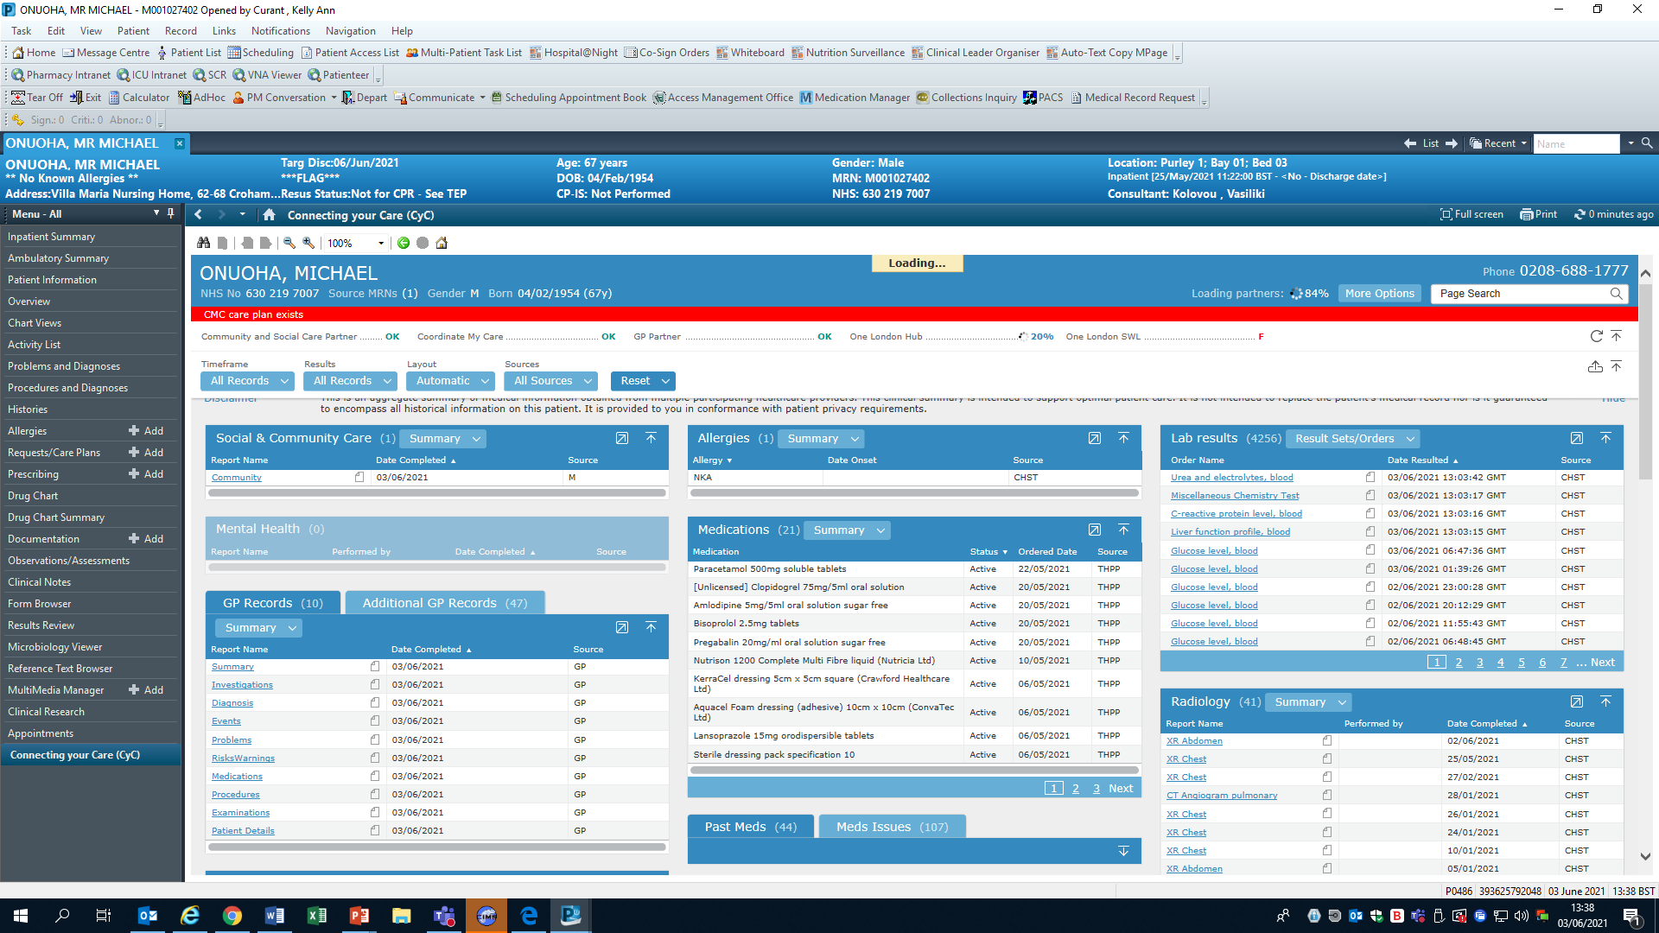
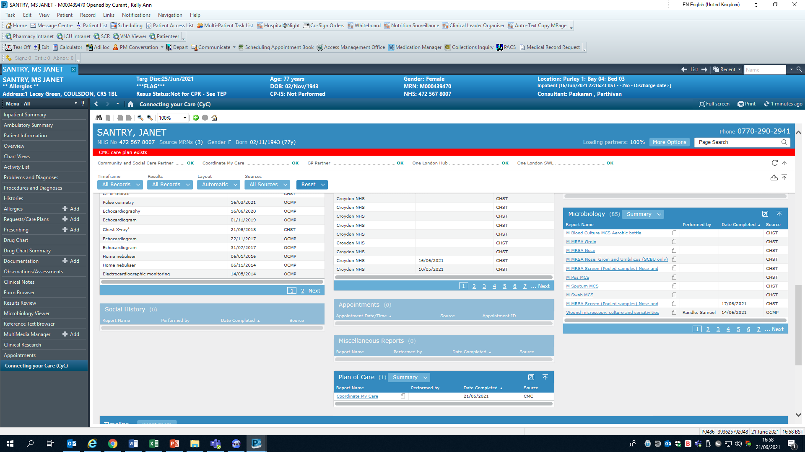
Launch of in-context link
  Dec 2020: link between CMC and both community and hospital EPR systems went live- single log in
  Training programme developed prior to the launch delivered to A&E Clinical Governance, new A&E doctor’s induction, elderly care teams and AOS
  CMC activity data re-analysed to assess improvement in uptake of access to the records after introduction of the link

Slide 14
Interim Results
52% increase in active users (21 over first 3 months (Feb to April 2021) (21 to 32)
CMC user database better reflects active user accounts & summary of type of activity
Snowballing of interest in CMC- expressions from other services for training such as Speech & Language Therapy & Stroke Team
Comparison of CMC activity before and after launching the link has shown:
        Increase in daily log-ins to CMCR
        Increase in Views of CMCR
        Increase in views of CMCR by urgent care and non-urgent care users

Slide 15
Comparison of CMC activity over time for all CHS/ CUH users combined

Slide 16
Challenges
6 week unavailability of the in-context link and intermittent teething problems
Log-in with CMC details at least once before using the in-context link
Covid-19 pandemic- getting staff engagement for training
Staff attending training but not obtaining their individual log-ins
Time commitment ++ to clean up the databases and confirm users are still employed by CHS
Duplication of staff records- some CMC staff users on both CHS & CUH lists
Set up a robust mechanism to clean up the CMC user list and inform CMC of staff leavers once the project finishes
Sustainability of the project once the project ends

Slide 17
What Next?
Presented findings at CHS Research and Development day (June 2020)
Identify new areas to promote CMC usage across the Trust
Teach new doctor’s in August 2020 and facilitate them obtaining log-ins
Improve the interface between care settings and transfer of patient information
Improve functionality of the in-context link
Inform the commissioning process of and development of a dynamic integrated (Urgent ) care plan

Slide 18
Stella Whitehouse, CNS, Dr Debra Swann & Kelly Curant, Administrator & MDT Co-ordinator Palliative Care Team
020 8401 3000 ext 4906, Bleep 320
ch-tr.palliativecareteam@nhs.net

