Slide 1




Innovation Exchange Event
Back our NHS staff:
Technology to support NHS staff and employers
#NHSHRInnovation
Tuesday 11 June 2019 – 5pm to 8pm

Slide 2
Anthony Geraets
Implementation Lead Clinical Workforce Productivity
NHS England & NHS Improvement

Slide 3
Digital Tools as Enablers of a Workforce Fit for the Future
Anthony Geraets, Implementation Lead Clinical Workforce Productivity, NHS England and NHS Improvement
June 2019
Notes:
Good evening everyone. It is a great pleasure to have been invited by Digital Health London to be here tonight and to have the opportunity to address an audience of innovators with a common interest in the NHS workforce, and how we can support them through application of technology to deliver health services fit for the future.
Andy Howlett, who was due to be speaking this evening is unfortunately unable to be here, and has asked me to send his apologies.

Slide 4
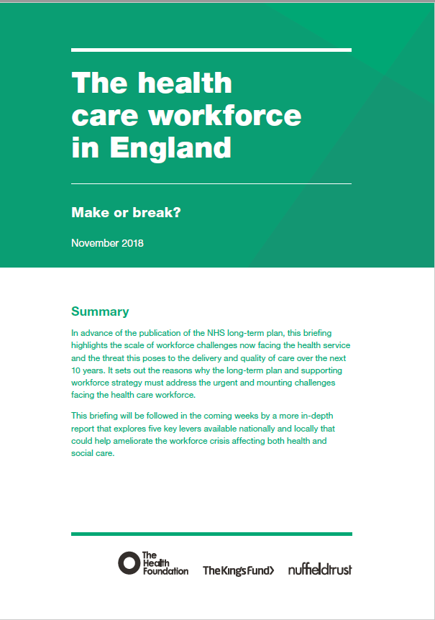


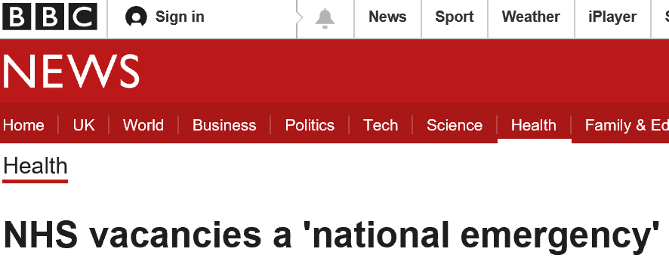


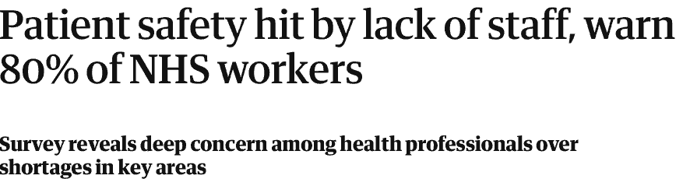
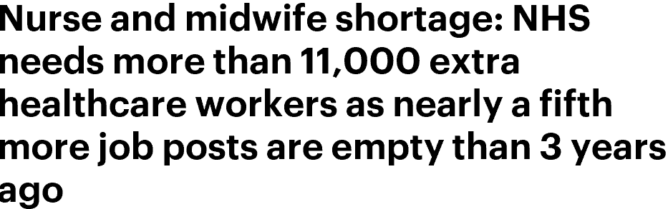
Workforce supply struggling to keep pace with demand
“Across NHS trusts there is a shortage of more than 100,000 staff. Based on current trends, we project that the gap between staff needed and the number available could reach almost 250,000 by 2030. If the emerging trend of staff leaving the workforce early continues and the pipeline of newly trained staff and international recruits does not rise sufficiently, this number could be more than 350,000 by 2030.”
Notes:
Everywhere we look these days we are reminded that the NHS workforce is under enormous pressure to meet the seemingly inexorable rise in demand for healthcare.
The think tanks have all published separately on this subject in recent times, and in late 2018 jointly published a document “Make or Break” highlighting the need for government and the NHS to act now. This report estimates that the workforce gap is 100,000 now, and may be as large as 350,000 by 2030

Slide 5

A “global workforce crisis in healthcare”
By 2030, the WHO estimates that the world will need 80 million health workers, but the supply will be 65 million
Notes:
Other commentators have highlighted that this issue is not confined to the NHS in the UK, but is a global issue.
In his recent book “Human”, Mark Britnell highlights what he calls “a global crisis in healthcare”, and the World Health Organisation’s estimated gap of 15 million healthcare workers worldwide

Slide 6
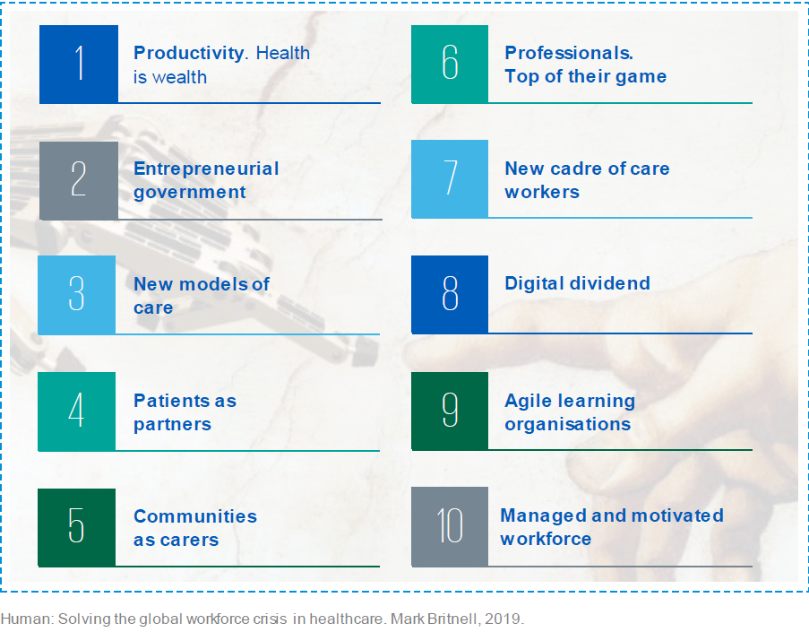
Digital technology is acknowledged as a key part of the solution
“Technological developments, including the widespread use of digital tools and intelligent devices, also have significant implications for the roles and functions of the health workforce. The long-term plan needs to focus clearly on the mechanisms for adoption and deployment of new technologies and their implications for the workforce”
Ten global changes to tackle the global health workforce crisis
Notes:
There is a strong consensus amongst the think tanks and commentators, both those with a UK focus and those thinking more globally, that digital technology is a key part of a solution to this growing workforce challenge
“Make or Break” highlights the need to accelerate the adoption and deployment of new technologies, and Britnell identifies what he calls the “Digital Dividend”
Both also highlight the importance of new care models, and how technology is can enable these to be established.

Slide 7
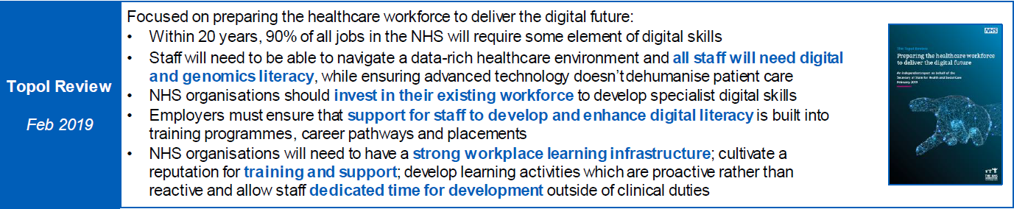
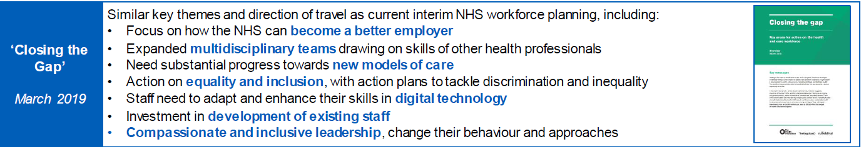
Digital skills are a key requirement for the workforce
The Topol Review published in February 2019 focussed on how the NHS should enable the uptake of new technology, specifically AI, genomics and robotics
“Closing the Gap” published in March 2019 highlighted digital technology as one part of a comprehensive approach to mitigating workforce shortages
Notes:
Alongside the identification of digital technology as a key enabler of future health provision, and a contributor to the solution to workforce shortages, the need for the general level of digital skills in that workforce to be enhanced has been acknowledged.
The Topol Review, published in February this year, highlights the need for improved digital skills throughout the workforce, and makes recommendations on how this might be achieved.
Another joint think tank publication in March, “Closing the Gap” also identifies the importance of staff adapting and enhancing skills in digital technology

Slide 8

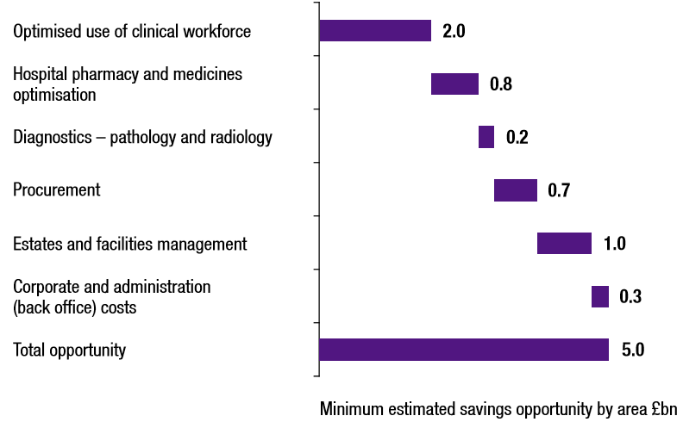
Lord Carter’s 2016 report prioritised optimal use of resource – and people are the most important NHS resource
“…my experience of the best of the NHS and other health care systems internationally shows that the provision of high quality clinical care and good resource management go hand-in-hand. All trusts should therefore grasp the use of their resources more effectively, the most important of which is their people”
- Lord Carter of Coles
Notes:
In his review of operational productivity in the acute hospital sector of the NHS in England in 2016, Lord Carter highlighted the significant productivity opportunity (valued at £2Bn at the time) through the NHS using its people more effectively.
Carter highlighted the unwarranted variation in the uptake of digital tools, in particular, electronic rostering and job planning, electronic prescribing and the use of technology to make back office and procurement processes more efficient. Carter emphasised the need for investment in these areas to enable productivity improvement.
This finding was repeated in his report into Community & Mental Health services published in July 2018, highlighting the variability in the uptake of mobile technology within community services and the transformative impact on those services where technology had been adopted.

Slide 9
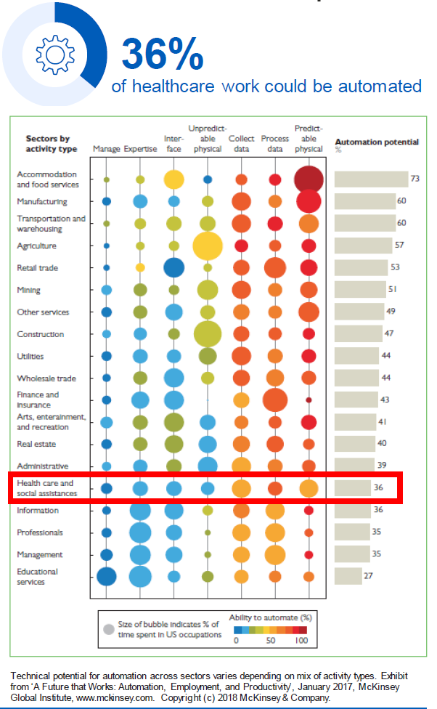
Productivity opportunities enabled by technology are significant
Opportunities to automate elements of current workload exist across a wide range of tasks in healthcare
Significant opportunities exist through digitising information, and connecting data sets that are currently siloed
  Population health
  Machine Learning & AI
Exploiting these opportunities will change how patients access care and how we deliver care
Notes:
The productivity opportunities in health through automation are reported to be significant. This analysis by McKinsey & Co in 2017 puts that figure at 36%.
Opportunities exist not only through the adoption of technologies that have been successfully exploited in other sectors for some time such as mobile communications or robotic process automation, but also through newer technologies that are enabled by the growth in processing power and exploitation of “big data”
Whether it is adoption of established, or emerging, technology, the way in which patients and healthcare workers interact will change

Slide 10
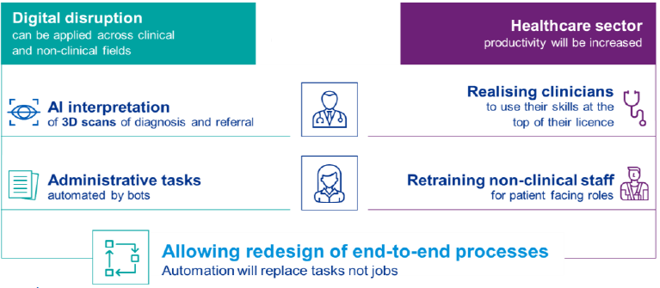
Technology will augment rather than replace the skills of clinicians
Tasks will be replaced by digital solutions, not jobs
Jobs will evolve as technology is embedded within care pathways and processes
Time saved will be redeployed to provide more care and/or better care
Notes:
For the healthcare workforce, the expectation is that digital technology will augment and enhance the skills of clinicians rather than replace them
We are already familiar with the way in which established technologies such as EPR systems save time and enhance clinician’s effectiveness (and productivity) through making clinical information available to them more reliably, sharing that information with multiple users simultaneously and enabling it to be transferred instantaneously.
Emerging applications of AI in healthcare are also augmenting clinicians; highlighting through algorithms the patients who are most likely to be clinically unwell and moving them to the top of the worklist; identifying which cells on a pathology slide appear abnormal and highlighting them to the pathologist; and taking routine measurements from digital images to speed up clinical interpretation and reporting.
As more digital tools are developed to augment clinical practice, traditional tasks will change and roles will adapt to take advantage of the time saved either to add more value or to treat more patients within the time available
The Topol Review talks about the “gift of time”, and the NHS People Plan will focus on “releasing time to care”

Slide 11

Priorities for the NHS have been set out in the Long Term Plan
“Technology will play a central role in realising the Long Term Plan, helping clinicians use the full range of their skills, reducing bureaucracy, stimulating research and enabling service transformation.”
“The rapid development of technology is a key opportunity to free up staff time. Staff report technology often delays access to the information they need, and that the personal technology in their pockets is more useful and functional than the technology they are provided at work.”
Notes:
The NHS Long Term Plan published earlier this year sets out the priorities for the NHS in England and how the increased funding settlement will be prioritised to reduce the burden of disease
Both adoption of Digital technology, with an entire chapter dedicated to the subject, and Workforce, which is subject to a comprehensive “NHS People Plan” developed jointly between NHSE/I, Health Education England and the service itself and due to be published later this year, have been highlighted as key enablers of the ambition set out in the LTP. An Interim People Plan was published last week, setting out the vision for the future workforce, and the immediate priority areas for this year.
From a digital perspective the emphasis was not just on exciting new innovations and technology, but also on the usability of the basic tools of the job as illustrated in the second of these two quotes from the LTP

Slide 12
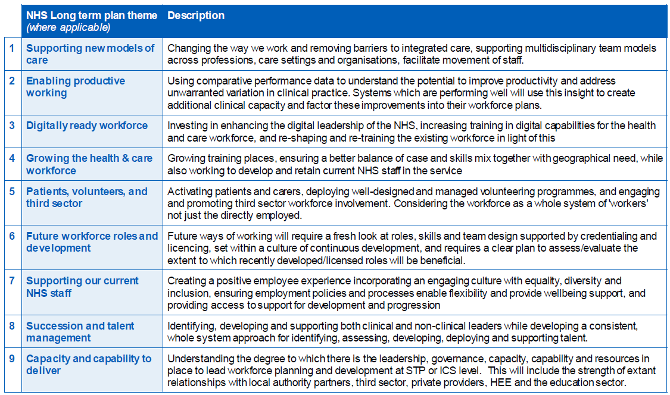
Key Themes from the People Plan
Notes:
The Interim People Plan highlights the key areas where the NHS approach to the workforce needs to change. Digital technology will underpin and enable in several of these areas including:
New Care Models where redesign of care pathways to keep patients out of hospital settings, and utilise population health data to target segments of the population with certain risk factors for preventive intervention, will no doubt lead to changes in the way in which services deploy the workforce. Digital technology will enable many of these pathway improvements (wearables, remote monitoring, video consultation, App supported patient self-management etc) as well as harvesting data.
Enabling productive working, not only through utilising outcome data to identify variation in performance and eliminate unwarranted variation (such as championed by the GIRFT and RightCare programmes led by NHSE & I), but through utilising digital tools to ensure workforce capacity and demand for care are matched dynamically to optimise care quality and efficiency – more on this topic in a moment.
And Supporting our current NHS staff utilising these same digital workforce deployment tools, alongside a change in culture that embraces flexible working patterns, flexible hours contracts, and creates the employment conditions within the NHS that makes is a place that staff want to work and remain.

Slide 13
Spreading the adoption of existing technology
Provider Digitisation
  GDE Programme
  HSLI Programme
  “Carter” programmes (EPMA, Workforce Deployment Systems)
  Local Health & Care Records
Population Health
  Using longitudinal health data to target health interventions more intelligently
New care models
  Telehealth
  Chronic disease management
  Primary care led services
Notes:
The provider digitisation programme is all about driving the spread of proven digital technology and ensuring all core patient data is digitised. This enables health processes to be made more efficient and make a massive impact on care quality and workforce productivity. The LHCR programme will join that digital information into a longitudinal health and care record for all patients, accessible anywhere to support care delivery
The rapidly growing body of health data enables, not only improvements in care delivery to individuals, but opens up the opportunities to plan and deliver care at population level. This enables a more risk-based approach and segmentation of patients, supporting the targeting of groups for preventive health interventions and screening. Keeping patients well and/or diagnosing illness earlier delivers significant outcome benefits and efficiencies. These services will see a changing requirement for our workforce and should see a greater proportion of care delivered in primary care settings.
Population health will see development of new care models, but new applications of established technologies will also enable new ways of delivering health services to patients. Video, mobile, smartphone Apps, remote monitoring including wearables and point of care testing applied in the primary and community care sector have the potential to transform many traditional approached to care.

Slide 14
Optimising Workforce Productivity
Workforce Planning
Workforce Deployment
Workforce Productivity
Productivity
Measurement
Workforce
Deployment
Software
Notes:
One of the digital technologies picked out in the NHS Long Term Plan is electronic rostering and job planning, both as an enabler of productivity, and as an enabler of flexible working patterns
In our approach to improving clinical workforce productivity, the NHS England & NHS Improvement Workforce Productivity team have focussed on three key “pillars” of success:
Effective workforce planning (ensuring workforce capacity, including skill mix, meets anticipated demand for care)
Optimising workforce deployment (ensuring available workforce is deployed dynamically and matched with actual demand for care on a daily basis)
Measuring productivity (developing meaningful metrics to enable a better understanding of productivity, and therefore the ability to influence it positively)
All three pillars are underpinned by e-rostering and e-job planning tools, or “workforce deployment software”, and the data that these tools generate

Slide 15
E-Job Planning and E-Rostering are central to all aspects of effective workforce management
E-rostering & E-Job Planning
Workforce Planning
Safe Staffing
Workforce Deployment
Temporary Staffing
Flexible Staffing
Staff Retention
Notes:
Workforce deployment is, of course the primary purpose of job planning and rostering software, but it also supports other aspects of managing the workforce:
Data on demand and seasonal variations supports effective workforce planning
Data on required staffing levels on a daily basis, and matching available workforce against that demand provides assurance that staffing levels are safe
Effective daily deployment is supported, enabling dynamic redeployment of staff to where they are needed, taking account of competence and skill mix
The visibility of workforce availability vs requirements enables early identification of temporary staffing requirements, maximising opportunities to fill with bank staff, and supporting effective control of agency staffing. Daily deployment supports minimisation of demand for temporary staffing
Flexible working patterns, self rostering and effective communication & engagement with staff is facilitated by smartphone Apps and remote access
A workforce planned properly at the right levels, with capacity and demand matched, and effectively engaged using digital tools is less likely to seek a better opportunity elsewhere, and has been demonstrated to reduce sickness and boost retention

Slide 16
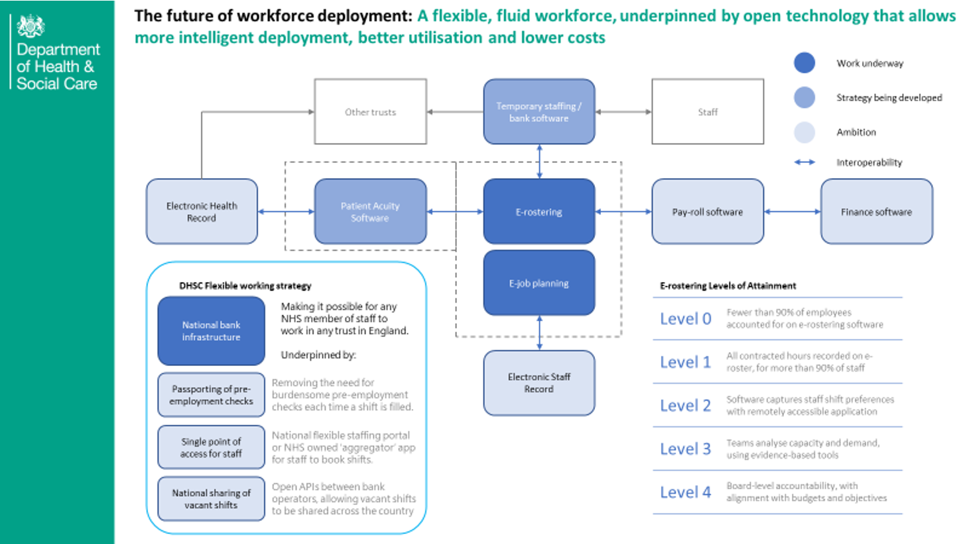
Suppliers will need to listen carefully to the customers and design tools that meet their needs
Future modular architecture based on open standards and interoperability, in line with SoS Tech Vision
Suppliers compete on basis of “added value” and innovative apps to solve problems for the users (employees and employers)
Notes:
The team at NHS England & NHS Improvement are working hard to create the conditions where there is a vibrant, competitive and innovative market place, underpinned by the principles set out in the Secretary of State’s Tech vision; interoperability, open data standards supporting APIs, and data owned by the NHS. We envisage a future with a modular architecture where NHS employers can pick and choose the applications and digital services that best meet their particular needs, and the software tools that they chose will “plug and play”. Suppliers should compete based on content, and should look beyond the basic functionality of rostering staff and seek to provide added value based on the ability to utilise data from other applications such as EPR systems.
The single most important message to suppliers is work hard to understand your customer’s problems and design tools to solve them.

Slide 17

Conclusion
Notes:
So to conclude, this is a very exciting time to be involved in developing and investing in digital technology in the NHS.
It feels like we are approaching a tipping point where we will start to feel a rapid transformation of the way in which care is delivered, enabled by digital tools and innovations.
This transformation is desperately needed to realise some of the big opportunities to improve health outcomes in the UK, and address the significant pressure that our highly skilled and dedicated workforce is experiencing.
There is a big opportunity for industry and the NHS to collaborate to provide the solutions, and I hope events like these assist in connecting people to start that collaboration.

Slide 18
Hamza Drabu
Partner
Nick Chronias
Partner
DAC Beachcroft

Slide 19

Technology and artificial intelligence to support the workforce
11 jUNE 2019
Hamza Drabu and Nick Chronias
Partners at DAC Beachcroft LLP

Slide 20


Slide 21
Technology, AI and Workforce Themes
AI diagnostic tools potentially reducing waiting times
AI to identify claim trends and fraudulent activity
Predictive technology to reduce staff turnover
Technology supporting HR transactional advice and recruitment

Slide 22
InnerEye
Cambridge University Hospitals has been using Microsoft’s InnerEye system to improve their oncology practice:
InnerEye analyses scans that would otherwise have to be marked up by clinical staff by hand
The system is currently used for prostate cancer patients
InnerEye outlines and marks the prostate on each of the scans and uses them to create a 3D model to assist with further treatment, including planning radiotherapy
InnerEye speeds diagnosis and is designed to consistently perform as well as top consultant

Slide 23
HeartFlow
HeartFlow software is used as a diagnostic tool for coronary artery disease
HeartFlow users CT scans to create a computerised 3D model of coronary arteries
The model assesses blood flow through the arteries
NHS England anticipates HeartFlow could prevent up to 35,000 patients a year undergoing invasive tests

Slide 24
AI supported claims handling
Zurich has developed a in-house AI programme to assist with claims handling
Using cognitive analysis the programme reviews and interprets data as well as reading documents and extracting relevant information
This information is used to make a decision on how to proceed with the claim
The programme can also help identify fraudulent activity and emerging claim trends
The programme is only currently used on a limited type of claim but with potential to be used much more widely

Slide 25
Predictive staff turnover tool
IBM has developed and patented a predictive attrition programme
The programme analyses multiple data points before predicting (with 95% accuracy) which employees may wish to leave IBM
The programme then sets out actions for managers to engage those employees
IBM’s Global HR team has reduced by 30%, partly as a result of this and other AI tools

Slide 26
HR transactional chatbox
Unilever uses an HR chatbox, Una, created using a Microsoft framework
Una can be reached through Skype for Business
Una has the ability to provide information then carry out transactions via a conversation
Una is to be made available in 106 countries where Unilever operates
When a country goes live with Una HR transactional telephone numbers and email addresses are switched off

Slide 27
AI and recruitment
Unilever has partnered with Pymetrics to create a virtual process to sift job applicants
Unilever recruits 30,000 people a year from 1.8 million applicants who trigger the process by submitting their Linked-in profile
Applicants play a set of neuroscience based games testing aptitude, logic, reasoning and risk appetite – this builds a candidate profile which is matched against the profiles of people who have successfully performed the role
Successful gaming stage candidates go to a video interview assessed by machine learning
Only after these stages are candidates progressed to an in-person assessment
Successful and unsuccessful candidates receive computer generated feedback
Unilever estimate 70,000 people hours have been cut as a result of this technology and the average time to hire has gone down from 4 months to 4 weeks

Slide 28
Questions to panel

Slide 29
Company pitches

Slide 30
Alfredo Thompson
Workforce Programmes Director
North Middlesex University Hospital NHS Trust

Slide 31
NHS Trust case study: North Middlesex University Hospital NHS Trust
By Alfredo Thompson
Workforce Programmes Director

Slide 32
We’ve halved our medical agency spend in the past year

Slide 33
We have decreased the number of shifts that breach the Pan-London rates by 70% and have maintained this
70%

Slide 34
1) How do you grow the medical bank?
2) How do you engage with your rota co-ordinators?
3) How do you harness senior medical leadership?
4) How do you ensure that the onboarding process is smooth?
5) How do you choose the right partners?
What have we learnt?

Slide 35
Any questions?
Thank you

Slide 36
World Café
Please grab a drink and come back to the auditorium in 10 minutes.

