Slide 1
HIN Summary of Urgent and Advanced Care Planning Accelerator Programme
Ellen Pirie
6th July 2021

Slide 2
Thank you to the project teams
The HIN has been privileged to work with and support eight fantastic teams to improve the use and quality of advance and urgent care plans. The passion, determination and resilience shown by project staff to better meet patient’s needs and wishes during a pandemic was impressive and inspiring.

Slide 3
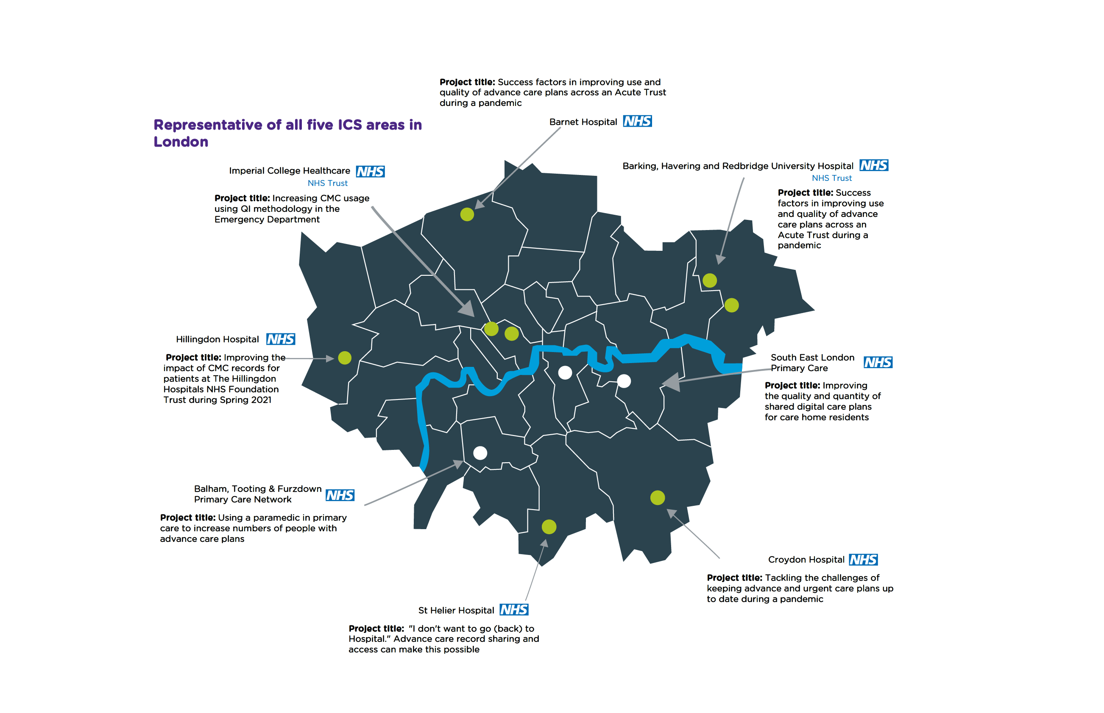

Slide 4
Urgent and Advance Care Planning Accelerator Programme
Eight projects have progressed
6 in Acute Trusts/GP Interface Service and these are covered in Sessions One and Three
2 in Primary Care and these are covered in Session Two
Most projects were delayed by COVID19 during January and February and restarted in March.

Slide 5
Project Activity
Senior Project Manager (Ellen Pirie) led the programme
Liaised with ICS/STP and organisations to agree projects, produce MoUs
Held regular progress meetings (107 in total between October to May)
Organised the 2 Collaboration events
November – 25 attendees from 14 organisations
March – 27 attendees from 10 organisations
Based on feedback from project teams we also had a very useful discussion session with LAS to get their feedback on what high quality Advance and Urgent care plans looked like for them

Slide 6
Key Findings Across Projects
1. Successfully implementing an ACP system is complex
It requires strong clinical leadership and effective administrative support.
In Acute settings, palliative care teams most often take this leadership role; however, they need engagement and cooperation from other teams, and this takes time to develop.
The CMC system has been funded centrally for London which has meant that providers have not always identified or prioritised the need for leadership and administrative support.

Slide 7
Key Findings Across Projects
2. Staff turnover adds to the complexity
New junior doctors need training and logins, and leavers need to be removed.
It has been challenging for many of the Acutes to build sustainable processes working with IT, HR and medical education to automate this work.

Slide 8
Key Findings Across Projects
3. Record Quality is dependent on high quality conversations with patient/families/carers
All project teams have highlighted that the quality of the record is critical and that providing training and support for staff to confidently lead sensitive conversations with patients and their families/carers is essential. This needs to become part of the organisation’s culture and skillset.

Slide 9
Key Findings Across Projects
4. Workload during COVID19 had major impact & lasted longer in Primary Care
The Acute Trust teams we worked with (mostly focused around emergency admissions for acutely ill elderly people) faced a very intensive period; however, by April 2021, they reported that things were returning to some level of normality.
Primary Care was kept extremely busy with vaccinations and dealing with patient demand and backlog.

Slide 10
Key Findings Across Projects
5. Getting data to assess impact has been challenging
Hard to track the CMC activity of staff who move frequently around between various sites and departments
CMC site based reporting data has not always available been available quickly, as their analyst resources are currently undertaking the development of a new data warehouse.
Ideally, we would want to track longer term measures, such as increase in people achieving their preferred place of care/ death (PPC/PPD), admissions avoided. However, our timescale was too short for this.

Slide 11
Recommendations
Shared digital advance & urgent care planning should be part of organisation’s strategic planning.
Sustainable resources for leadership and training are required.
Notes:
After this slide I will pass back to Carrie for the final closing words

Slide 12
Recommendations
The culture and skills required need to be developed and embedded across the wider clinical workforce and supporting services (e.g., IT, HR, medical education).
Technology solutions should be better integrated (e.g., with organisational user directories and with primary and secondary care record systems) and more responsive (e.g., enabling adhoc local reporting) to make spread and adoption of shared digital care planning easier, more effective and higher quality.
Notes:
After this slide I will pass back to Carrie for the final closing words

Slide 13
Webpage
Please see our webpage for the resources from this programme
Project posters
Presentations will be added
Case study videos
Materials that teams are happy to share
Recordings of today’s sessions will be added
www.healthinnovationnetwork.com/acp

Slide 14
Thank you for attending our event

