Slide 1
Increasing CMC usage using QI methodology in the Emergency Department
Dr. Katherine Buxton - Consultant in Palliative Medicine; Clinical Lead for End of Life Care
Frits Klinkhamer – Improvement Lead
Medical Examiner); Frits Klinkhamer – Improvement Lead

Slide 2
Introduction:
CMC: shared urgent care record used across care settings helping us all meet patient priorities and wishes
343 existing users across the Trust but not routinely used leading to key patient information being overlooked
Improvement goals centered around: increasing awareness of CMC and its role increasing the number of staff completing training increasing login acquisition and subsequent use
Centralisation of advance care planning, CMC training, process of gaining a login and standardisation of reporting to support leadership

Slide 3
Background
Project carried out in a large multi-site acute hospital Trust involving various specialties including two Emergency Departments, two Acute Frailty teams & renal services
Improvement team members included representatives from these specialties with an interest in end-of-life care, supported by the Clinical Lead for end-of-life care and an Improvement Lead
Patient group for this project was those thought to be in their last 12 months of life

Slide 4
Methods
QI approach that included:
Flow Coaching to support Trust-wide adoption of CMC to improve patient flow and to reduce variation of care
The ‘Big Room’ met fortnightly and included specialty representatives alongside other CMC users to discuss progress and troubleshooting obstacles
Change ideas were trialed through PDSA cycles to see if i.e. login numbers increased – 5 step login poster, facilitated training in the department & virtually, handover & team meeting updates,

Slide 5
Measuring the impact of our work
Measures included:
Both the number of staff with CMC logins and those with active CMC logins
Number of logins each month Trust-wide, by service and by individual staff
Number of care plans created/updated each month Trust-wide and within individual teams

Slide 6

QI Tools: Process Map – LAS
Note 1: CMC frequently not checked
2. Rapid assessment of patient by nurse & Consultant following LAS handover
Work up starts : bloods, ECG, imaging, medications
Note 2: CMC not checked
3. Streaming decision: work up carries on where the patient goes
4a. Waiting Area
4b.Resus
4c.Majors
4d.Speciality
4e.Urgent Care Centre
4f.Ambulatory Care
5a.Patient seen by ED Dr
5b.Patient seen by ED resus Dr
5c.Patient seen ED doctor
5d.Patient seen directly by Spec. Doctor
5e.Patient seen by GP or ENP
5f.Patient assessed by AEC Doctor

Slide 7
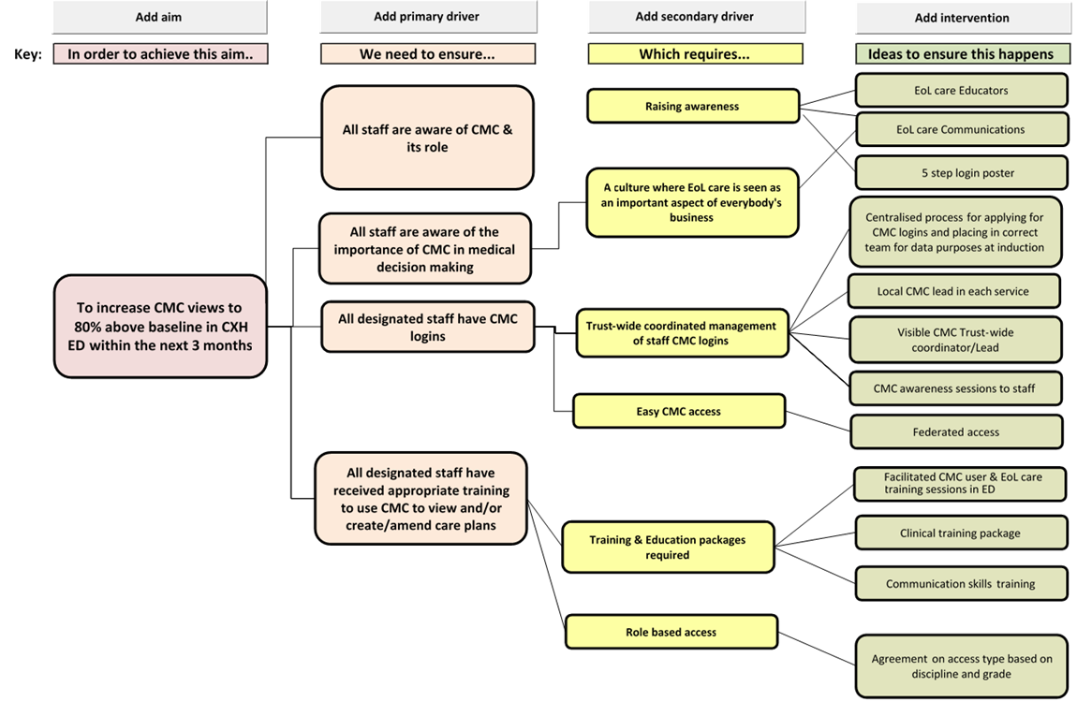
QI Tools: Driver Diagram

Slide 8
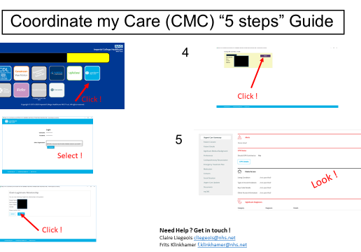
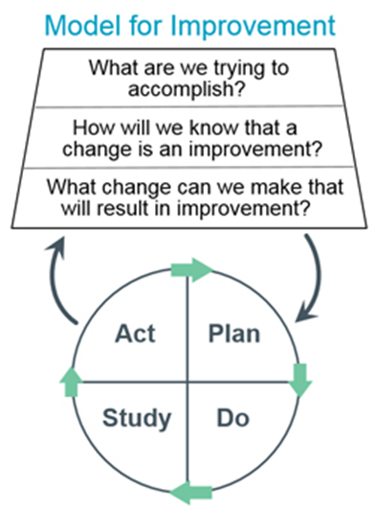

Change Ideas & PDSA cycles

Slide 9
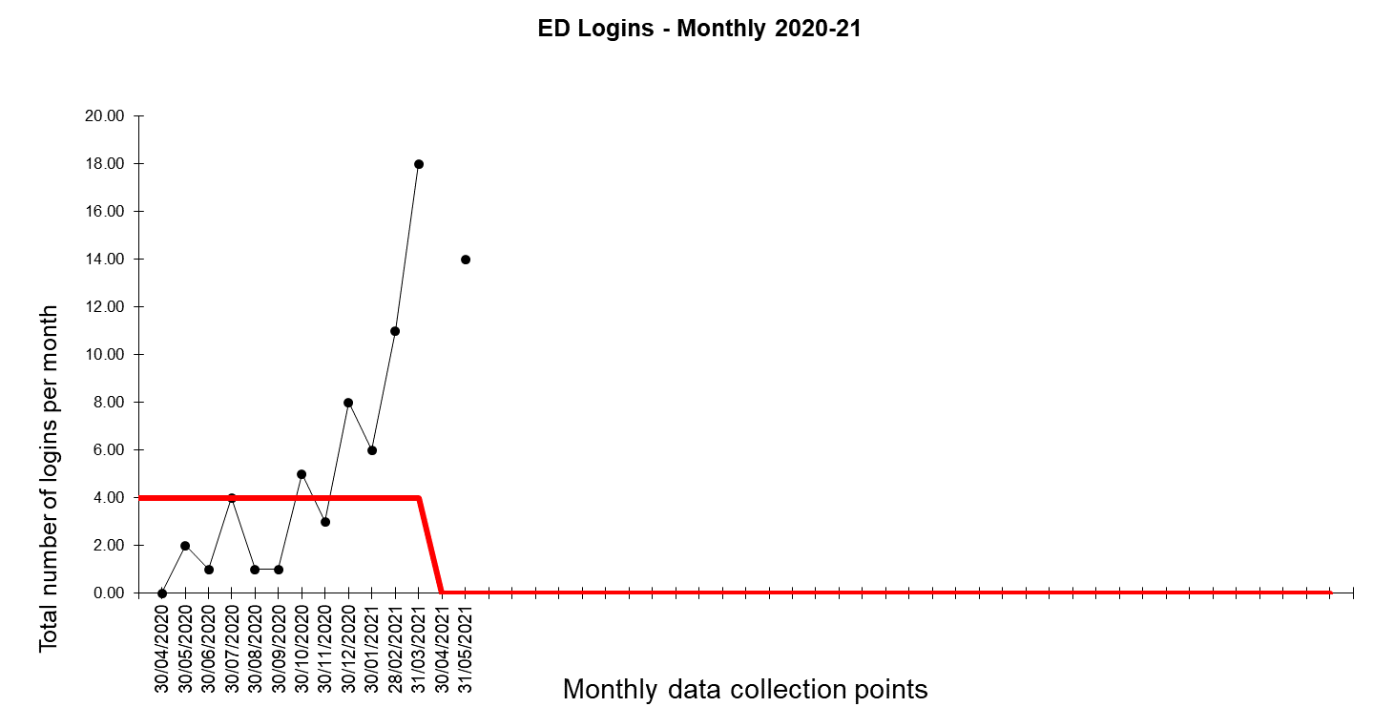
Results
Notes:
April data incomplete so not recorded ; some ED staff sitting in the wrong teams so activity not being included in ED team

Slide 10
Conclusions
The key impact of the changes is twofold:
Growing acknowledgement of advance care planning and CMC adoption as a Trust-wide priority which is being centrally managed
Working with individual teams and departments, at grass roots level, to support incorporation of ACP and CMC into their business as usual
Amending/adapting training delivery to meet their needs
We will continue a centralised-approach to CMC management and use Flow Coaching methodology to engage other teams and support the wider adoption process
Accurate and timely CMC user activity data including user validation extracts would be very useful to support robust centralisation management of CMC Trust-wide and service support

Slide 11
What worked well
Big Room and Flow Coaching approach
5 step login poster
Centralisation of training and login acquisition and general oversight of CMC use across the Trust
Process mapping to better understand the ‘as is’ pathway and identify opportunities to streamline processes and pathways to incorporate CMC checks at the earliest point possible

Slide 12
What we would do differently
Project teams would benefit greatly from having more time with the leads on hand to support education & training
Project teams would have benefitted from focussed education on QI tools and methodology to support implementation

