Slide 1

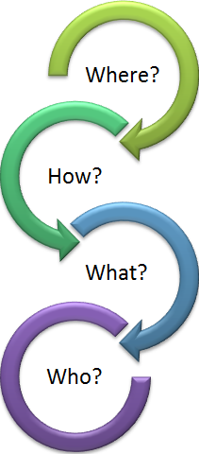
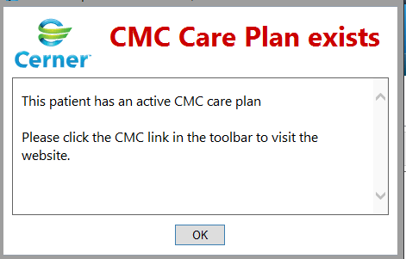
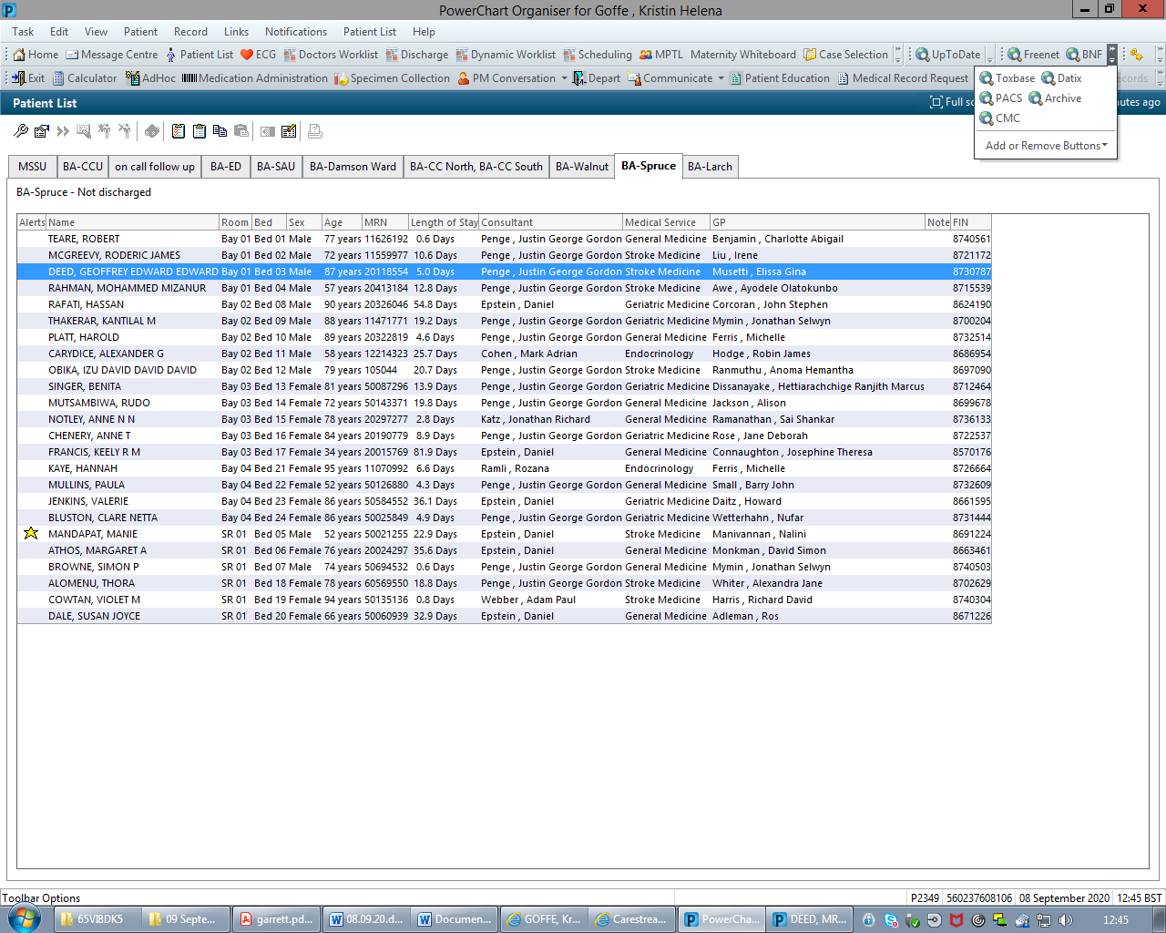
CMC Care Plans seek to share with Urgent Care services:
WHY?
Improve communication between care setting
Respect patients wishes and provide person-centred care
Where the patient wants to and should be cared for? (patient preferences)
How much clinical/medical intervention is appropriate? (ceiling of treatment)
What to expect and do? Expected symptoms and management plans (Emergency Treatment plan)
Who to contact? Contacts (professional and personal) to support the best outcome for the patient.
Key Points!
View and Confirm ->
  view the contents of the patients care plan
  confirm with the patient or their representative: wishes or circumstances might have changed
  you can see who last reviewed the care plan at the top right – you should update as needed during admission
Consent -> document clearly on creation of the care plan regarding patient consent to sharing of personal information between health-care professionals. If creating in best interests, document who was spoken to. Patient leaflets are readily available on the website
White Space -> using the white space makes the care plan personal to the patient and more useful to the health-care professional who may be picking up your conversations in future.
DNACPR -> please provide a paper copy for the patient if creating a new DNACPR on CMC. The endorser (responsible consultant) must be aware and in agreement with the care plan.
Remember: patients in London CCGs, eg Barnet and Enfield. CMC is not commissioned in Hertfordshire
Do you need training and access?
This is quick and easy!
See ‘quick-guide’ on Freenet palliative care page.
Any questions – speak to:
[@nhs.net]
This will take you directly to your patient’s care plan

Slide 2
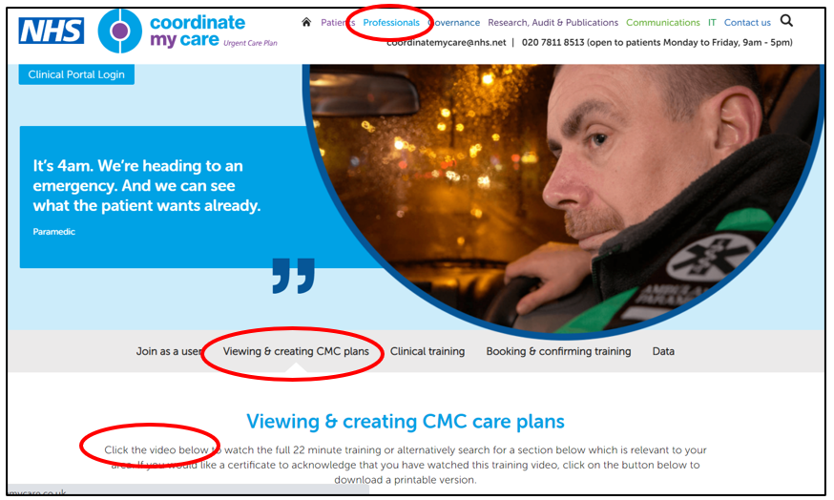
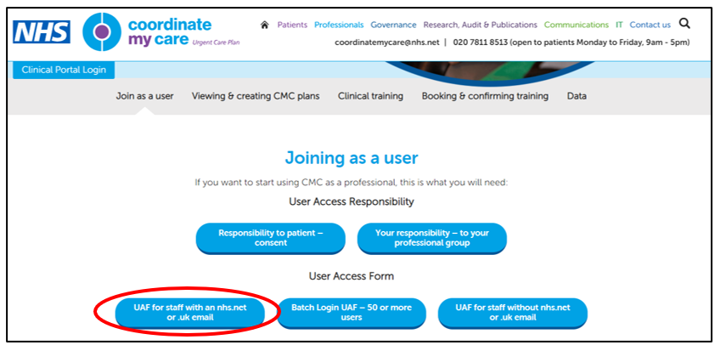
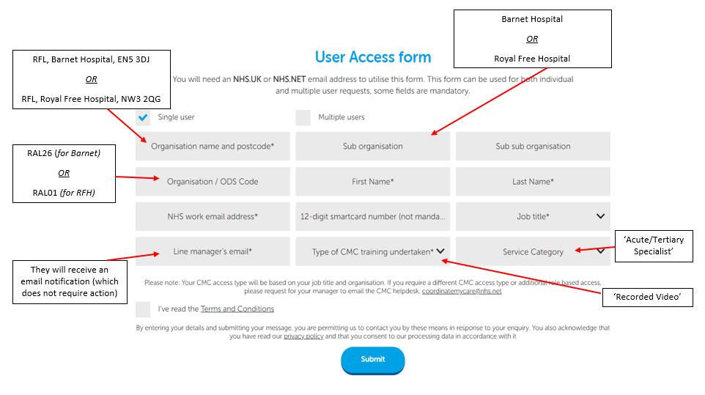
Sign up in two simple steps!
1
Complete short training video
https://www.coordinatemycare.co.uk/for-healthcare-professionals/training-viewing-creating-cmc-care-plans/
There are additional resources available in ‘clinical training’ section.
If you prefer to attend a webinar, see ‘booking and confirming training’
2
Complete User Access Form (UAF) -> ‘UAF for staff with nhs.net email address’
https://www.coordinatemycare.co.uk/for-healthcare-professionals/become-a-user/
Your login details will be emailed to you!

