Slide 1
Improving the quantity and quality of shared anticipatory care records from GP services supporting care homes with nursing
Sharing our story from
South East London

Slide 2
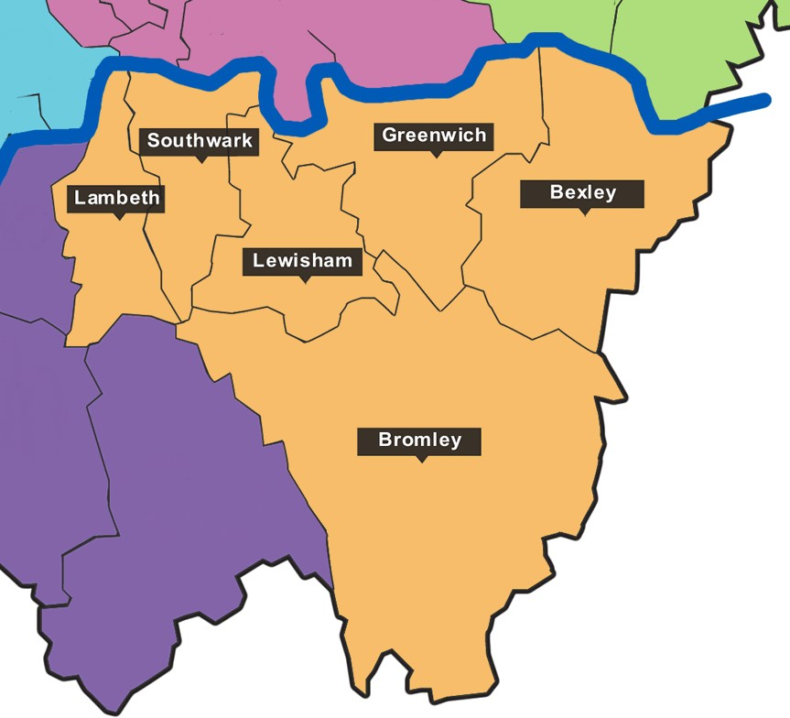
Notes:
SEL Map and newly formed CCG April 2020
Bexley 20 care home 1320 beds
Bromley 40 care homes 1200 bed
Greenwich 11 care home 710 residents
Lambeth 9 nursing home 666 beds 790 when including residential homes
Lewisham 12 nursing homes 543 beds more when including residential homes
Southwark 7 home 370 beds
Different numbers of settings of care, different bed numbers,
commissioning conversations between LA and care home provider
Health care supporting services and models vary
Strong similarities in people supported but different landscapes in number size and setting
Part of the initial work in the pilot was connecting across this diverse landscape
Supporting frail older residents from care homes out of hospital where possible
Challenges in sharing information
Making this information personal and individual
CMC platform is a key enabler for access to shared records but it is challenging for care home providers and on site staff to have access to the secure platform and view records.

Slide 3
Our project team
Dr Emily Gibbs GP with QHS GP care home service, Southwark and CCG Clinical lead
Joanne Hare, CCG commissioner working as trained non clinical facilitator using Coordinate My Care to record personal care preferences
Peninsula/ Clover GP practice supporting care homes in Greenwich
Notes:
QHS GP service practice visits all older adults nursing and residential homes in Southwark (2 joint nursing/ residential homes 5 residential) covering 350 beds
Peninsular practice covering most older persons care home beds in Greenwich

Slide 4
Where did we focus?
General practices supporting care homes
Champion work in Southwark and Greenwich
Focus on how to support use of Co ordinate my care
Network across the geographies, linking with other projects with similar themes
Promote CMC platform to enable information sharing
Learning from transfers across care

Slide 5
What have we done?
Over 300 individual records and conversations through the facilitator in Greenwich
Creation of records needing review and publication from GP lead
69 new records in Southwark. Records viewed frequently and updated at review opportunities such as MDT meetings, change in condition

Slide 6
Case study
Extension of GP service to residential care home of 20 beds
All “new patient” checks included review of care planning wishes including creation of CMC record
Support framework for residents without capacity to consent to record sharing
CMC alert sent to GP when contact with urgent care services
Contacts with frailty services when resident in A&E
Notes:
including family discussions and best interest decision making framework for sharing information through CMC platform
Care home staff know each resident has a plan for care
Individual specifics for situations where appropriate to have treatment escalation
Access into wider community services such as @home service, specialist palliative care, end of life care nursing support

Slide 7
Case study
GP practice identified lists of residents without CMC plans
Facilitator was given EMIS access to read and confirm details
Where gaps of information identified, more information gathered by speaking with care home
Facilitator called relatives to have care planning conversation
CMC record started and then GP lead reviewed and published record

Slide 8
What did we learn?
Residents and families have been disconnected over the last 18 months
Conversations are key
Working over telephone contact is challenging when having a conversation about frailty
Supporting sharing of information in best interest framework with good discussion and documentation

Slide 9
Tips and prompts
In context EMIS link shortcut direct to CMC platform
Updates can easily be made on this link
Records can be created through link
Subscribe button for each record created will send email alert when urgent care access record
CMC platform can store lists by care home address
Have a process to close records as part of death certification

Slide 10
