Slide 1
^{Lipid Management}
Improving Practice in Primary Care
Helen Williams, Consultant Pharmacist for CVD, SEL CCG
& National Specialty Adviser for CVD Prevention, NHSE&I

Slide 2
Summary of National Guidance for Lipid Management for Primary and Secondary Prevention of CVD
INITIAL CONSIDERATIONS:
● Measure non-fasting full lipid profile (Total cholesterol, HDL-C, non-HDL-C, triglycerides) and HbA1c as part of an initial baseline assessment. ● Consider secondary causes of hyperlipidaemia and manage as needed.
● Ensure appropriate baseline and follow up tests as detailed on page 2. Measure BMI. ● Identify and exclude people with contraindications/drug interactions ● If non-fasting triglyceride above 4.5mmol/L see page 2.
PRIMARY PREVENTION
Consider statin therapy for adults who do not have established CVD but fall into the categories below. Use QRISK risk assessment tool where appropriate (see page 2, ‘Primary Prevention Risk Assessment’)
SEVERE HYPERLIPIDAEMIA
If TC>7.5mmol/L and/or LDL-C >4.9mmol/L and/or non-HDL-C >5.9mmol/L, a personal and/or family history of confirmed CHD (<60 years) and no secondary causes: suspect Familial Hypercholesterolaemia (Possible Heterozygous FH)
Do not use QRISK risk assessment tool
SECONDARY PREVENTION
Offer statin therapy to adults with CVD, this includes angina, previous MI, revascularisation, stroke or TIA or symptomatic peripheral arterial disease. Do not delay statin treatment if a person has acute coronary syndrome. Take a lipid sample on admission (within 24 hours)
Age ≤84 & QRISK ≥10% over next 10 years
Type 2 diabetes & QRISK ≥10% over next 10 years
Type 1 diabetes, if they have one or more of the following:
• Over 40 years
• Had diabetes for >10 years
• Have established nephropathy
• Have other CVD risk factors
CKD eGFR
< 60 mL/min/1.73m2 and/or albuminuria
Age ≥85 years if appropriate consider comorbidities, frailty & life expectancy
Identify and address all modifiable risk factors - smoking, diet, obesity, alcohol intake, physical activity, blood pressure and HbA1c.
DIAGNOSIS AND REFERRAL
Take fasting blood for repeat lipid profile to measure LDL-C.
Use the Simon Broome or Dutch Lipid Clinic Network (DLCN) criteria to make a clinical diagnosis of FH.
Refer to Lipid Clinic for further assessment if clinical diagnosis of FH
or if TC>9.0mmol/L and/or
LDL-C >6.5mmol/L and/or
non-HDL-C >7.5mmol/L or
Fasting triglycerides > 10mmol/L
(regardless of family history) (page 2)
SECONDARY PREVENTION
Do not delay statin treatment in secondary prevention while managing modifiable risk factors. Prescibe a high intensity statin: Atorvastatin 80mg OD. Use a lower dose of Atorvastatin if there is a potential drug interaction, high risk of or experiencing adverse effects, or patient preference. Offer Atorvastatin 20mg if CKD (people with GFR< 60 mL/min/1.73m2).
Identify and address all modifiable risk factors - smoking, diet, obesity, alcohol intake, physical activity, blood pressure and HbA1c.
• Measure full lipid profile again after 3 months (non-fasting).
• High intensity statin treatment should achieve reduction of non-HDL-C > 40% from baseline. If not achieved after 3 months
- Discuss treatment adherence, timing of dose, diet and lifestyle measures
- If started on less than atorvastatin 80mg and the person is judged to be at higher risk (based on comorbidities, risk score or clinical judgement – see page 2 ‘Additional Risk Factors’), consider increasing to 80mg Atorvastatin. For how to increase in people with CKD see ‘Special Patient Populations’ (page 2).
• If non-HDL-C baseline value is not available*, consider target non-HDL-C < 2.5mmol/L (approximately equivalent to LDL-C < 1.8mmol/L) as recommended by Joint British Societies (JBS3).
*This scenario is not covered by NICE CG181
• If patients on a high‑intensity statin have side effects, offer a lower dose or an alternative statin (see page 2 ‘‘Extent of lipid lowering with available therapies’)
Consider additional risk factors, if present, together with QRISK score (treated for HIV, severe mental illness, taking medicines that cause dyslipidaemia, systemic inflammatory disorder (e.g. SLE), impaired fasting glycaemia, recent change in risk factors).
PRIMARY PREVENTION
If lifestyle modification is ineffective or inappropriate offer statin treatment.
Atorvastatin 20mg OD
TREATMENT TARGETS IN FH
If clinical diagnosis of FH and/or other risk factors present, follow the recommended treatment management pathway for primary or secondary prevention as for non-FH, BUT
Aim to achieve at least a 50% reduction of LDL-C (or non-fasting non-HDL-C) from baseline.
Consider specialist referral for further treatment and/or consideration of PCSK9i therapy IF
- they are assessed to be at very high risk of a coronary event**
- OR therapy is not tolerated
- OR LDL-C remains >5mmol/L (primary prevention)
- OR LDL-C remains >3.5mmol/L (secondary prevention)
Despite maximal tolerated statin and Ezetimibe therapy.
**defined as any of the following:
• Established coronary heart disease.
• Two or more other CVD risk factors
• Measure full lipid profile again after 3 months (non-fasting).
• High intensity statin treatment should achieve reduction of non-HDL-C > 40% from baseline. If not achieved after 3 months;
- Discuss treatment adherence, timing of dose, diet and lifestyle
- If at higher risk (based on comorbidities, risk score or clinical judgement – see page 2 ‘Additional Risk Factors’) consider increasing the dose every 2-3 months up to a maximum dose of atorvastatin 80mg daily.
- For how to increase in people with CKD see ‘Special Patient Populations’ (page 2)
If maximum tolerated dose of statin does not control non-HDL-C/LDL-C well enough after 3 months confirm statin adherence, then consider the following options based on shared decision making* with the patient
If recommended statin treatment is contraindicated or not tolerated – follow AAC Statin Intolerance Algorithm for advice regarding adverse effects (click here).
Ezetimibe 10mg daily (NICE TA385). Reassess after three months. If non-HDL-C remains > 2.5mmol/L; consider injectable therapies arrange a fasting blood
test and assess eligibility
Injectable therapies**
If non-HDL-C > 2.5mmol/L;
Arrange fasting blood test to measure LDL-C to assess eligibility:
- Inclisiran - if fasting LDL-C ≥ 2.6mmol/L despite maximum tolerated lipid lowering therapy (TA733)
OR
- PCSK9i - see overleaf
for LDL-C thresholds.
(TA393/4) If eligibility criteria are not met, consider ezetimibe
10mg daily (if not
previously considered)
• If patients on a high‑intensity statin have side effects, offer a lower dose or an alternative statin (see page 2 ‘Extent of lipid lowering with available therapies’)
• If maximum tolerated dose of statin does not achieve non-HDL-C reduction > 40% of baseline value after 3 months consider adding Ezetimibe 10mg daily (NICE TA385)
• If recommended statin therapy is contraindicated or not tolerated;
- Ezetimibe monotherapy may be considered. Assess response after 3 months
See local statin intolerance guidance / pathway where available
Ezetimibe 10mg/bempedoic acid 180 mg combination may be considered when ezetimibe alone does not control non-HDL-C/LDL-C well enough (NICE TA694).
If statin intolerance is confirmed, consider:
- Ezetimibe 10mg monotherapy. Assess
response after 3 months (TA385)
- Ezetimibe 10mg/bempedoic acid 180 mg
combination when ezetimibe alone does not
control non-HDL-C sufficiently. (NICE TA694)
* See overleaf for information to support shared decision making
** Inclisiran and PCSK9i should not be prescribed concurrently
If non HDL-C remains > 2.5mmol/L despite other lipid lowering therapies consider Injectable therapies – arrange a fasting blood test and assess eligibility criteria (TA393/394, TA733)
If non-HDL-C reduction remains < 40% of baseline despite maximal tolerated lipid lowering therapy (including people with intolerances and contraindications) consider referral to specialist lipid management clinic according to local arrangements.

Slide 3
Cholesterol – Secondary Prevention (pre-existing CVD)
Healthcare assistants/other appropriately trained staff
Gather information e.g. Up to date bloods, BP, weight, smoking status.
Self-management e.g. Education (cholesterol, CVD risk), BP monitors (what to buy, how to use), signpost to shared decision making resources.
Behaviour change e.g. Brief interventions and signposting e.g. smoking, weight, diet, exercise, alcohol.
Stratification
Priority One
Not on statin therapy
Priority Two (A)
On suboptimal intensity statin*
Priority Two (B)
On suboptimal statin dose**
Priority Three – routine follow up
Sub-optimal non-HDL (>2.5mmol/l) levels despite maximal statin therapy
Prescribing clinician
Optimise lipid modification therapy and CVD risk reduction
Review CVD risk factors, lipid results and liver function tests.
Initiate or optimise statin to high intensity – e.g. atorvastatin 80mg.
Titrate therapy against reduction in LDLc/non-HDLc (statin>ezetimibe>PCSK9i)mAB)/inclisiran).
Optimise BP and other comorbidities.
Use intolerance pathway and shared decision-making tools to support adherence.
Arrange follow-up bloods and review if needed.
* E.g simvastatin
** E.g atorvastatin 40mg

Slide 4
SEL CCG –where are we now?
Secondary Prevention
Secondary Prevention | Definition | Estimated Proportion of SEL patients
Priority One | CVD not on statin | 26%
Priority Two | CVD on sub optimal intensity statin | 15%
Priority Three | CVD on sub optimal dose of statin | 42%
Priority Four | CVD with non-HDL chol>2.5mmol/L | 7%
Lipid management for secondary prevention gives the greatest return on investment
4 boroughs have been running meds opt schemes focusing on statin uptake in CVD (priority group 1)
Proportion of patients on low and moderate statins vs statins
Proportion of patients ‘not at target’
Addressing statin intolerance and statin hesitancy
Optimising lipid lowering therapies beyond statins – ezetimibe, PCSK9i and inclisiran
Long term adherence support

Slide 5
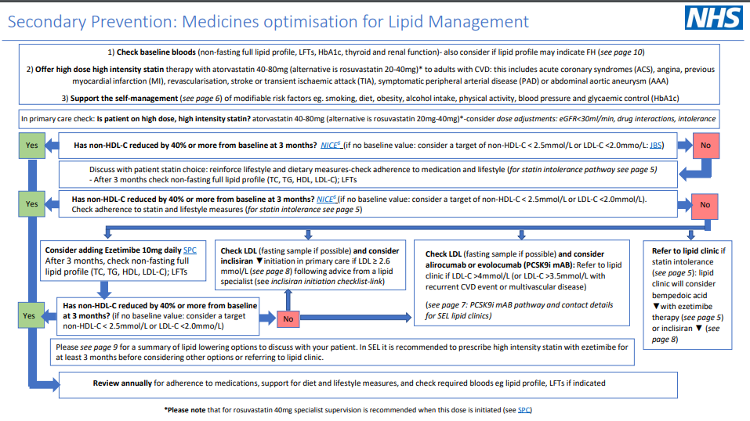
https://selondonccg.nhs.uk/wp-content/uploads/dlm_uploads/2021/11/Lipid-management-SEL-pathways-Nov-21-FINAL.pdf

Slide 6
Optimisation Pathway for Secondary Prevention
Is patient on high dose, high intensity statin*?
(atorvastatin 80mg or equivalent)
Optimal High Intensity Statin for secondary prevention (High intensity statins are substantially more effective at preventing cardiovascular events than low/medium intensity statins)
Atorvastatin | 80mg
Rosuvastatin | 20mg
Yes
No
Initiate / increase to high dose high intensity statin *** and re-enforce lifestyle and diet measures
Non-HDL-C reduced by 40% or more from baseline at 3 months? ****
(if baseline non-HDL not available, consider intensification of therapy if non-HDL-C > 2.5mmol/L)⁷
No
Check adherence to statin and lifestyle measures **
* Dose may be limited if:
eGFR<30ml/min
Drug interactions
Intolerance
** If statin not tolerated, follow statin intolerance pathway and consider ezetimibe 10mg daily +/- bempedoic acid 180mg daily. If non HDL-C remains > 2.5mmol/L despite other lipid lowering therapies consider injectable therapies.
*** See statin intensity table
**** Current NICE Guidance recommends a 40% reduction in non- HDL cholesterol
Consider ezetimibe 10mg daily
Reassess after three months. If non-HDL-C remains > 2.5mmol/L; consider injectable therapies arrange a fasting blood test and assess eligibility
Consider injectable therapies
If non-HDL chol > 2.5mmol/L; Arrange fasting blood test to assess eligibility:
Inclisiran - if fasting LDL-C ≥ 2.6mmol/L despite maximum tolerated lipid lowering therapy OR
Refer for PCSK9i if fasting LDL-C > 4mmol/L (or > 3.5mmol/L if recurrent events)
If eligibility criteria are not met, consider ezetimibe 10mg daily (if not previously considered)
Yes
Review annually for adherence to drugs and support for diet and lifestyle measures
*Tables adapted from Y Javaid

Slide 7
Statin Intensity Table – NICE recommends Atorvastatin and Rosuvastatin as First Line
Approximate Reduction in LDL-C
Statin dose mg/day | 5 | 10 | 20 | 40 | 80
Fluvastatin |  |  | 21% | 27% | 33%
Pravastatin |  | 20% | 24% | 29%
Simvastatin |  | 27% | 32% | 37% | 42%
Atorvastatin |  | 37% | 43% | 49% | 55%
Rosuvastatin | 38% | 43% | 48% | 53%
Atorvastatin + Ezetimibe 10mg |  | 52% | 54% | 57% | 61%
Low/moderate intensity statins will produce an LDL-C reduction of 20-30%
Medium intensity statins will produce an LDL-C reduction of 31-40%
High intensity statins will produce an LDL-C reduction above 40%
Simvastatin 80mg is not recommended due to risk of muscle toxicity

Slide 8
Shared Decision-Making Resources
Benefits per 10,000 people taking statin for 5 years | Events avoided
Avoidance of major CVD events in patients with pre-existing CVD & a 2mmol/l reduction in LDL | 1,000
Avoidance of major CVD events in patients with no pre-existing CVD & a 2mmol/l reduction in LDL | 500
Adverse events per 10,000 people taking statin for 5 years | Adverse events
Myopathy | 5
Haemorrhagic Strokes | 5-10
Diabetes Cases | 50-100
Shared decision-making resources:
BHF information on statins
Heart UK: Information on statins
NICE shared decision-making guide​
Collins et al 2016 Lancet Systematic Review Lancet 2016; 388: 2532–61

Slide 9
Optimising Primary Prevention
Incentivised in the DES and IIF (£)
DES: Offer statin treatment to patients with a QRISK2&3 score >= 10%, where clinically appropriate, and in line with NICE guideline CG181
IIF: CVD-03: Percentage of patients aged between 25 and 84 years of age inclusive and with a CVD risk score (QRISK2 or 3) greater than 20 percent, who are currently treated with statins
How to do it?

Slide 10
Cholesterol –Primary Prevention (no pre-existing CVD)
Healthcare assistants/other appropriately trained staff
Gather information: E.g. up to date bloods, BP, weight, smoking status, run QRISK score.*
Self-management: Education (cholesterol, CVD risk), BP monitors (what to buy, how to use), signpost to shared decision making resources.
Behaviour change: Brief interventions and signposting e.g. smoking, weight, diet, exercise, alcohol.
Stratification
Priority One
One of:
QRISK ≥20%
CKD
Type 1 Diabetes
AND
Not on statin
Priority Two
QRISK 15-19%
AND
Not on statin
Priority Three
QRISK 10-14%
AND
Not on statin
Priority Four
On statin for primary prevention but not high intensity
Prescribing clinician
Optimise lipid modification therapy and CVD risk reduction
Review QRISK score, lipid results and LFTs.
Initiate or optimise statin to high intensity – eg atorvastatin 20mg.
Titrate therapy against reduction in LDLc/non-HDLc (statin>ezetimibe).
Optimise BP and other comorbidities.
Use intolerance pathway and shared decision-making tools to support adherence.
Arrange follow-up bloods and review if needed.
*QRISK 3 score is recommended to assess CV risk for patients with Severe Mental Illness, Rheumatoid Arthritis , Systemic Lupus Erythematosus, those taking antipsychotics or oral steroids

Slide 11
SEL CCG – Test beds – where are we now?
Primary Prevention
Secondary Prevention | Definition | Estimated Proportion of SEL patients
Priority One | QRisk > 20% or Type 1 diabetes or CKD not on statin | 10%
Priority Two | QRisk 15-20% not on a statin | 5%
Priority Three | Qrisk 10-15% not on a statin | 9%
Priority Four | Qrisk ≥ 10% not on a statin | 4%
Have all patients between 40-74yrs had a QRisk score?
How can we improve uptake of statins for primary prevention ?
Education of clinicians / patients? shared decision making resources?

Slide 12
Shared Decision-Making Resources
Benefits per 10,000 people taking statin for 5 years | Events avoided
Avoidance of major CVD events in patients with pre-existing CVD & a 2mmol/l reduction in LDL | 1,000
Avoidance of major CVD events in patients with no pre-existing CVD & a 2mmol/l reduction in LDL | 500
Adverse events per 10,000 people taking statin for 5 years | Adverse events
Myopathy | 5
Haemorrhagic Strokes | 5-10
Diabetes Cases | 50-100
Shared decision-making resources:
BHF information on statins
Heart UK: Information on statins
NICE shared decision-making guide​
Collins et al 2016 Lancet Systematic Review Lancet 2016; 388: 2532–61

Slide 13
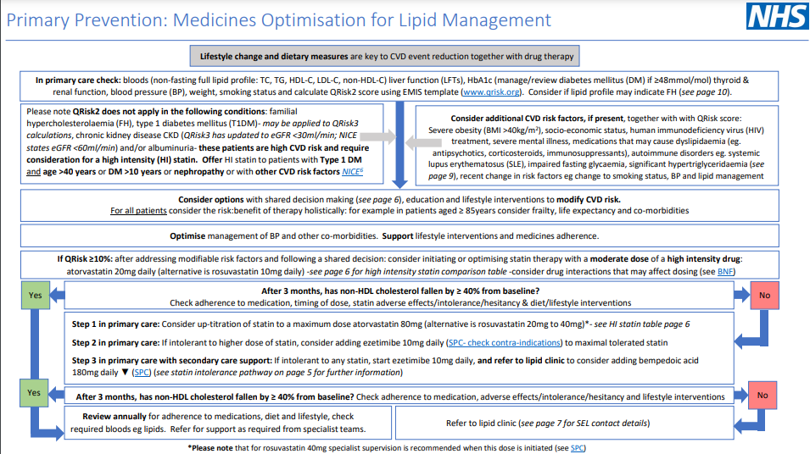
https://selondonccg.nhs.uk/wp-content/uploads/dlm_uploads/2021/11/Lipid-management-SEL-pathways-Nov-21-FINAL.pdf

Slide 14
Optimisation Pathway for Primary Prevention
Review and re-enforce lifestyle and diet measures as first line
Is patient on high intensity statin?
(atorvastatin 20mg or equivalent)
Yes
No
Optimal High Intensity statin for Primary Prevention (High intensity statins are substantially more effective at preventing cardiovascular events than low/medium intensity statins)
Atorvastatin | 20mg
Rosuvastatin | 10mg
Initiate atorvastatin 20mg/day
After 3 months - has non-HDL-C reduced by 40% or more from baseline?
Yes
No
Check adherence and tolerance*
Titrate statin up to maximum atorvastatin 80mg or equivalent
* If statin not tolerated, follow statin intolerance pathway and consider ezetimibe 10mg daily +/- bempedoic acid 180mg daily
If non-HDL cholesterol has not fallen by 40% or more from baseline, consider adding ezetimibe 10mg daily
Review annually for adherence to drugs, diet and lifestyle

Slide 15
Digital Resources to Support Self-Management: Cholesterol
Heart UK resources
Healthy Eating, blood fats explained, understanding cholesterol, and Familial Hypercholesterolemia
British Heart Foundation resources - Understanding Cholesterol
Diethttps://www.heartuk.org.uk/downloads/health-professionals/publications/blood-fats-explained.pdf
Providing information and recipes for easy ways to eat better from the ‘One You’ website
NHS advice on lowering cholesterol levels
Smoking cessation
NHS support, stop smoking aids, tools and practical tips
Exercise
NHS ‘One You’
iPrescribe app offers a tailored exercise plan by creating a 12-week exercise plan based on health information entered by the user
Getting active around the home: tips, advice and guidance on how to keep or get active in and around the home from Sport England
Dance to health: Online dance programme especially tailored to people over 55 years old
Alcohol
Heart UK alcohol guidance
NHS Drink Less guidance
Mental Health - Tips and suggestions for looking after your mental health
Peer support - Communities of people living with high cholesterol

Slide 16
UCLP resources
All free and easy to download from: https://uclpartners.com/proactive-care/
Cholesterol framework: https://s31836.pcdn.co/wp-content/uploads/CHOLESTEROL-FINAL-V6.pdf
Searches (need to sign up so get updates): https://uclpartners.com/proactive-care/search-and-risk-stratification-tools/

Slide 17
^{Lipid Management}
Improving Practice in Primary Care
Helen Williams, Consultant Pharmacist for CVD, SEL CCG
& National Specialty Adviser for CVD Prevention, NHSE&I

