Slide 1
South London – Maternity and Neonatal Safety Improvement Programme QI Network Series - Session 4
Early Success and Refining
16th March 2023

Slide 2
Welcome!
Agenda:
Welcome and introductions – 10mins
PDSA cycle – 10mins
Normothermia QI project at Croydon NHS Trust – 10mins + 5mins Q&A
Breakout session – 35mins
National Data Dashboard – 15mins
Next steps – 5mins
Please mute your microphone
Please change your name to the number matching your Trust and full name – you can do this by hovering over your name on the participants list and clicking more.
1 = Guys and St Thomas
2 = Kings College Hospital
3 = Lewisham and Greenwich
4 = Kingston
5 = St Georges
6 = Epsom and St Helier
7 = Croydon
8 = Other

Slide 3
Homework from previous session
Implement your change idea and start to measure your data (including gathering baseline data).
On a scale 1-5 (5 being very successful), please score in the chat the questions below:
Q1: How successfully has your change been implemented?
Q2: How successfully have you worked as a team?
Q3: How successfully have you managed to collect your data and compare to baseline?

Slide 4
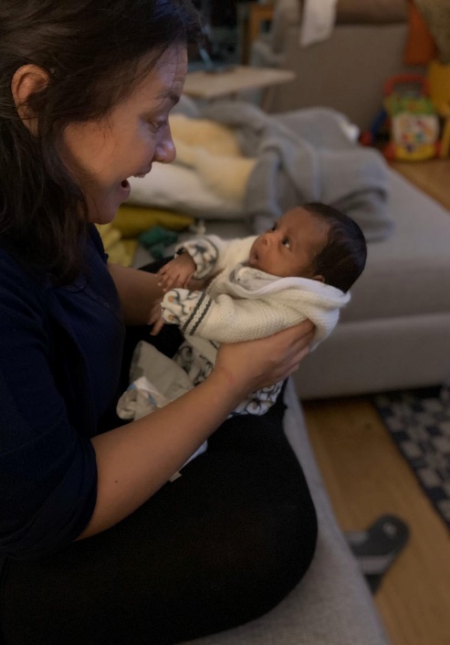
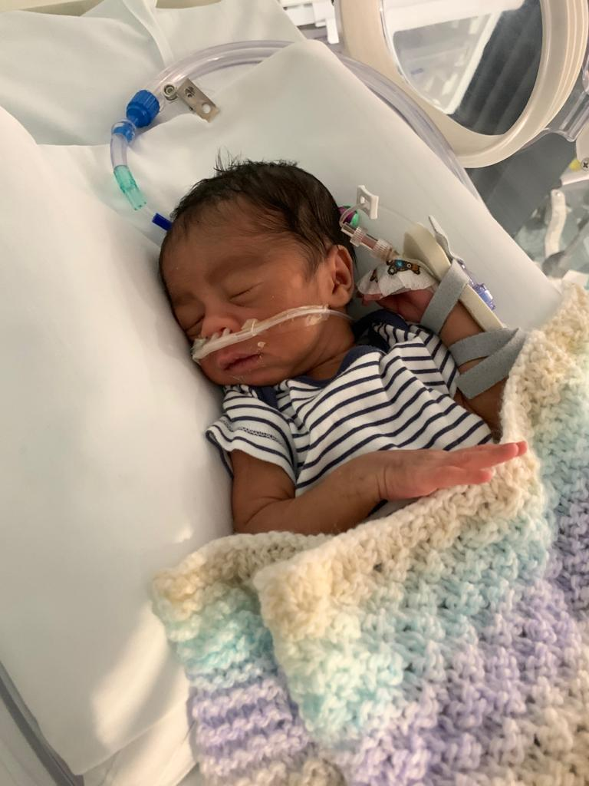
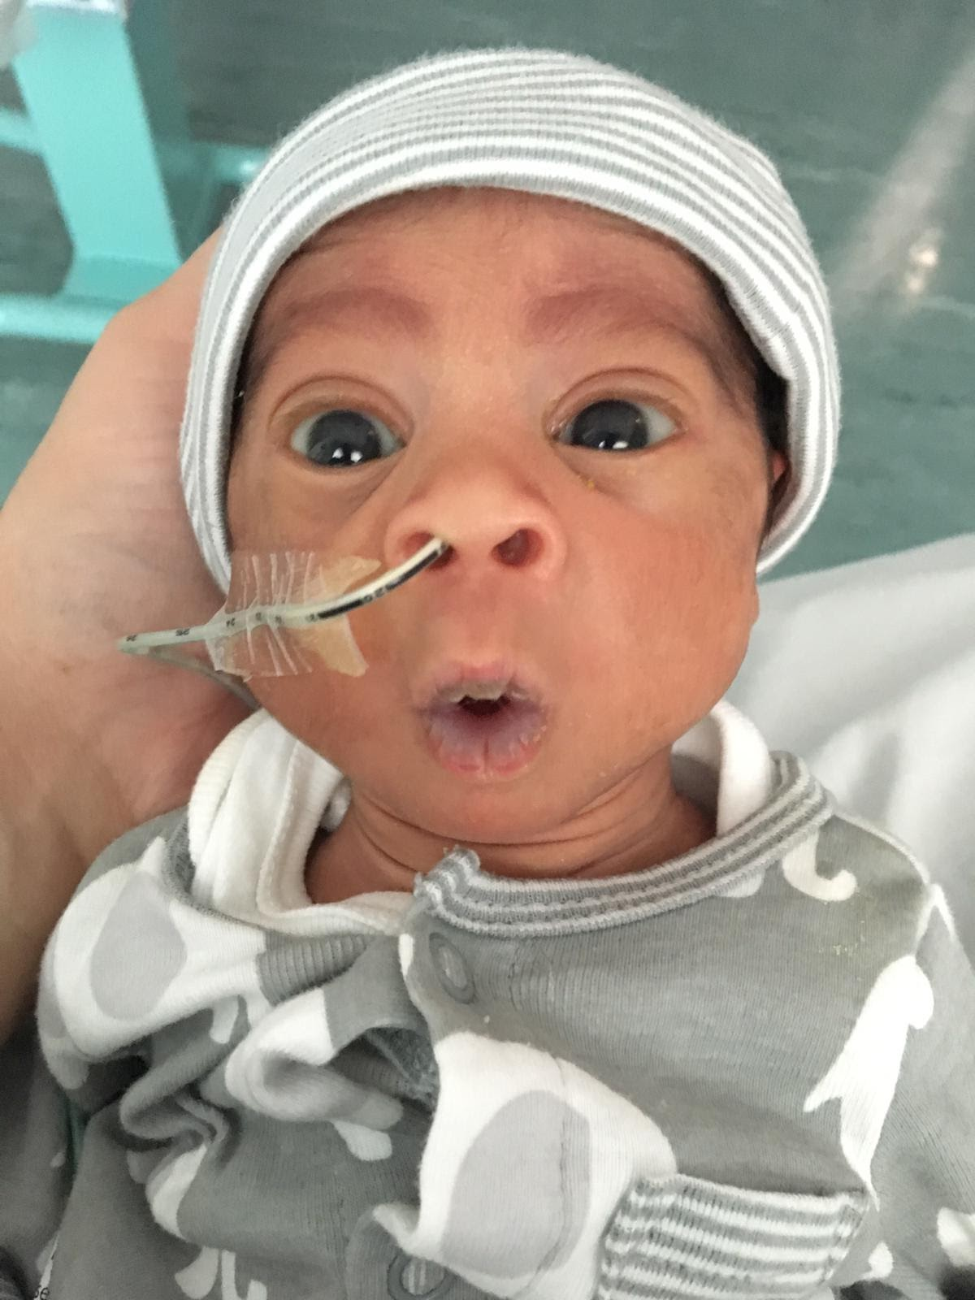
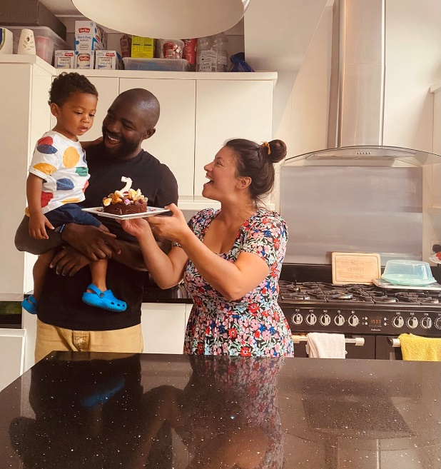
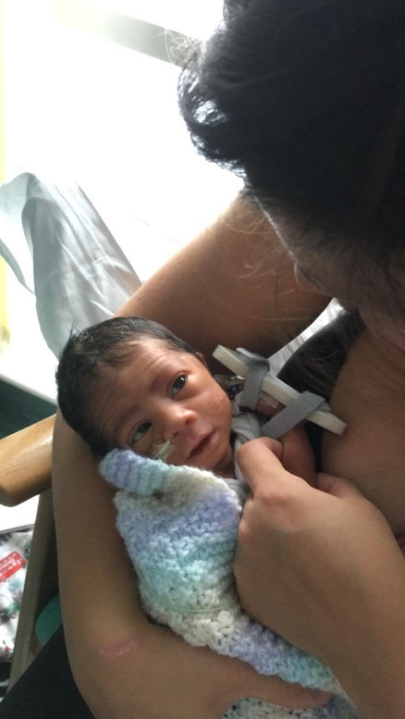
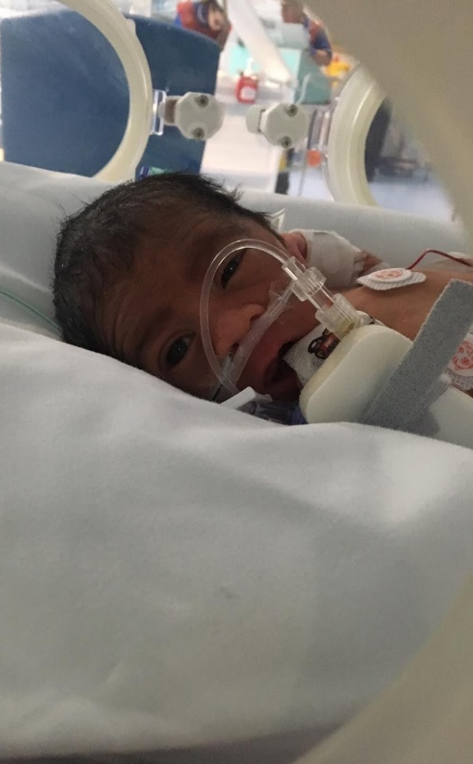
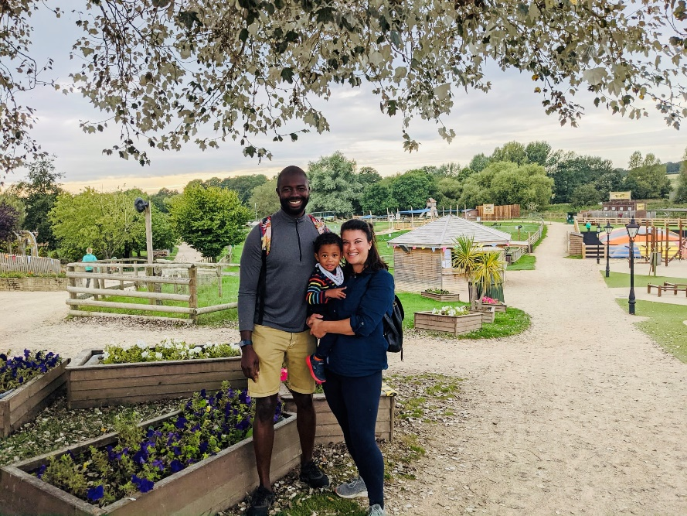
Jade Umeh story
Notes:
Jade from the London ODN patient rep telling her story

Slide 5
Diagnosis
Planning
Iterative testing
Refine and scale up
Looking at data
Reviewing complaints/serious incidents
Talking to staff and patients
Process mapping
RCAs
‘Deep dives’
Write your aim statement
create a driver diagram
Stakeholder mapping
PDSAs!
Spread and adopt
Communication and involvement
Measurement
Notes:
The MatNeoSIP QI collaborative started in June 2022 where the aim of the 1st session was to introduce the basics to Quality Improvement and how this related to how we could start a preterm optimisation journey together to improve the lives of babies born preterm. Following that 1st session, I asked you to set an aim for your project and to identify a multidisciplinary project team within your unit/Trust.
The 2nd session in September focused on understanding the present state with the aim of providing a safe environment for the teams to step back, look at the service in detail and identify areas for improvement. Following that session, I asked you to start to look at the data associated with your identified problem.
The 3rd session in December focused on developing change ideas and making sure you had the right stakeholders involved so that the project would be successful and sustainable. We also looked at measurement for improvement methodology. Following that session, I asked you to implement your change idea and start to measure your data (including gathering baseline data).
Now for the 4th session, we are in the “testing” phase of the series, looking to refine the change by learning from what worked well/not so well. I know we are all at different stages in our projects, however PDSA cycles is something we can all learn about as it is applicable to any stage

Slide 6
Testing
Notes:
The idea of a PDSA cycle is that it is like playing. We test ideas, we learn and we keep going.

Slide 7
…or playing
Notes:
And children do it all the time. They learn from their mistakes, they look to improve. If you think back to a time when you were young or if you have kids, and think about the small changes they/you make everyday to grow, change and improve. It happens all the time without us even realising.

Slide 8
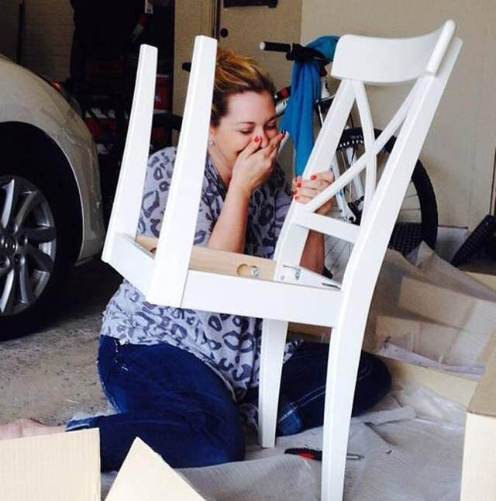
Test small,
Fail fast,
Learn,
Keep going…
Notes:
And it doesn’t have to be big. The small things are often what make a difference. Whatever you do though, it is important to keep going until you are satisfied.
These photos are all images of daily life activities where the cycle of Plan, Do, Study, Act is applicable – take the chair for example: She planned to build it, she did, she observed it was wrong, and now she will act and try again (hopefully until it is right)!

Slide 9
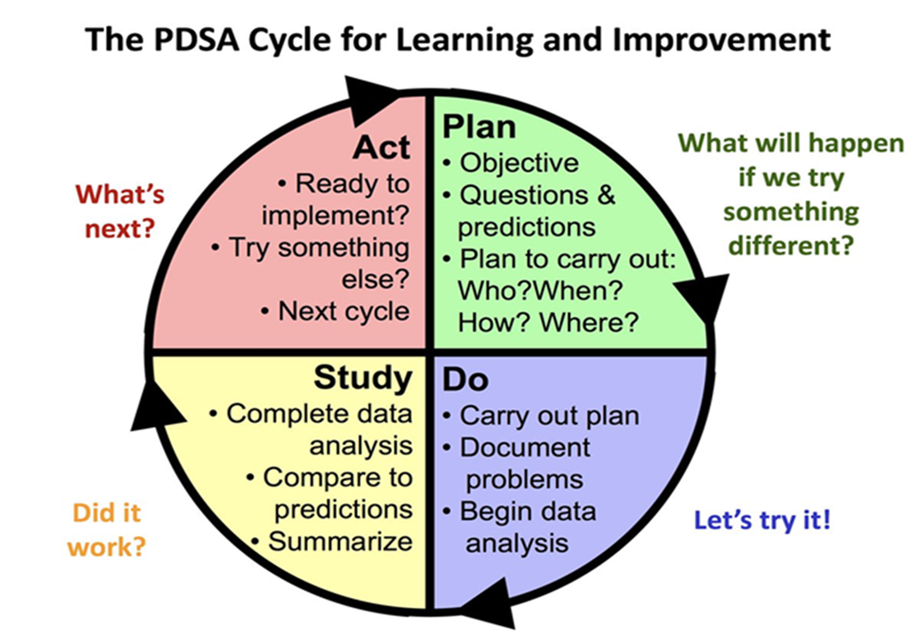
Theory of PDSA
Useful tool for documenting a test of change.
Plan - Develop a plan to test the change - Who? What? When? Where?
Do - Carry out the test
Study - Observe, analyze, and learn from the test
Act - Determine what modifications, if any, to make for the next cycle
Notes:
The Plan-Do-Study-Act (PDSA) cycle is a useful tool for documenting a test of change and engaging a project group.
Develop a plan to test the change (Plan) - Who? What? When? Where?
Carry out the test (Do)
Observe, analyze, and learn from the test (Study)
and then you determine what modifications, if any, to make for the next cycle (Act)

Slide 10
Plan: Plan the test, including a plan for collecting data.
State the question you want to answer and make a prediction about what you think will happen.
Develop a plan to test the change. (Who? What? When? Where?)
Identify what data you will need to collect.
Notes:
When working as a group on an improvement project, as you’ve found out, it requires a bit more planning than if we were just playing.
Setting an aim and a project team is the 1st step, but then thinking about:
What is the objective of the test / cycle?
What is the theory?
What do you predict will happen?
Plan how long the test will run for and when you will regroup to reflect on what happened
Plan what data to collect. Consider starting small so you can run a test and learn as quickly as possible.

Slide 11
Do: Run the test on a small scale
Carry out the test.
Document problems and unexpected observations.
Collect and begin to analyse the data.
Notes:
Do: Run the test on a small scale
Carry out the test.
Document problems and unexpected observations. Keep track of this on a project plan, in meeting notes, on a excel shareable document.
Collect and begin to analyse the data thinking carefully about what you are collecting.

Slide 12
Study: Analyse the results and compare them to your predictions
Complete, as a team, if possible, your analysis of the data.
Compare the data to your prediction.
Summarize and reflect on what you learned.
Notes:
Study: Analyse the results and compare them to your predictions
Complete, as a team, if possible, your analysis of the data. Some of you have started to do this effectively in presentations with pie charts or run charts.
Compare the data to your prediction.
Summarize and reflect on what you learned as a project team.

Slide 13
Act: Based on what you learnt from the test, make a plan for your next step
Adapt (make modifications and run another test), adopt (test the change on a larger scale), or abandon (don’t do another test on this change idea).
Prepare a plan for the next PDSA.
Notes:
Act: Based on what you learnt from the test, make a plan for your next step
In most improvement projects, teams will test several different changes, and each change may go through several PDSA cycles as you continue to learn.
For example with DCC:
Looking at babies born in good condition and then moving onto babies born in poor condition
Introduction of the lifestart trollies in some trusts
Keep a file (either electronic or hard copy) of all PDSA cycles for all the changes your team tests.

Slide 14
To wrap up
Plan, Plan, Plan – invest time early on to make sure your aim is specific and measurable and you have a plan for how you are going to collect your data
Seek usefulness and not perfection: measure just enough to get to the next step
Start with your baseline: What’s your average now? Sort of variation do you see? What’s your target?
Make measurement part of your routine: or better yet, use measures that already exist
Use it as an engagement tool!
Notes:
To wrap up
Plan, Plan, Plan – invest time early on to make sure your aim is specific and measurable and you have a plan for how you are going to collect your data
Seek usefulness and not perfection: measure just enough to get to the next step, doesn’t have to be super onerous
Start with your baseline: What’s your average now? What sort of variation do you see? What’s your target?
Make measurement part of your routine: or better yet, use measures that already exist e.g. NNAP data
Use it as an engagement tool!

Slide 15
Normothermia on admission audit
SpR Drupti Jogia
SHO Alina Petric
NNU Matron Caroline Nyawira

Slide 16
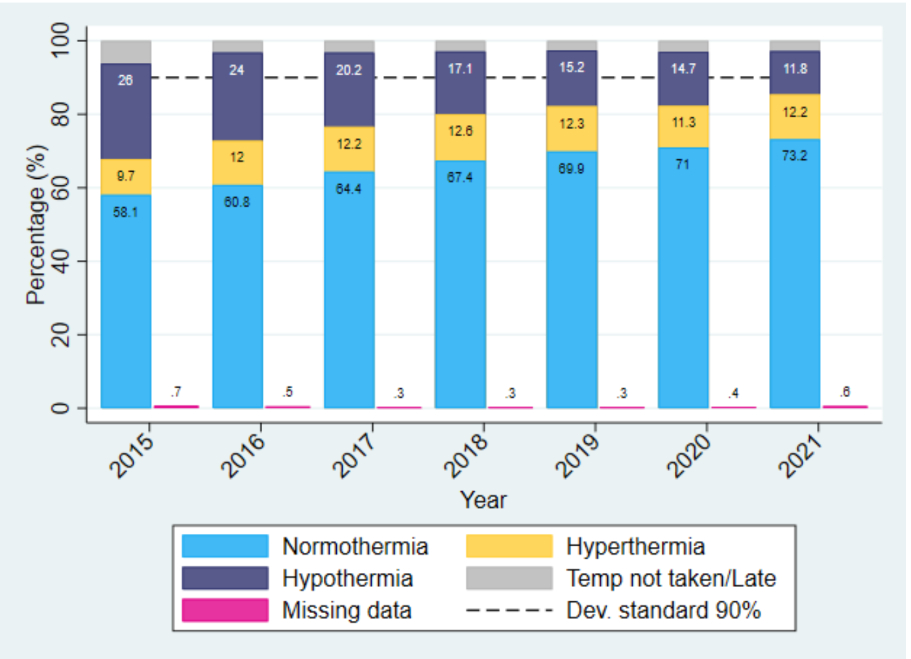
National Neonatal Audit Programme (NNAP)
Assesses whether babies admitted to neonatal units receive consistent high-quality care in relation to the NNAP audit measures
Part of the optimal perinatal care – temperature on admission
Aim >90 % babies born less than 32 weeks gestational age to have temperature between 36.5-37.5C in the first hour of birth
International Liaison Committee on Resuscitation (ILCOR) 2015 strongly links suboptimal temperatures to increases in mortality and morbidity in preterm infants.

Slide 17
Our audit aims
Normothermia on admission to Neonatal Unit for all babies regardless gestational age
Evaluate current hypothermia rate with current measures in place
Aim to reduce rates of hypothermia by understanding what is the main cause and how we can improve it

Slide 18
Methodology
Retrospective study – reaudit September - December 2022
Data collection using Badger and Cerner
Data collected
Date of birth
Gestational age
Area admitted from
Temperature of area
4 temperature measurement
Exclusion criteria : missing data, transfers, re-admission, admission from A/E

Slide 19
Measures in place
ALREADY IN PLACE
Term babies
Pre heat resuscitaire
Warm towels
Hats (when available)
Preterm babies
Pre heat resuscitaire
Transwarmer
Neobag
Adequate size hat
Transport to NNU
If from LW/Theatre -transport incubator
If from PNW - cot
NEW ADDED
Admission temperature check list
On Resuscitaire prior transfer
In transfer incubator prior transfer
In transfer incubator on arrival to the unit
In incubator within 15 min from admission

Slide 20
Results
 | April, May, June 2022 | Sept, Oct, Nov, Dec 2022
Total admission | - | 120
Total admission to NNU after excluding missing data, transfers, re-admission from home or A/E | 56 | 90 (75%)
Hypothermic admission | 32% | 4 (4%)
Premature admission | 54% | 37 (33%)
Missing data | - | 3 (3%)

Slide 21
Results

Slide 22
Results

Slide 23
Results

Slide 24
Results
Areas hypothermic neonates admitted from

Slide 25
Results
Pre transfer temperature | Sept 3/16 | 1 low
 | Oct 14/26 | 3 low
 | Nov 15/27 | 1 low
 | Dec 9/21 | 0 low + 1 high
Temperature In incubator prior transfer | Sept 0/16 | no documentation
 | Oct 3/26 | normal
 | Nov 9/27 | 4 low
 | Dec 10/21 | 1 low + 1 high
Temperature in incubator on arrival to NNU | Sept 0/16 | no documentation
 | Oct 3/26 | all normal
 | Nov 10/27 | 1 low
 | Dec 8/21 | normal
Temp of area | 18/93
Temp 19C-25C | 19C - baby was not hypothermic
Coldest place - theatre
Warmer place - LW room

Slide 26
SUMMER VS WINTER

Slide 27
Conclusions
Significant improvement in achieving normothermia amongst all admissions regardless of gestational age in winter audit
NNAP data 100% normothermia for neonates <32 weeks
Theatre and postnatal ward were equally reported to be coldest place of admission
It is well known that theatre has the coldest environment temperature; we can not comment on environment temperature on PNW as there are no room thermometers
Current measures in place are adequate for achieving normothermia

Slide 28
Recommendations
Improving documentation – to be included in Badger induction training that temp on admission should be as the temp from nursing admission paperwork
Continue measuring 4 temperatures
Have normothermia champion on each shift (doctors, nurses)
Room thermometer in postnatal ward
Liaise with theatre coordinator/maternity coordinator –theatre environmental temperature could be increased in case of extreme preterm birth without impact on surgery/mother (aim 26C)
Notes:
Verbal – uniform documentation
Temp prior to admission was low and we warm baby in order to achieve temp on admission. IF the temp is high we descrease resuscitaire heat for same reason

Slide 29
Discussions

Slide 30
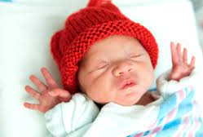
Thank you !
Big thank you to all neonatal team for keeping our babies warm!

Slide 31
Breakout Rooms
Based on the data and what you have learnt so far, discuss what can be changed, adapted or abandoned?
We will put you in breakout rooms as per your QI project
Project | Trust
Delayed Cord Clamping | GSTT, KCH, LGT, St Georges
Normothermia | GSTT, Kington, Croydon
Improving administration of probiotics for preterm infants | EpstH
See guide for breakout rooms to help drive conversation

Slide 32
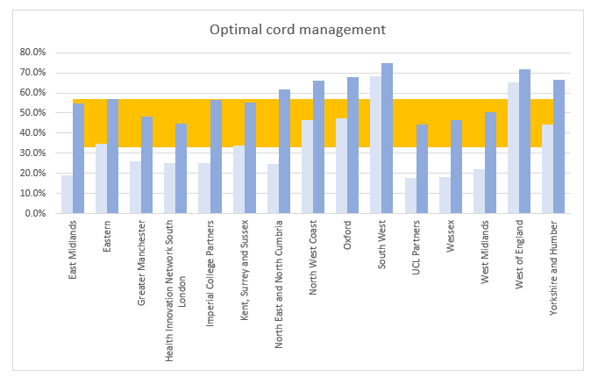
MatNeoSIP National Data Dashboard – Local Impact
Optimisation Pathway
Health Innovation Network South London
645 women giving birth at less than 30 weeks of gestation received magnesium sulphate within the 24 hours prior to birth. This means that 17 babies will not develop cerebral palsy.
20 women in preterm labour at less than 34 weeks of gestation received intravenous intrapartum antibiotic prophylaxis to prevent early onset neonatal Group B Streptococcal (GBS) infection irrespective of whether they have ruptured amniotic membranes. This means that 2 babies were born without group B strep.
Between 14 and 23 babies born at less than 34 weeks gestational age survived because their umbilical cord was clamped at or after one minute after birth.
Data from April 2020 to Oct 2022

Slide 33
Next steps
The next QI workshop is the celebratory event on 15th June 2023, 2-5pm
Your task to complete by Friday 19th May is to:
Populate case study template and submit for showcasing at the Celebratory event on 15th June
Before you go, please could you put one word in the chat to tell us how you have found the session today. Wait until we say “GO” then press “ENTER”
If you have any questions please reach out to the MatNeoSIP lead – Gemma.dakin@nhs.net

Slide 34
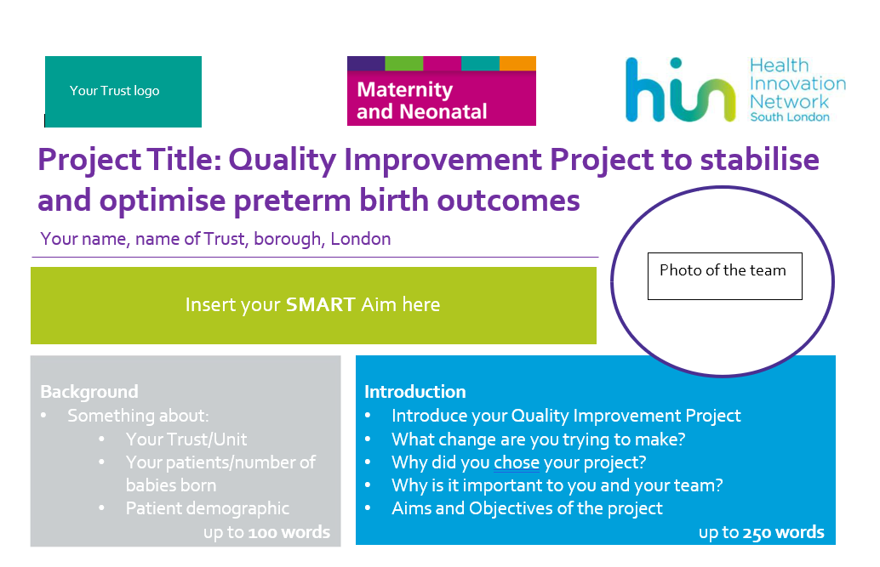
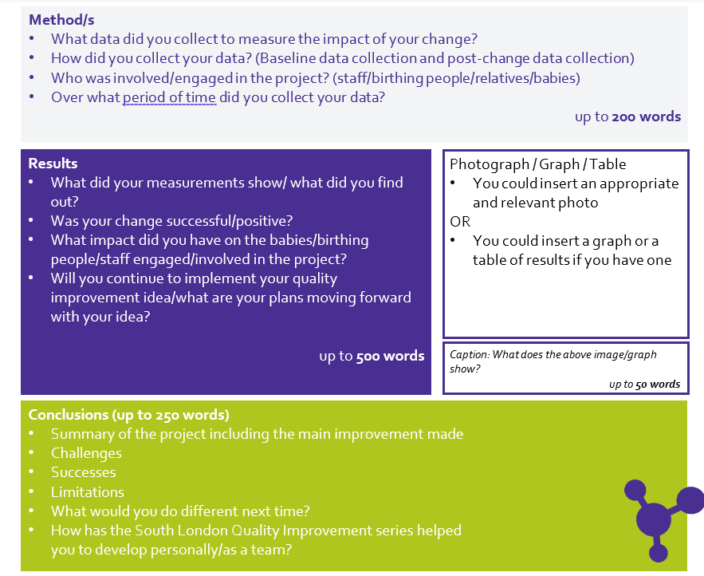
Case study Poster

Slide 35
Close and Thank you
Gemma.dakin@nhs.net

