Slide 1

GSTT @Home Service - Falls Response
August 2023
Aimee Venner, Therapy Lead for @home service
Health and Social Care Making a Difference!

Slide 2
Falls Response - @Home Service
Purpose:
Provide a brief overview of the @home service
Outline the NHSE guidance for UCR services in providing a falls response
Outline the current @home service falls response
Future planning to further enhance this provision within the community

Slide 3
Brief overview of the @home service
The @home service provides safe, effective and timely home based acute / short term medical, nursing, therapy, and social care assessment and intervention, for residents living in the London boroughs of Lambeth and Southwark.
Primary Aims:
prevent acute hospital admissions where possible, and/or reduce the length of stay when patients have been admitted
provide patients with multidisciplinary input to manage their urgent needs, and to remain in their usual place of residence
Response times:
0 – 2 hour, same day, or next day response as part of a commitment to the NHS Long-term plan
(National Health Service (2019) The NHS Long term plan. Available from: https://www.longtermplan.nhs.uk/wp-content/uploads/2019/08/nhs-long-term-plan-version-1.2.pdf [Accessed 3rd Aug 2023])

Slide 4
Brief overview of the @home service
Service operates 7 days a week from 8am to 8pm
Acceptance criteria:
Adults – over 18 year and known to adult services
Lambeth and Southwark resident
active, acute /short term medical, nursing, therapy or social need that can be safely managed in the community, that otherwise would require a hospital admission/stay.
Complex medical management of: acute infections – including IV antibiotic treatment, respiratory infection – including COVID; diabetes, heart failure – including IV diuretics, COPD, AKI, hyperemesis gravidarum, falls
Complex therapy and social management of: falls; acute/rapid deterioration in function requiring rehab and/or adaptive equipment; urgent care provision; significant carer stress; acute/emergency safeguarding, housing, financial issues; palliative care/EoL needs
Notes:
Not an exhaustive list of interventions

Slide 5
NHSE guidance for UCR services responding to patients who have fallen in their usual place of residence
One aspect of the ‘going further for winter’ resilience plan is that UCR teams should implement a community-based falls response, to improve support for people in the community, inclusive of care homes
build capacity and resilience within the community
Take pressure off LAS to attend higher acuity, critical, and life-threatening calls

Slide 6
Current @home service falls response
Referral is made into the service via phone call to 0203 049 5751
the UPA clinician will triage the referral and allocate to the most appropriate response time and clinician/s
An urgent clinical response is provided by an @home GP and therapist either as a joint visit or consecutive visits depending on the needs of the patient
If safe to assist the patient off the floor, backwards chaining will be attempted first
If the patient needs greater assistance to get up from the floor with support, the Mangar Eagle can be used to lift the patient to sitting
The patients usual transfer aid or an appropriate aid can be used to transfer the patient to a place of safety / comfort for further assessment

Slide 7
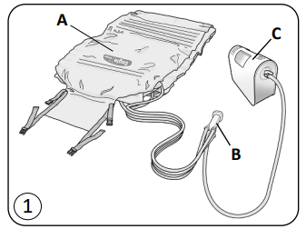
Current @home service falls response
The Mangar Eagle
an inflatable lifting device which is designed to sit up and lift a fallen person from the floor
When inflated, the Eagle lifts the person into a raise d seated position ready to stand with or without assistance.
The Eagle is powered by a Mangar Airflo 24 Compressor and controlled using a 4-Way Hand Control
GSTT manual handling team recommends that a minimum of 2 qualified staff are to be in attendance when using the Mangar Eagle

Slide 8
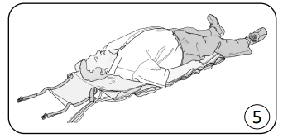
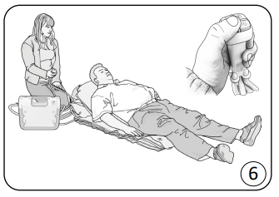
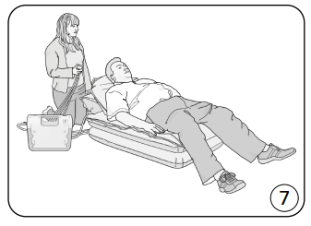
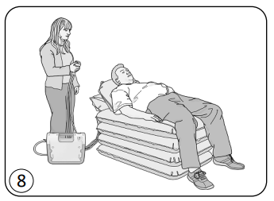
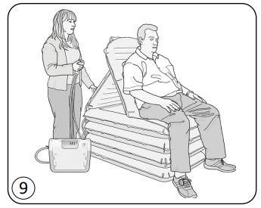
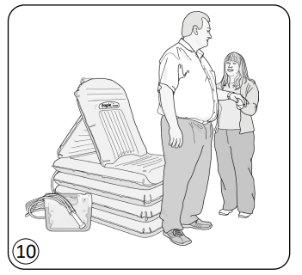
Current @home service falls response
The Mangar Eagle

Slide 9
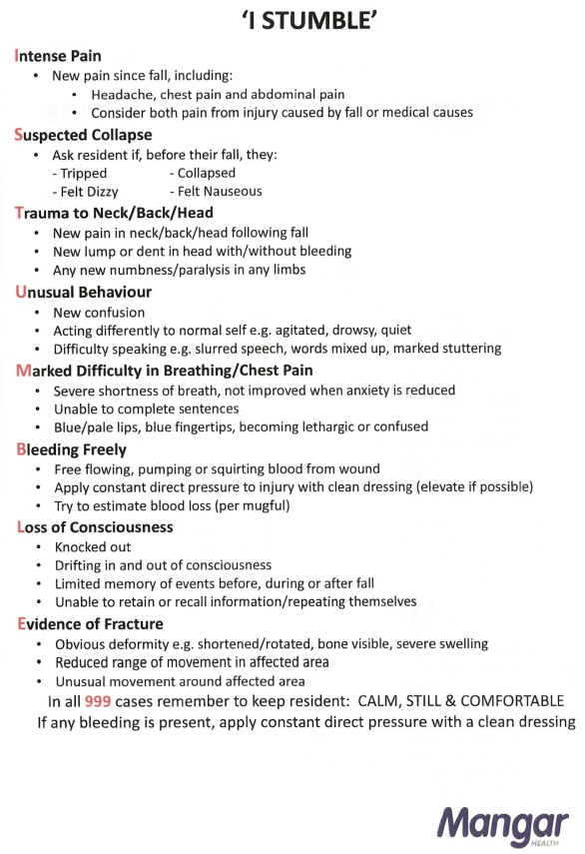
Current @home service falls response
The Mangar Eagle
An ELITE risk assessment and the I STUMBLE clinical assessment must be completed as part of the risk assessment, prior to determining if the Mangar Eagle is suitable

Slide 10
Current @home service falls response
Indications for patient to remain in the floor
    Significant change in blood pressure or other clinical observations
    Head or neck injury or heavy impact, any neurological symptoms e.g. dizziness, double vision, dysphasia, dysarthria, dysphagia, nausea, numbness (new), nystagmus
    New onset of confusion unable to follow instructions
    Unable to move or in too much pain
    New swelling or unusual limb angles
    Insufficient number of/ or physically able bodied people to assist with the manual handling task

Slide 11
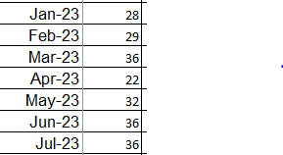
Current @home service falls response
Referrals into the @home service, with ‘falls’ listed as the primary diagnosis at point of triage
Total referrals Jan – Jul 2023: 219
164 referred originated from external sources
55 referrals were internally generated within @home
The Mangar Eagle was ready for use at the end of Jan 2023 and has been used roughly 3 times in assisting patients up from the floor

Slide 12
Future plans
Provide greater awareness and exposure within care homes, of referring to @home as the urgent community response provider for a falls response
Provide greater awareness and exposure within the wider community teams in Lambeth and Southwark, regarding the Mangle Eagle lifting equipment
Closer working between @home and care homes in providing support for community fallers, reducing the need for LAS referral

Slide 13


Bexley Urgent Community Response Team
Cherie Trew
UCR Lead
August 2023

Slide 14
Criteria
Notes:
Information leaflet for HCP happy to email to all

Slide 15
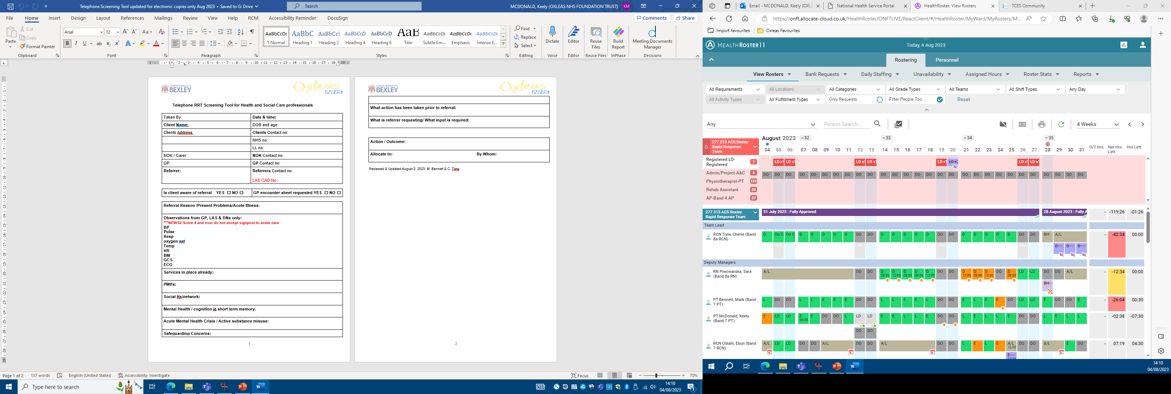
Telephone Screening Tool
Notes:
Screening tool used to triage all referrals very short and concise, case study follows

Slide 16
Triage - Mr A
Reason for referral: Information below gathered at triage
LAS Referral (26-7-23) Mr A 103 years, complaining of lethargy and unsteady on his feet.
HCP –
Patient feeling generally unwell for 4 days
Observations LAS: 125/66 HR 89 RR 20 02 Sats 97 Temp 37.5 BM 11 NEWS2 (0)
Past Medical History:
Bradycardia, T2DM, Hiatus Hernia, Hypothyroidism, Basal Cell Carcinoma, lower limb cellulitis, previous DVT 2006
Medication:
Lansoprazole 30mg, Clopidogrel 75mg, Levothyroxine sodium 50microgram, Gaviscon oral suspension.
Allergies – unknown.
NOK – Wife (82)
Patient accepted – seen within 2 hours

Slide 17
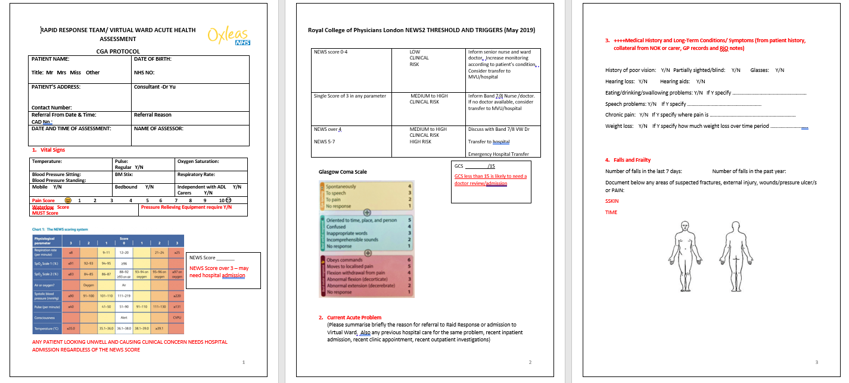
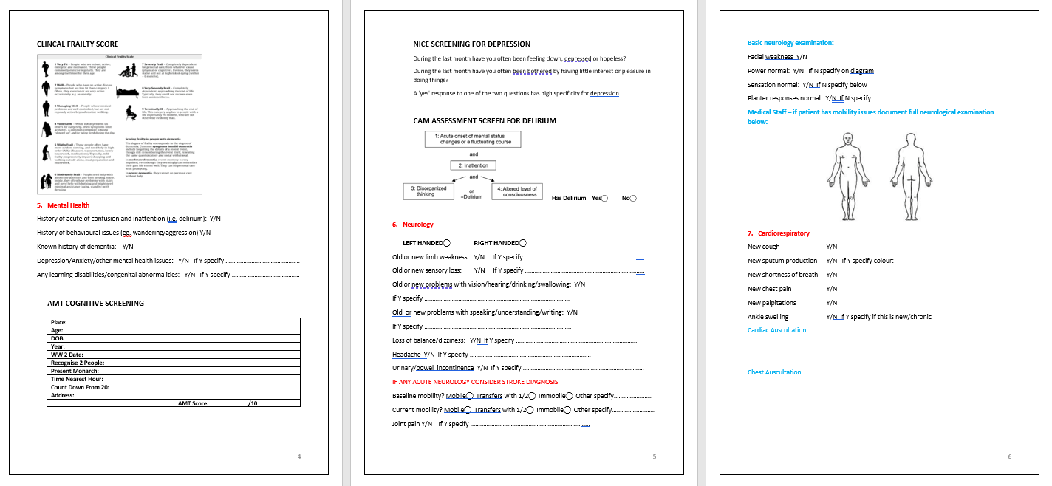
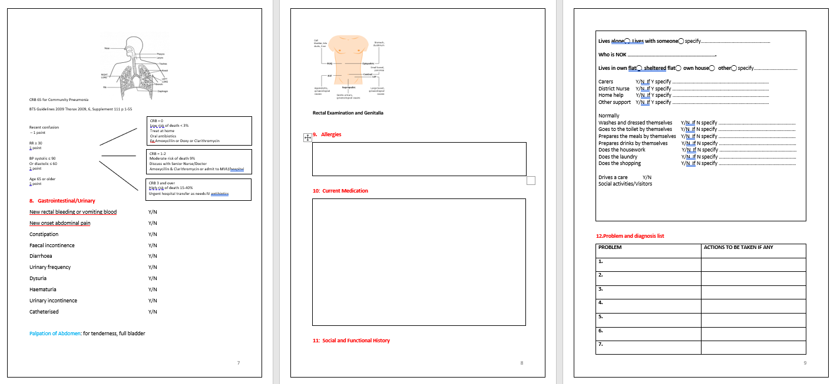
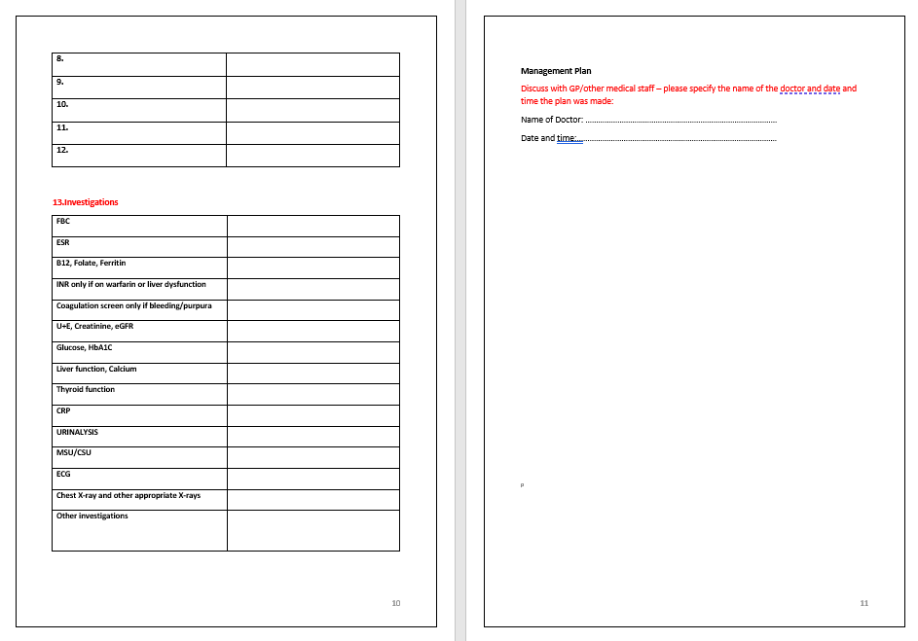
Acute Health Assessment
Notes:
Initial assessment take approx. 1.5 hours, it's a one stop shop this visit will gather all pertinent information and develop the plan for the next 5-14 days dependent on the assessed need – UCR or VW requirement

Slide 18
Initial visit Acute Health assessment
PC: Lethargy, unsteady and reduced mobility.
HPC: 5-6 day history of lethargy, unsteady mobility, unable to manage activities of daily living.
Past Medical History: Bradycardia, history of DVT, T2DM, Hiatus Hernia, Hypothyroidism, Basal Cell Carcinoma.
Medication:
Lansoprazole 30mg, Clopidogrel 75mg, Levothyroxine sodium 50microgram
Over the counter - Gaviscon oral suspension, Paracetamol PRN
Allergies – Doxycycline

Slide 19
Initial Visit Acute Heath Assessment
Urineanalysis:
Leukocytes = +++
Nitrate = ++
Protein = +
pH = 7
Blood = ++
SG = 1.010
Ketone = -
Glucose = -
Vital Signs:
Respiration – 18
Saturation 97% room air
Blood pressure 132/61 Sitting
Blood pressure 125/63 Standing
Heart Rate 79 regular
Temperature 37.8
BGT: 8.4 mmol
National Early Warning Score (NEWS2) = 0
Pain Score: 0/10
GCS: 15/15
Notes:
The observations highlight potential unresolving UTI -

Slide 20
Social Care Assessment
Social care
Lives in a house with his wife
Private carer twice a week to help with shower.
Takes medicine from blister pack with assistance from wife.
Support network- Son visits weekly, very supportive neighbours.
Son buys shopping and supports with finances.

Slide 21
Initial Visit/Acute Heath Assessment
FALLS/FRAILTY
No falls in the last week. Two falls in the past year
Frailty score = 5.
Abbreviated Mental Test score: 8/10
MENTAL HEALTH
No signs of confusion, behaviour issues, self-harm or suicidal thoughts during visit.
No history of dementia.
CVS
Denies chest pain, palpitations, PND, SOB/SOBE, no lower limb oedema, heart sounds 1+2+0 –
Respiratory
Denies cough, sputum production – bilateral equal air entry no adventitious sounds,
GASTROINTESTINAL/URINARY
Denies vomiting, constipation, diarrhoea,
c/o urinary frequency
Abdomen – Nil distention, bowel sounds heard in all quadrants, abdomen soft none tender, denies supra pubic tenderness, No CVA tenderness.
No red flags - weight loss, night sweats, blood sputum, faeces, PND,

Slide 22
Pressure Areas: SSKIN
S Patient sleeps on a bed.
S All pressure areas intact
K Patient mobilise with X 2 walking sticks .
I Patient is continent, choses to wear pads just in case.
N Patient reports to have a small but well balanced diet including fruit vegetables and adequate fluid intake approx. 1.5 - 2 litres daily .
MUST Score = 1
Waterlow Score = 13

Slide 23
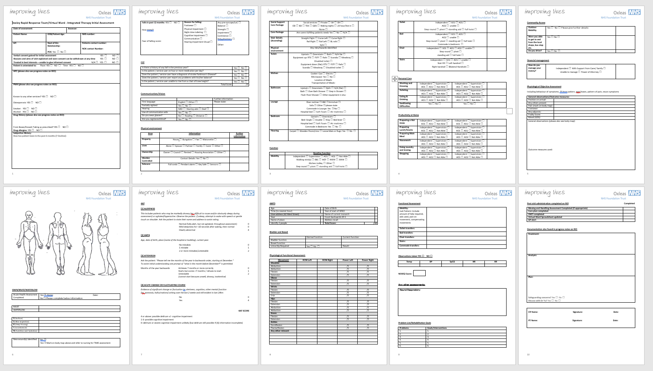
Initial Therapy Assessment

Slide 24
Initial Therapy Assessment
Falls
Physical Environment
Communication an Vision
Personal Care
Baseline function
Productivity at Home
Community Access
Financial Management
Physical Objective Assessment
Outcome Measures
SSKIN
AMTS/4AT
Bladder and Bowel
Home Exercise Programme
Observations
Nutrition
Neuro/Resp assessment
Onward referrals
Equipment provision
Liaise with GP
MSK assessment
Functional assessment
Moving and Handling

Slide 25
Initial Therapy Assessment
~Mr A ~
On Assessment
Independent with toilet transfers upstairs and downstairs
Independent with chair and bed transfers
Slow but Independent on stairs with bilateral rails
Independently mobile with x 2 walking sticks but unsteady
Independent with chair and bed transfers
Usually independent with personal care, past 4 days requires assistance from wife.
Balance assessment – moderate risk of falls

Slide 26
Problems identified
UTI
Low grade pyrexia
lethargy
Unsteady mobility
Generally unwell
Support with ADL’s
Plan
Sent MSU for C&S
Started Trimethoprim 200mg BD (review result )
Paracetamol 1gram QDS
Monitor observations daily
Monitor Pressure areas
Provided pressure relieving equipment
Provided a zimmer frame & HEP
Provided a care package, care was increased to BD 7/7. Rapid Care – free for first 5 days
PT assessment
OT assessment and equipment provided
Notes:
Difficult scenario – antibiotics do not appear to be effective – UTI unresolving –
1- wait for CSU result
2- stop Cipro start Co-amoxiclav

Slide 27
First follow up visit – Day 2
Observations:
8am- Respiration – 20 bpm, 02 Sats 97% room air, BP 142/68mmHg Pulse 80, Temperature 38.1 degrees. BM 12.1mmols
National Early Warning Score (NEWS) scored of 1.
Patient has taken – x 2 Trimethoprim
Had not taken paracetamol – Paracetamol prompted during visit
Plan/Action:
Discussion with Team Consultant
Continue with Paracetamol 1gram QDS
Increase visits to TDS
Provide patient with Electronic BP machine, tympanic & 02 sats monitor (self-monitoring wife will support)

Slide 28
Day 2, monitoring cont.
12 pm - Resp – 20 bpm, 02 Sats 97% room air, BP 132/68mmHg Pulse 70, Temperature 37.5 degrees. BM 10.3mmols
4pm Resp – 18 bpm, 02 Sats 97% room air, BP 130/80mmHg Pulse 68, Temperature 37.1 degrees.
8pm- Resp – 16 bpm, 02 Sats 98% room air, BP 132/ 70 mmHg Pulse 76, Temperature 36.7 degrees. BM 8.1mmols
Mrs A happy to monitor during the night if concerned.
Safety netting – Patient and wife to call LAS if temp increased to 38c, chest pain,SOB.

Slide 29
Follow up visit – Day 3
Telephone call at 8am - Mrs A, reports patient had a good night, no night sweats – self monitored at 7am- BP 132/70 -HR 68, temp- 36.6- 02 sats 97%.
Visit at 12 MD
Vital Signs:
Respiration - 19b/m
Saturation 98% room air,
Blood pressure 142/79 mmHg
Pulse 59 regular
Temperature 36.8 degrees, without Paracetamol.
Blood Glucose – 8mmols
National Early Warning Score (NEWS) scored 0.

Slide 30
Follow up visits
Daily nursing visits to monitor patient's condition and antibiotic effectiveness.
Mr A, reported feeling better
Health promotion advice regarding fluid intake
Discharged from caseload at day 6
Patient provided a physiotherapy HEP.
Patient decided to keep the BD care package, team social worker visited to discuss long term plan and financial implications.

Slide 31
Notes:
Patient information

Slide 33
Any Questions ☺

Slide 34
Urgent Community Response Team
Nina Whittle, UCR Consultant ACP
August 2023

Slide 35
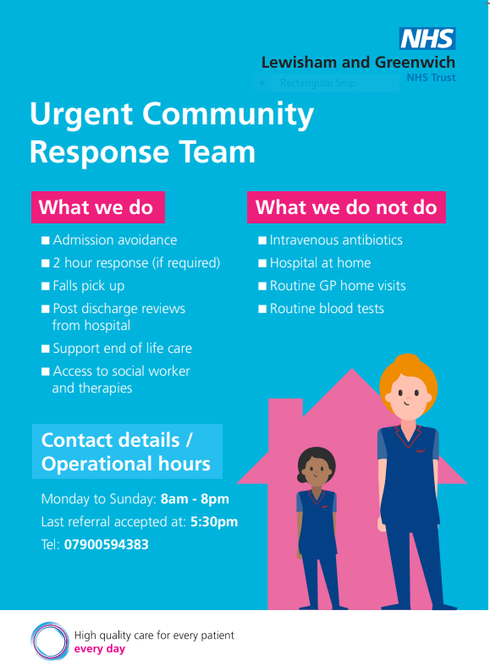

Slide 36
Lewisham Care home referral numbers
 | No of care home pts to ED | No of care home referrals to UCR
June 2023 | 45 | 16
May 2023 | 43 | 23
April 2023 | 40 | 25
March 2023 | 46 | 18
Feb 2023 | 38 | 32
Jan 2023 | 38 | 22
Dec 2023 | 43 | 35
Number of care home referrals into UCR for 2022/3 – 193
Number of care home referrals into ED for 2022/23 - 444

Slide 37
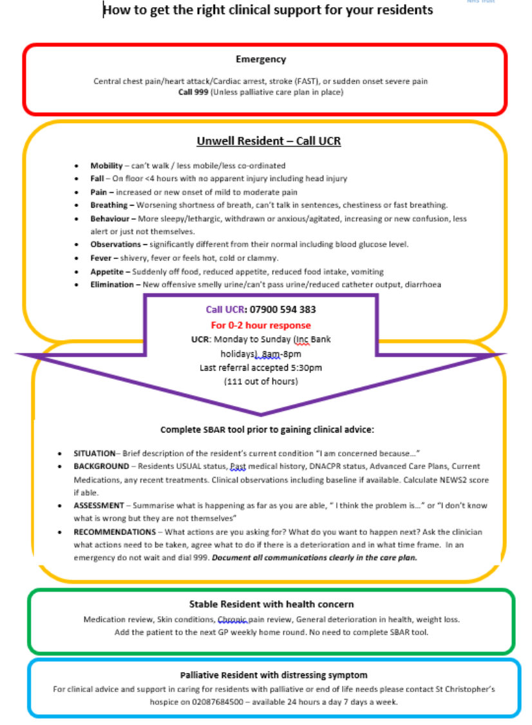

Slide 38
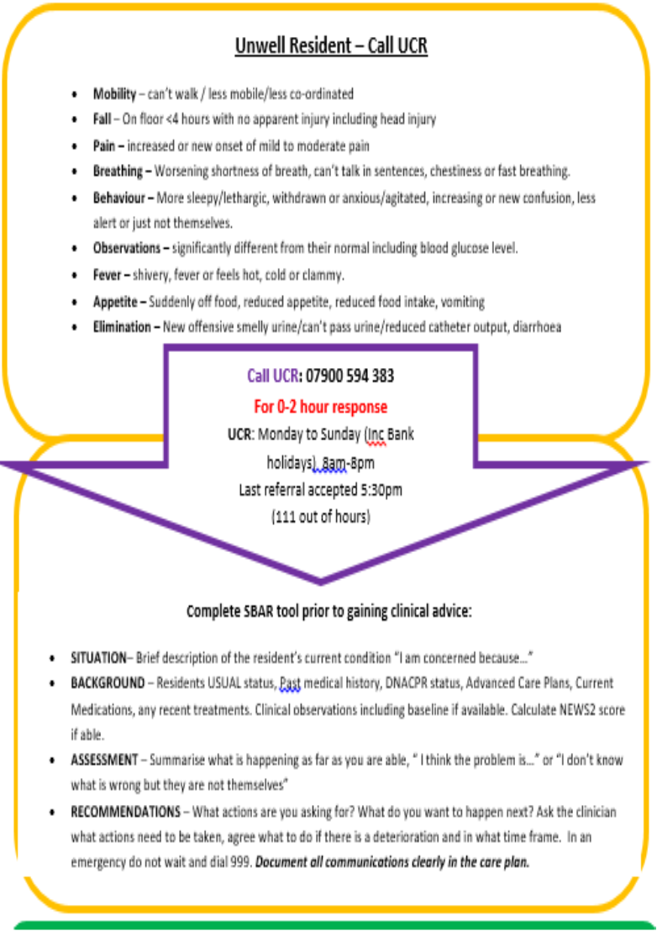

Slide 39
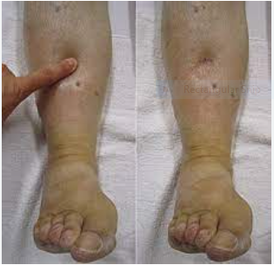
Case study – CCF
Direct Care Home referral of Peter 73 years – New to the home (unable to make contact with the GP)
C/O – Increased SOB and lower leg swelling for
past 2/7
PMHX: T2DM, Non-alcoholic fatty liver disease
Prev gastric ulcer, CKD, Atrial fibrillation,
Chronic cardiac failure
OBS: Sats 93%, HR 75, RR 21, BP 110/60, T 36.5oC
Adv Care Plan – For full escalation no DNACPR in place or discussion had
UCR accept and attend as 0-2 hr response

Slide 40
UCR assessment - Peter states that he feels well and does not want to go to hospital
WHAT DID THE UCR DO:
Medical assessment
Blood tests
Additional medication – diuretics
Discussion with frailty consultant
Reviews x 3 over 5 days
OUTCOME:
Positive result from the change in medications
Reduction in SOB and leg swelling
Referral of the patient to the Virtual Ward for ongoing assessment of the blood pressure which remained low

Slide 41

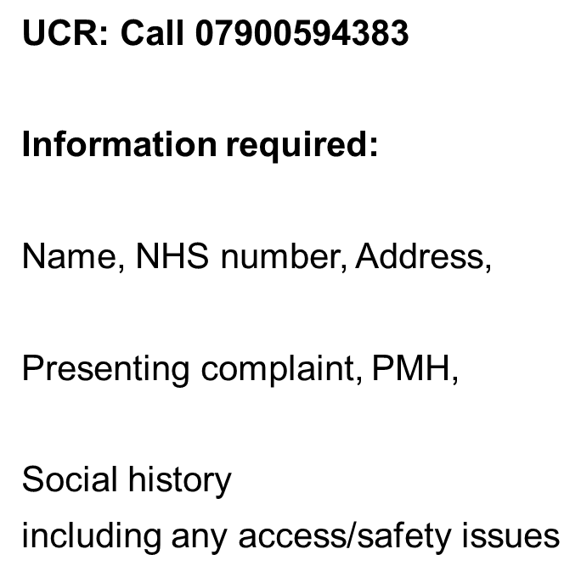
How to Refer
Call us if in doubt

Slide 42


Bromley Healthcare
Urgent Community Response
Yoven Soobramaney, Service Lead for Rapid Response
August 2023

Slide 43


Rapid Response & Falls Pick-up
UCR within Bromley Healthcare is the umbrella team:
As telecare/care home/LAS/111clinician, we would like you to refer into the Rapid Response element of UCR for appropriate patients that do not require an emergency admission to hospital
- concerned may require a medical assessment or falls pick-up service as they are below their baseline, acutely unwell or on the floor.
Our Rapid Response consists of 12 clinicians of various skill mix - ANP, ACP, ACP Apprentice, Paramedic and Registered Nurses with specialised skills and a paramedic.
We have a Lead Triage ANP/ACP 0800-1900 office based Mon-Fri, and at weekends, remotely whilst out visiting. We work alongside our UCR admin who will initially pick up the phone to record demographics
Referral process:
Service hours 0800-2000 7 days a week - Must be registered with a Bromley GP and 18+ yrs old
A telephone call in to SPA (single point of access on 0208 3158722 - referral details and patient demographics taken by administrator).
Referral created on to EMIS.
The call is then passed to the Lead Clinician to triage the referral with the referrer. Aim to be completed within 20 minutes of the referral being created at most although this is usually within minutes.
Referral then accepted/declined/passed to other BHC service after discussion with referrer Lead Clinician confirms outcome with administrator. If accepted the Lead Clinician will allocate to ACP/ANP/RN/Paramedic/Physio/OT diary based on symptoms/urgency and timeframe.

Slide 44
Examples of the types of patients that you are likely to refer to UCR:
Those with signs of possible infection, such as those that may be:
  More confused than normal , (please ensure there is no head injury from the fall first)
  Those who may be passing urine more frequently or pain on passing urine
  Those with a new cough or chesty symptoms
Those who may be functionally off their baseline, for example:
  Those who are now struggling with their mobility or transfers and at risk of falls
  Those who have fallen/found on the floor.
  Those who were previously managing, but are now struggling with daily activities of living such as personal care and meal preparation due to not feeling their usual self (If this is a long-term difficulty, this will need to go to social services)
Those who just aren’t quite right
  You will likely know your client group well and see that they are just not quite themselves.
  ! Remember, this is a service for those who are acutely unwell and require medical assessment.
  ! They must be safe to be left at home.

Slide 45
Rapid Response Inclusion criteria | Exclusion criteria
Is aged 18 years and over and is registered with a Bromley GP –living in their own home or usual place of residence such as a residential/care home setting with risk of admission if not seen today by UCR Is acutely unwell but medically stable and needs assessment/intervention, within two-hours or same day to stay safely at home/usual place of residence, and avoid admission to hospital Living with dementia but acutely unwell/below optimal self – Best practice to keep patients safe within their own environment- May require support/monitoring for short period by assessing and referring to the appropriate service(decline in mobility/infection) Not exhaustive list Deterioration in functional ability, at risk of hospital admission as a result Exacerbation of long-term condition, at risk of hospital admission Falls due to non-medical (extrinsic) cause, without apparent injury /red flags (head injury must be excluded prior to referral). Able to assist patients still on the ground (Level 1 or 2 who is has been on floor no longer than 4 hours) Clinical conditions such as frailty, falls, COPD, worsening dementia, mobility problems (which may result in hospital admission if not addressed within 2-hours) | Is medically unfit or injured, requiring emergency care intervention and an admission into an acute hospital bed Is experiencing a mental health crisis and requires referral/ assessment by a specialist mental health team Needs acute/complex diagnostics and clinical intervention for patient safety in hospital that cannot be managed in the community Social Care needs only Chronic Health Needs

Slide 46
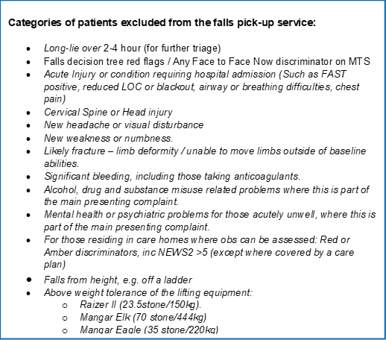
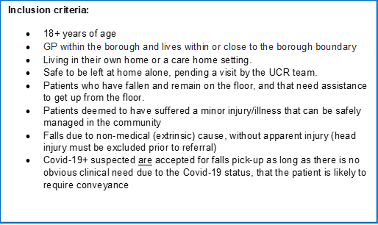
Falls Pick-up Service Criteria

Slide 47
Phone call from
Neuro Rehab
HPW
RATT
RR
Accepted
Calling
Rapid Response Referral
Referral should be under the referral target :
‘unscheduled care’ and in the top pot ‘Inbound referrals’
For the Lead clinician to pick up and triage
If the referral meets all the criteria after being triaged, it can be accepted onto the falls pick up service. The lead Clinician will accept it via 2 processes.
Rapid Response phone
07519607238
Rapid admin takes the call from the referring clinician and creates a Rapid Response referral on emis.
REJECTED
After triaging the clinician may have found ‘red flags; which means the referral must be rejected on emis. The Lead Clinician will create a rejection note on the patient’s emis consultations using the RR template
(BRR/@homeassessment template v21 or v7 RRT triage template)
Rapid Response Referral must be accepted
The lead clinician will accept the referral which is in ‘inbound referrals’ – ‘unscheduled care’ on emis, and move it into the emis top pot ‘assessment waiting’ – ‘Rapid response Multidisciplinary team – 2hr’
Rapid Response Lead Clinician takes the call and triages to see if it is appropriate for acceptance
(Triage template: BRR/@homeassessment template v21 or v7 RRT triage template on emis)
RATT Referral must be created
The lead clinician will request the RATT Admin to create a RATT referral – referral target (Rapid Access Therapy – inbound referrals)(While creating the referral, RATT Admin must add a referral comment “FALLS PICK UP” Once it is on the system, the Lead clinician must move the RATT referral on emis which is in ‘Rapid Access Therapy’ ‘inbound referrals’ TO ‘Under discussion’. Communicating with the RATT admin that this has been done.
The Lead Clinician will Reject RR referrals on emis. This referral is located in ‘inbound referrals’ ‘unscheduled care’
If the lead clinician triages the patient’s case as a ‘serious injury’, the clinician present will be advised to call 999 and wait with the patient.
Rapid Response
Once the Lead clinician has accepted the Rapid Response referral on emis they must assess who is available to attend to the patient, based on proximity
Once a clinician has been identified, the Lead Clinician must book this in on Emis.
Assessment
Falls policy p33
RR and RATT clinician complete falls pick up procedure
Intranet > Policies > Falls prevention > Page 33
Complete Emis consultation
RR Emis template name
(BRR @Homeassessment template v21)
RATT Emis template name
(Rapid Access Therapy Template v5)
Rapid Access Therapies
Once the Lead Clinician has communicated with the RATT admin that the referral is in under discussion. The RATT admin will accept the referral on emis, accepting them into ‘Rapid Access Therapies’ - ‘ assessment waiting’.
The RATT admin will add the patient on malinko, assigning them to the ‘falls pick up’ intervention.
Once the lead Clinician has informed the RATT admin that the visit has been booked, they can book it on malinko, assigning it to the closest Band 7 or Band 7 in office.
Serious Injury
* Head injury
* Spinal injury
* Any other suspected serious injuries
Call LAS / wait with patient
18minute procedure
While waiting for the RR / RATT clinicians to complete a pick up, the referring clinician must stay with the patient unless they are safe or with family.
Safety netting policy
The Band 7 RATT should take the raizer, slide sheet and the handles from SPA storage room.
Once emis consultation notes have been completed, both RR and RATT clinicians should DISCHARGE the patient on emis
RATT clinician informs RATT admin that the patient has been Discharged – RATT admin can unselect the ‘falls pick up’ intervention on malinko
2hour time frame
–
Rapid Response
Using the raizer trolley, RATT clinician takes equipment to the car. The first clinician to arrive at the address goes in first
2hour time frame
RATT clinician and RR clinician Complete the initial Assessment at the patients home
Onward Referrals
HPW / RATT / RR / POC / DN
Referrals to be done via SPA.
Referring clinician can phone in on:
0208 315 8750
RATT clinician returns equipment back to base
- Raizer
Trolley
Charger
Sliding sheets
Handles

Slide 48
Other Services within UCR:
Following on from this, the Rapid Response team can make direct referrals into the following UCR services if required:
Rapid Access Therapy Team (for urgent OT / PT intervention)
Home Based Rehab (HBR)
Intermediate Care bed based rehab (30 bedded unit based in QMS) we cannot step up into beds yet
Bromley Hospital @ Home service
Single Point Access (SPA) for access into social care support

Slide 49
Case Study – Confusion and Respiratory
87 year old Male - referred by GP via SPA to RR due to worsening confusion and a cough.
PMH: vascular dementia and ILD.
History – more confused and needing support with transfers which is not usual. Has a chronic cough however now has increased sputum production, no haemoptysis.
No fever, SOB, chest pain, nausea/vomiting, urinary symptoms. No neuro focal.
Vitals - BP 97/62, 20rr, 96%, 73bpm, 36.7. NEWS2 score – 2.
Examination – Crackles to left mid-lower zones on auscultation. No wheeze. Normal heart sounds. Urinalysis NAD.
Grade 2 pressure sore found – treated. Skin assessment – Medley score: 14. Datix completed.
CRB-65 – 2/4
LRTI found – doxycycline prescribed. Safety netted.
Onward referrals – DN to manage wound and BP review. RATT for mobility assessment.

Slide 50

Any questions?

Slide 51
JET’s Social Care OOH Delivery
Social Care staff are available Monday to Friday 9am to 8:30pm, including Saturday and Sunday from 9am to 5pm.
Everyday of the week from 8:30pm to 10pm there is a Social Worker on Stand by, in order to respond to an OOH crisis in the community.
Then after 10pm, they are then on call till 8am.
To compliment the Social Care OOH approach, there is access to Emergency Placements and an urgent response Care Provider.

Slide 52
JET & The Transdisciplinary Model
Holistic Approach
Reduce Delays for patients
Improve patient Experience

Slide 53
Continued
Reflective Learning Sessions
Bite Size Practice sharing
Sharing of knowledge with other disciplines within The team

Slide 54
Discharge to Assess and Out of Borough Pathways for Weekend Activity
New pathway into JET within the last 6 months.
A referral is received from Hospital called a Discharge to Assess.
A Social Care member organises a care package and then visits within 24 hours.
As part of the Assessment process, ongoing Health issues are picked, which are referred into JET.
These groups of people are still unwell and recovering:
by accessing the JET Service at the Weekend, they have access to Social Workers, Nurses, GP’s, Physio’s and Occupational Therapists.

