Slide 1
Lipid Management
Dr John Wong Kingston Hospital

Slide 2
What can be done on lipid management in primary care?
At least 2 measurements of lipids
Fasting sample is very useful
QRISK3
If possible, managing primary and secondary targets
Assessment of diet
Review of weight

Slide 3
Where referrals are needed
Review of need for treatment e.g. FH Assessment of risk for treatment QRISK
Inadequate response to treatment
Adverse effects of treatment
Mixed hyperlipidaemia i.e raised TG

Slide 4
What would then happen in secondary care to manage cases?
Lipoprotein ‘a’
Familial hypercholesterol screening
Assessment for change in medication
Bempedoic acid (Nustendi) /Ezetimibe
PCSK9
Inclisiran
CT angio

Slide 5
Monitoring of secondary factors
Diabetes management
Weight- ‘Exercise’, slimming classes
Smoking- Stop smoking clinics
Blood test before lipid appointment

Slide 6
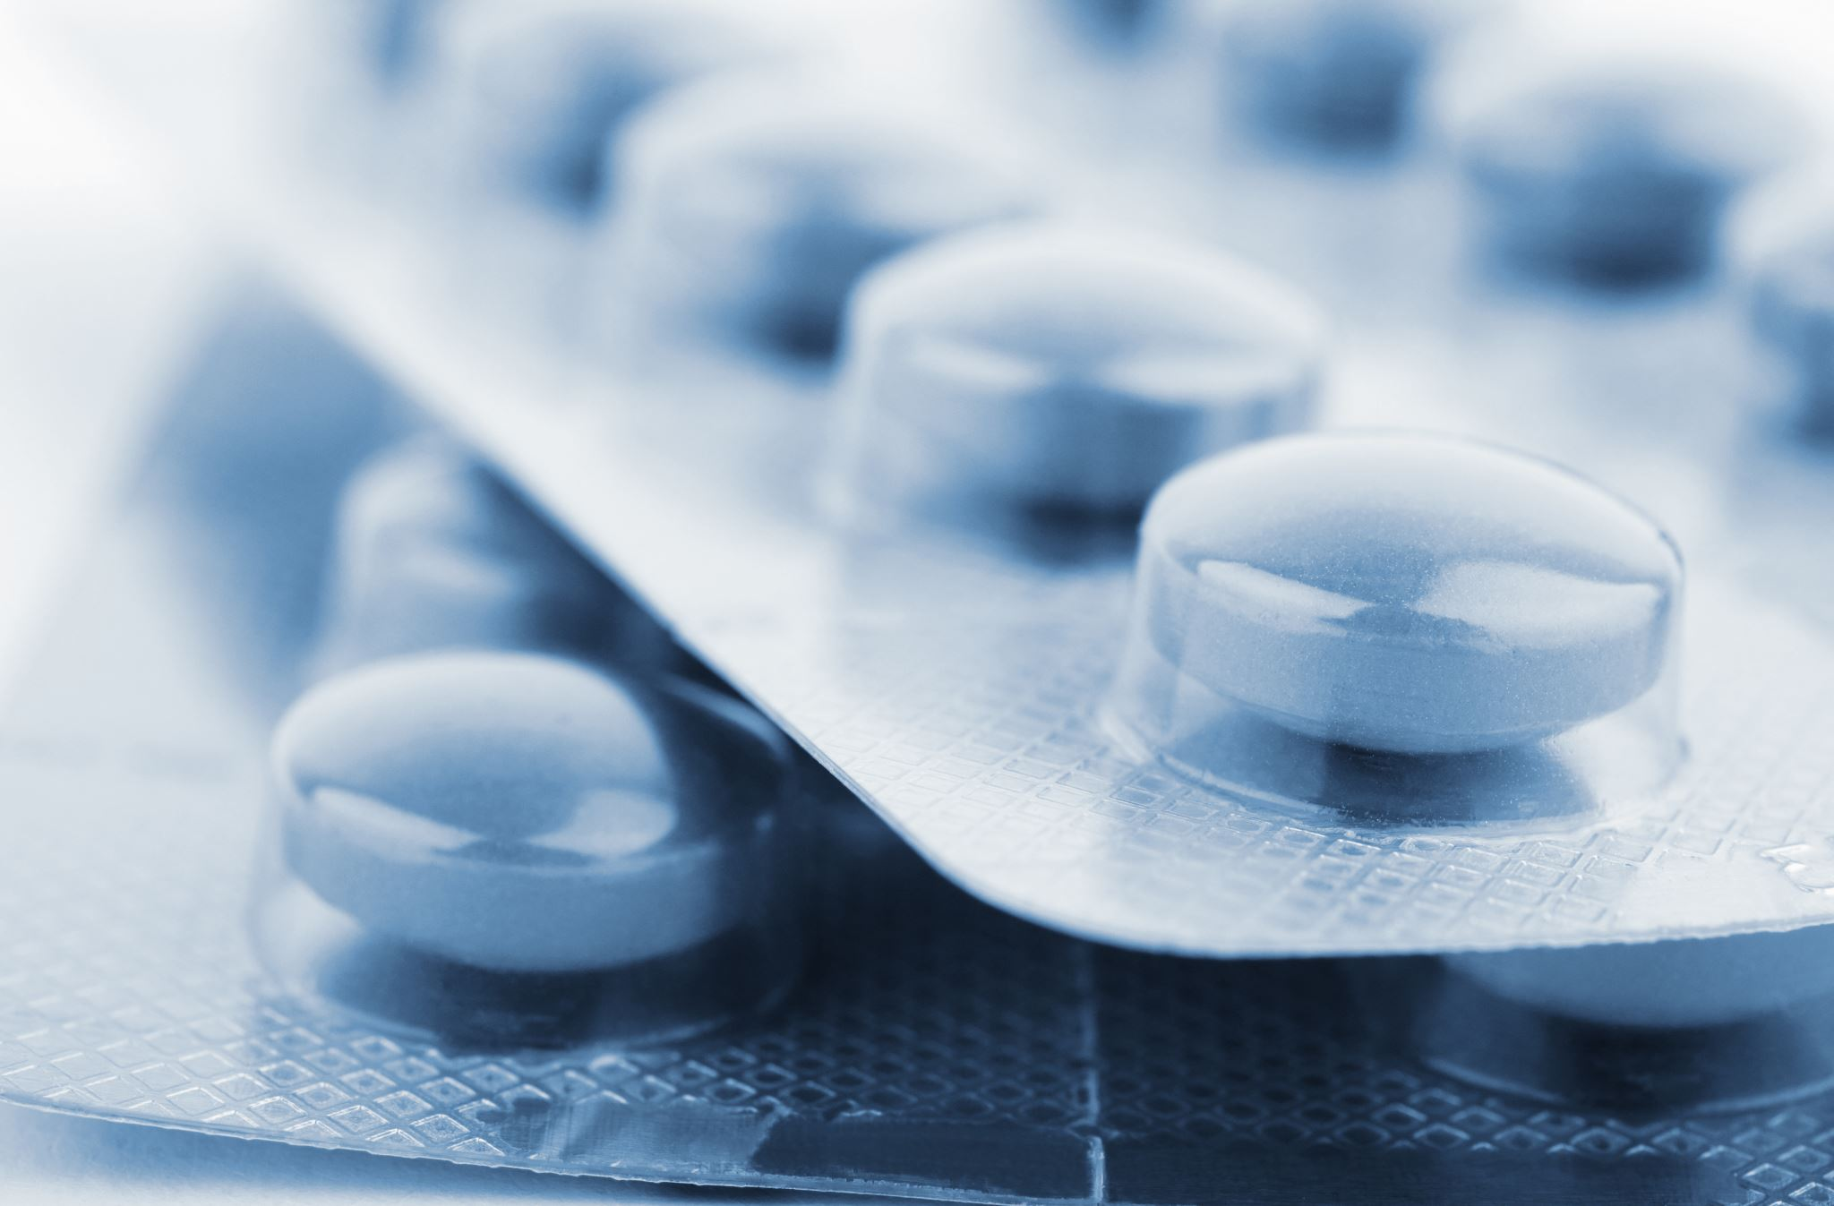
Questions
Which statin?
Simvastatin/Atorvastatin - hydrophobic/lipophilic
Pravastatin/ Rosuvastatin- hydrophilic/lipophobic
Simvastatin 80
Atorvastatin 80
Rosuvastatin vs Atorvastatin
Diabetes Management
Cataracts
Ezetimibe
Nustendi
PCSK9
Inclisiran

Slide 7
CT Angio
2023-Ann. Intern. Med
Screen asymptomatic population over 3.5 years, those with extensive obstruction i.e. >33% of coronary artery tree obstruction > 50% luminal stenosis has 12X higher risk of MI and 3X higher risk of secondary end point MI or death.

Slide 8
NEJM 2023
50% of cardiovascular disease (CVD) and 20% of deaths from CVD may be attributed to:
BMI
Systolic blood pressure
Current smoking
Diabetes Mellitus (DM)
Non-HDL cholesterol
The above 5 modifiable risks contribute 57.2% of women, 52.6% of men for CVD.
22% of deaths in women and 19.1% of deaths in men may be attributable to these 5 modifiable risk factors.

Slide 9
Diabetes mellitus and statins
South Korean Study (coronary artery disease)
US Study
Conclusions
US Study
Incidence of DM
Numbers Needed To Treat (NNT)
1/167 for 1.9 years
1/255 for 4 years
1/200-300 for 5 years
1/198 for 5 years
South Korean study
DM. 7.2% vs 5.9% (Rosuvastatin, Atorvastatin)
Cataract 2.5% vs 1.5% (Rosuvastatin, Atorvastatin)

Slide 10
ANY QUESTIONS?

