Slide 1
SWL lipid management guideline update- Highlights
Pedro Bandeira
Specialist Pharmacist- Cardiovascular services and Lipid Disorders
South West London Lipid optimisation collaborative project
SWL Cardiology Network
St. George’s University Hospitals NHS Foundation Trust

Slide 2
Learning outcomes
Important changes in the SWL lipid guidance update
Newer Lipid lowering therapies (LLTs) and Formulary status (RAG) changes
Referral criteria to lipid clinics and injectable therapies
Rationale
NICE clinical guideline for Cardiovascular disease: risk assessment and reduction, including lipid modification (CG181) -updated in May 2023
NHS Summary of national guidance for lipid management -updated in December 2022.
23/24 QOF guidance on cholesterol:
  two indicators focusing on CVD secondary prevention lipid therapy optimisation (CHOL001 and CHOL002)
CLEAR outcomes RCT August 2023- showed CV outcome benefits of bempedoic acid

Slide 3
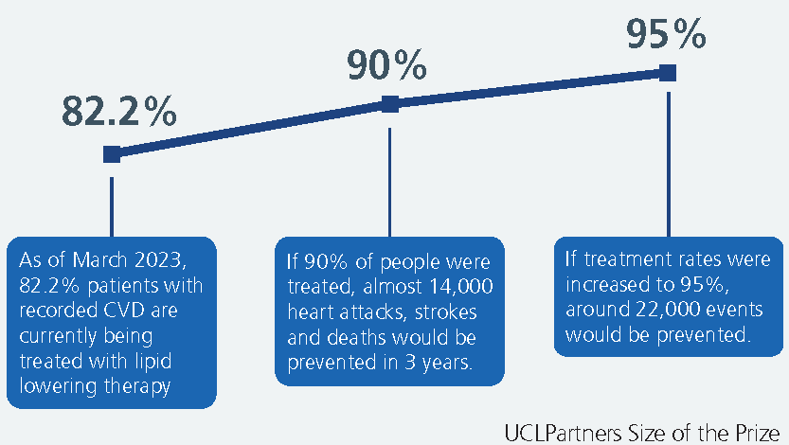
National and local priorities
National Medicines optimisation opportunities 23/24
  Optimising lipid management for CVD prevention (alongside lifestyle/diet)
  Links to the QOF metrics to support implementation and monitoring
UCLP cholesterol size of the prize
  1. Initiate and empower: Identify and treat all people at high-risk of CVD with lipid lowering therapy (LLT) and support personalised care conversations.
  2. Optimise: Consider use of high intensity statins and combination therapy with ezetimibe or other LLT whilst maintaining support for adherence to medication.
  3. Intensify: Protect high risk patients by reducing lipid levels to target, intensifying LLT when required.
NHSE: What is the opportunity?
Notes:
The opportunity: Size of the Prize sets reasonable levels of ambition that go beyond the historical status quo of suboptimal treatment – showing how many additional heart attacks and strokes will be prevented in three years and the savings generated if more people have their treatment optimised.

Slide 4
SWL Lipid guidance clinical pathways update:
Primary prevention
Secondary prevention
Statin intolerance
Hypertriglyceridaemia (new)

Slide 5
Primary Prevention: Medicines Optimisation for Lipid Management in primary care
Please note: Lifestyle change and dietary measures are key to CVD event reduction together with drug therapy (see page 7)
In primary care check: bloods (non-fasting full lipid profile: (TC, TG, HDL-C, LDL-C, non-HDL-C) liver function (LFTs), HbA1c (manage/review diabetes mellitus (DM) if ≥48mmol/mol), thyroid & renal function (and albumin creatinine ratio when applicable), blood pressure (BP), weight, body mass index (BMI), alcohol intake, smoking status and calculate CV risk. Use QRISK3 wherever possible or QRISK2 score using EMIS/in-built system template in people up to and including aged 84 years. Interpretation of CVD risk scores should always reflect informed clinical judgement. Consider secondary causes of hyperlipidaemia and manage as needed, consider if lipid profile may indicate FH- (see pages 4 and 13). If non-fasting Triglycerides above 4.5mmol/L, please refer to page (Hypertriglyceridaemia pathway- see page 12)
Offer high intensity statins (e.g. atorvastatin) to all patients with high CVD risk including:
1. Type 2 DM with CVD risk ≥ 10% and/or chronic kidney disease (CKD). Do not use a risk assessment tool (QRISK 3) to assess cardiovascular disease (CVD) risk in people with an eGFR less than 60 ml/min/1.73 m2 and/or albuminuria (QRISK3 has updated to eGFR<30ml/min/1.73m²).
2. Familial hypercholesterolaemia, or CKD and/or albuminuria, or type 1 DM and age above 40 years or DM over 10 years or nephropathy or with other CVD risk factors NICE⁶
Consider additional CVD risk factors, if present, together with QRISK score:
Severe obesity (BMI >40kg/m²), socio-economic status, human immunodeficiency virus (HIV) treatment, migraine, erectile dysfunction, severe mental illness, medications that may cause dyslipidaemia (e.g. antipsychotics, corticosteroids, immunosuppressants), autoimmune and inflammatory disorders e.g. systemic lupus erythematosus (SLE), impaired fasting glycaemia, hypertriglyceridaemia (see page 13); CV risk changes (BP, smoking status and lipid levels)
Consider options with shared decision making (page 7-8), education and lifestyle interventions (page 7) to modify CVD risk (e.g. BP, HbA1c, weight, smoking, alcohol intake, diet, physical activity).
For all patients consider the risk: benefit of therapy holistically and consider deprescribing options e.g. frailty, short estimated life expectancy over next 5 years, poor overall functional status, low CV event risk, suspected adverse effects related to medication, non-adherence- a shared management plan with the patient and carer/family members (SPS guidance; Prescqipp; a guide to deprescribing statins). Optimise blood pressure management and other co-morbidities. Support lifestyle interventions, medicines adherence and ensure regular checks of CVD risks
If age below 85 years and QRISK above 10%: address modifiable risk factors and following a shared decision: consider initiating statin therapy with a moderate dose of a high intensity drug (HI):
atorvastatin 20mg daily (alternative is rosuvastatin 10mg daily)* -see page 7 for high intensity statin comparison table -consider drug interactions that may affect dosing (see BNF)
Yes
After 3 months, check full lipid profile: is non-HDL cholesterol reduction greater than 40% from baseline?
Check adherence to medication, timing of dose, statin adverse effects/intolerance/hesitancy & diet/lifestyle interventions, measure LFTs (ALT)
No
Step 1: in primary care- Consider up-titration of statin to a maximum dose atorvastatin 80mg^ (alternative is rosuvastatin 20mg to 40mg)*- see HI statin table page 7 and consider dose limitations in CKD (eGFR<30/min^*)
Step 2: in primary care- If intolerant to higher dose of statin, consider adding ezetimibe 10mg daily (SPC- check contra-indications) to maximum tolerated dose of statin
Step 3: in primary care- If intolerant to any statin, start ezetimibe 10mg daily and/or consider adding bempedoic acid [Prescribed as bempedoic acid plus ezetimibe 180mg/10mg (Nustendi)▼] Formulary status- Amber 1 (NICE⁸). Refer to eRS lipid specialist advice and guidance as required (see page 6- statin intolerance pathway)
Yes
After 3 months, is non-HDL cholesterol reduction greater than 40% from baseline? Check adherence to medication, adverse effects/intolerance/hesitancy and lifestyle interventions
No
Review annually for adherence to medications, diet and lifestyle, check required bloods e.g. lipids, LFTs at 12 months post initiation then as clinically indicated. Refer for support as required from specialist teams
Refer to lipid clinic for further input
^ Atorvastatin: consider initial dose of atorvastatin 20mg- potential drug interaction; high risk of or experiencing adverse effects; intolerance. For CKD- eGFR less than 30ml/min/1.73m²- seek specialist advice for dose up-titration
*Rosuvastatin: CrCl 30-60ml/min- initiate a lower dose- see BNF (note: if CrCl less than 30ml/min- specialist input to initiate and up-titrate; use of 40mg dose- specialist supervision advised)
For all drugs listed- check SPC or BNF for cautions, contraindications & interactions
Notes:
For reference only- highlights in next slide

Slide 6
SWL CVD primary prevention pathway
CVD risk assessment tool from QRISK 2 to QRISK 3 (NICE guideline 2023)
Threshold for statin use: age 18-84 years old and QRISK3>10% (NICE, 1.1.7)
Do NOT use QRISK3 for patients with CKD (eGFR<60ml/min or albuminuria), familial hypercholesterolaemia, age 85 or above (NICE 1.1.9)
additional CVD risk factors e.g. migraine, erectile dysfunction
Offer high-intensity statins (e.g. atorvastatin or rosuvastatin) for:
  Familial hypercholesterolaemia
  CKD and/or albuminuria
  type 1 DM and age > 40 years; DM over 10 years or nephropathy or with other CVD risk factors
Consider benefit and risk, frailty, and life expectancy
Check adherence to medication, adverse effects/intolerance/hesitancy and lifestyle
Aim for non-HDL reduction of 40% (and LDL<3 or non-HDL <3.5mmol/L)
Up-titrate statin dose if necessary to achieve targets, or consider ezetimibe
Notes:
Follow annual review recommendations (NICE guideline NG238 Dec 2023):
1.11.8 Provide annual medication reviews for people on lipid-lowering treatment. [May 2023, amended December 2023]
1.11.9 Offer an annual full lipid profile to inform discussions about secondary prevention of CVD. [May 2023, amended December 2023]
1.11.10 Consider an annual full lipid profile to inform discussions about primary prevention of CVD. [May 2023, amended December 2023]
1.11.11 During the annual medication review:
discuss and encourage medicines adherence, if the shared decision is to continue with lipid-lowering treatment
discuss and encourage dietary and lifestyle changes if appropriate
address CVD risk factors. [May 2023, amended December 2023]

Slide 7
CVD Secondary Prevention: Medicines optimisation pathway for Lipid Management
Check baseline bloods (non-fasting full lipid profile, LFTs, HbA1c, thyroid and renal function)- consider secondary causes of hyperlipidaemia and manage as needed, consider if lipid profile may indicate FH- (see page 4 and page 13)
Offer high dose high intensity statin therapy with atorvastatin 80mg^ (alternative is rosuvastatin 20-40mg)* to adults with CVD without delay: this includes acute coronary syndromes (ACS), angina, previous myocardial infarction (MI), revascularisation, stroke or transient ischaemic attack (TIA), symptomatic peripheral arterial disease (PAD) or abdominal aortic aneurysm (AAA)
3) Support the self-management (see page 7) of modifiable risk factors e.g. smoking, diet, obesity, alcohol intake, physical activity, blood pressure and glycaemic control (HbA1c)[SWL diabetes guidance]
)
In primary care check: Is patient on high dose, high intensity statin? atorvastatin 80mg^ (alternative is rosuvastatin 20mg-40mg)* Consider dose adjustments in CKD, drug interactions, intolerance
Yes
Has non-HDL-C reduced by 40% or more from baseline at 3 months NICE⁶ AND non-HDL-C below 2.5 mmol/L or LDL-C below 1.8 mmol/L JBS3?
No
For all patients: Discuss with the patient statin choice (page 7, page 8): reinforce lifestyle, dietary measures, suspected adverse effects to medication and adherence. Consider switching to another HI statin/increase statin dose if on suboptimal dose and/or add ezetimibe 10mg daily based on risk score, co-morbidities and clinical judgement. Consider the risk: benefit of therapy holistically and consider deprescribing options e.g. frailty, short estimated life expectancy over next 5 years, poor overall functional status, low CV event risk, non-adherence-
a shared management plan with the patient and carer/family members (SPS guidance; Prescqipp; a guide to deprescribing statins). Check full lipid profile & LFTs after 3 months
Is Non-HDL-C below 2.5mmol/L or LDL-C below 1.8mmol/L JBS3? Check adherence to medication/lifestyle measures, intolerance to statin (statin intolerance- see page 6).
If maximum tolerated dose of statin and ezetimibe does not achieve lipid targets as above, consider the following options based on shared decision making with the patient:
No
Yes
Step 1: In primary care- Add ezetimibe 10mg daily SPC to HI statin and/or adjust statin dose. Recheck full lipid profile (TC, TG, HDL, LDL-C), LFTs in 3 months
Step 2: Consider injectable therapies via lipid clinic/A+G- alirocumab/evolocumab (PCSK9i mAB): refer to lipid clinic if LDL-C >4 mmol/L (or LDL-C >3.5 mmol/L with recurrent CVD event or multivascular disease. PCSK9i (see page 9)-Formulary status- Red
Consider inclisiran ▼via A+G or referral to lipid clinic if LDL-C ≥ 2.6 mmol/L and patient not eligible for PCSK9i mAB/other LLTs. Formulary status- Red (see page 10 for details on initiation)
Step 3: Check fasting lipid profile and consider icosapent ethyl ▼if CVD on a statin, LDL-C above 1.04 and ≤ 2.6 mmol/L plus TG≥ 1.7 and < 4.5mmol/L- Formulary status- Amber 2 (see page 11)
For Statin intolerance options- (see page 6):
- Rechallenge with low-dose alternative statin
- Specialist recommendation of [bempedoic acid plus ezetimibe] ▼ (NICE⁸) Formulary status- Amber 1
- Lipid specialist Initiation inclisiran▼ (page 10)- Formulary status- Red
Yes
Is Non-HDL-C below 2.5mmol/L or LDL-C below 1.8mmol/L on maximum tolerated doses of HI statin and/or ezetimibe JBS3?
No
Discuss lipid lowering options with your patient. In SWL, it is recommended to prescribe high intensity statin with ezetimibe for at least 3 months before considering other options or referral to lipid clinic (advice and guidance) to consider injectable therapies (LDL-C) and/or to consider oral Icosapent ethyl (TG)
Consider current regimen if well tolerated and review annually- adherence to medications, dietary and lifestyle measures, check required bloods (full lipid profile, HbA1c if indicated, LFTs at 12 months post initiation and then as clinically indicated)
^ Atorvastatin: consider initial dose of atorvastatin 20mg- potential drug interaction; high risk of or experiencing adverse effects; intolerance. For CKD- eGFR less than 30ml/min/1.73m²- seek lipid specialist advice for dose up-titration
* Rosuvastatin: CrCl 30-60ml/min- initiate a lower dose- see BNF, (note: if CrCl less than 30ml/min- specialist input to initiate and up-titrate; use of 40mg dose- specialist supervision advised)
(beware of interactions e.g. concomitant use with clopidogrel, max dose 20mg once daily)
For all drugs listed- check SPC or BNF for cautions, contraindications & interactions
Notes:
For reference only- highlights in next slide

Slide 8
SWL CVD secondary prevention pathway
Offer high intensity statins (atorvastatin 40-80mg or rosuvastatin 20mg-40mg)
Reduce doses of HI statins if intolerance or new side-effects develop
Consider dose adjustments in CKD, drug interactions, intolerance (AAC)
Add-on ezetimibe to HI statins or as monotherapy
For patients unable to tolerate HI statins: check statin history/allergy, PMHx and consider statin holiday for 2 weeks then:
  alternative frequency of rosuvastatin: 5mg weekly, twice weekly, 3x weekly (or gradual increase regimens)
  Ezetimibe alone or with bempedoic acid (Nustendi®)-can be started by primary care (after specialist advice) or by secondary care
  consider rechallenge with low-dose alternative statin (e.g. pravastatin)
LDL level at least <1.8mmol/L but aim as low as possible (NICE LDL target<2)
Refer to lipid clinic for injectable therapies if on statin not meeting lipid targets

Slide 9
Statin intolerance pathway/options if not achieving lipid lowering targets
In primary care: Discuss with the patient if signs and symptoms are statin intolerance or due to a statin reluctance/non-adherence. Consider that a statin at any dose reduces CV risk- if a patient cannot tolerate a high intensity statin, aim to treat with a maximum tolerated dose of a statin, but if symptoms persist consider alternative options/specialist (see below)
For Statin Related Muscle (SRM) symptoms: symmetrical pain/weakness in large proximal muscle groups, worsened by exercise. Measure creatine kinase (CK)*: if above 4x Upper Limit Normal (ULN) and below 10x ULN with intolerable symptoms: stop statin for 4 to 6 weeks*. If below 4xULN, consider statin dose adjustments or ezetimibe/alternative lipid lowering therapies.
If CK normalises and symptoms have resolved for at least 2 weeks, then rechallenge: Offer a low or moderate dose of HI statin e.g. atorvastatin 10 to 20mg daily or rosuvastatin 5 to 10mg daily.
Please note: Non-standard dosing may be prescribed by cardiology and lipid specialist clinics e.g. rosuvastatin 5mg weekly or three times a week (off label use but accepted practice)
No recurrence of muscle symptoms:
Titrate dose at 8 week intervals to achieve appropriate targets- continue to monitor for symptoms and continue therapy
If recurrence of muscle symptoms: recheck CK* and consider alternative options or add-on therapy if not tolerating statin/
achieving lipid lowering targets:
Continue maximal tolerated dose of statin (if not tolerated -stop the statin) if CK below 4x Upper limit normal
Add in ezetimibe 10mg daily (SPC)- review adherence/tolerance and full lipid profile in 3 months
Stop statin for 2 weeks and rechallenge with alternative regimens of HI statins (rosuvastatin 5mg three times a week)
If tolerating ezetimibe but not achieving lipid lowering targets: consider adding bempedoic acid [Prescribed: bempedoic acid plus ezetimibe 180mg/10mg▼] (NICE⁸) or lipid specialist input -inclisiran▼ for secondary prevention
Bempedoic acid initiation: Prescribed- Bempedoic acid plus ezetimibe 180mg/10mg (Nustendi)▼(NICE⁸)
This is Amber 1 in SWL and initiation can be undertaken by a specialist or prescribed in primary care :
Bempedoic acid primary care monitoring: NOTE: Prescribed- Bempedoic acid plus ezetimibe 180mg/10mg (Nustendi)▼(NICE⁸)
Patient information: Report any unexplained muscle pain, tenderness or weakness^.
Monitor SPC | Baseline
Renal function | eGFR <30ml/min/1.73m²: Avoid
Liver function | Severe hepatic impairment: Avoid
Uric acid | Active gout: Avoid
FBC | Hb level (in particular)
Drug interactions | e.g. simvastatin 40mg; For full list- See BNF & SPC
Contraindications | Pregnancy, breast feeding, age <18yrs: For full list- See SPC
Myopathy symptoms | Check
Monitor SPC | Within 3 months then annually
Renal function | Review- eGFR <30ml/min/1.73m²- limited experience
Liver function | Review- AST/ALT ≥3x ULN- Stop treatment
Uric acid | Hyperuricaemia with gout symptoms present- Stop
FBC | Hb decrease by ≥20g/L from baseline or < lower limit of normal (LLN)- Stop treatment, investigate further/ refer to appropriate specialist
Myopathy Symptoms | Monitor: if present check CK >10x ULN confirms myopathy- Stop bempedoic acid and statin; reduce statin dose or change statin/lipid lowering therapy if symptoms persist (see above).▼Report any side effects to the yellow card scheme. Patient counselling^
*For muscular symptoms: check CK: if >50x ULN stop statin and consider rhabdomyolysis- seek urgent specialist advice, if 10-50xULN check renal function- if deteriorating, stop statin for 1 month to see if symptoms and CK resolves. Restart a lower dose and uptitrate or consider alternatives above. See: Statin-Intolerance-Pathway-NEW.pdf (england.nhs.uk)
If patients report symptoms that are not typical of SRM (e.g. asymmetric distribution, failure to resolve with de-challenge despite normal CK) consider other musculoskeletal disorders, metabolic, degenerative or inflammatory e.g. Vitamin D deficiency, polymyalgia rheumatica. Check Bone profile, Vitamin D, C-Reactive Protein.
For all drugs listed- check SPC or BNF for cautions, contraindications & interactions
Risk factors for intolerance: for all doses of all statins (except for simvastatin 80 mg), factors predisposing to these adverse effects are not well defined, but as with most drugs, older people appear to be more vulnerable. Hypothyroidism, pre-existing muscle disease, and renal impairment are also possible causative factors, and commencement of treatment with an interacting drug is a well-established precipitant. Other suspected risk factors include female sex, diabetes mellitus, and Chinese (and possibly East Asian in general) ancestry.
For abnormal LFTs: If transaminases raised 3xULN stop and restart once LFTs normalised- consider other causes of abnormal LFTs. LFTs are checked at baseline and within 1 year of statin therapy.
Notes:
For reference only- highlights in next slide

Slide 10
Statin intolerance and shared-decision making
De-challenge and re-challenge in statin intolerance with long-acting rosuvastatin as an option
Bempedoic acid can be used in primary/secondary prevention for statin intolerance pts
  Main ADRs: 4.7% hyperuricaemia (normally within first month), 3.1% gout, 2.5% anaemia
Baseline assessment:
  FBC (Hb),LFT,U+Es, urate level
  Assess for risk of myopathy and gout
Not recommended as monotherapy (not approved by NICE)
IMOC October 2023: RAG rating change
  From Amber 2 (specialist initiation and stabilisation before TOC to GP) to Amber 1: Prescribed under recommendation of a specialist (e.g. lipid specialists, cardiologists)
Shared decision-making using QRISK-3, QRISK-lifetime and NICE statin patient decision aid
When to deprescribe statins in
SWL diabetes guidance added to relevant place in support and self-management

Slide 11
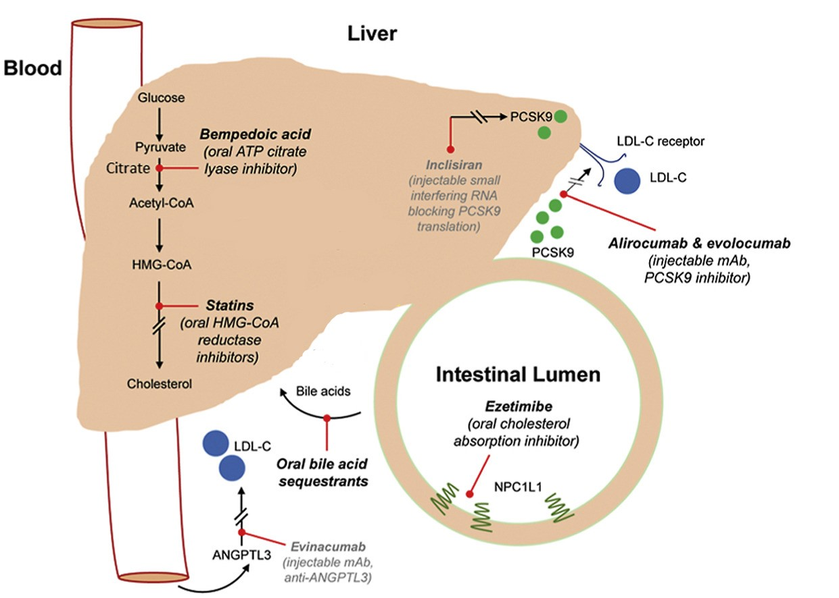
Increased LDL uptake, reduced LDL in bloodstream
Decreased synthesis
Reduced absorption
Reduced reabsorption (via ↑ bile synthesis )
Notes:
Schematic picture summarising the different LLTs available, their target site and mechanism of action
Bempedoic acid: Inhibition of the ACL enzyme leads to decreased cholesterol synthesis in the liver; it is a prodrug and converted to active coenzyme A form by enzymes found only in the liver and not in muscles. lack of active metabolites of bempedoic acid in skeletal muscles: ↓ statin-associated muscle symptoms (SAMS)

Slide 12
Hypertriglyceridaemia Pathway
SNOMED code: hypertriglyceridemia 302870006
Suspected hypertriglyceridaemia: check dietary and lifestyle factors, non-fasting lipid profile (TC, TG, HDL-C, LDL-C, non-HDL-C) plus LFTs, TFTs (TSH, T4), renal function, HbA1c
STEP 1: Consider and exclude secondary causes:
Poorly controlled/new diabetes, excess alcohol intake, non-alcoholic fatty liver, liver disease, obesity (weight/BMI, waist circumference), renal disease (e.g. CKD3) , drug-induced Cushing’s, TG-raising medication (e.g. steroids), untreated hypothyroidism (e.g. TSH>10), smoking
Manage lifestyle factors and address secondary causes. Refer to social prescribing and support from local services prior to referral to lipid clinic
STEP 2: In primary care or secondary care check bloods: repeat fasting (12 hours) lipid profile (TC, TG, HDL-C, LDL-C, non-HDL-C) plus LFTs, TFTs, renal function, HbA1c after 3 months.
Offer lifestyle and dietary changes (physical activity, smoking cessation, reduced alcohol intake, Mediterranean diet). Note: LDL-C levels are not available or reliable if TG levels are above 4.5mmol/L
If fasting TG above 20 mmol/L
If fasting TG 10-20 mmol/L
If non-fasting 4.5 to 9.9 mmol/L
If fasting TG above 2 to less than 4.5 mmol/L
-Strict low fat diet, start fenofibrate* and/or Omega 3-fatty acids (if secondary causes excluded)
-Refer to lipid clinic for urgent specialist review if not a result of excess alcohol or diabetes. At risk of risk of acute pancreatitis (check for symptoms)
-Omega 3-fatty acids may be initiated by lipid specialists for the control of triglycerides, but are not recommended for the secondary prevention of MI
Repeat fasting lipid profile within 2 weeks plus
Repeat QRISK3 AND review for potential secondary causes of hyperlipidaemia
Repeat with a fasting lipid profile
^CVD risk may be underestimated by risk assessment tools^
Optimise management of other CVD risk factors AND seek specialist advice if non-HDL-C >7.5mmol/L
CVD risk (QRISK3) <10%: consider a fibrate* and recheck lipid levels within 4-6 weeks of initiation. Review ongoing management, aiming for TG <4.5mmol/L and consider de-prescribing if clinically appropriate
Primary prevention
Secondary prevention
Mixed dyslipidaemia and family history: Consider statin if as QRISK underestimate CVD risk
CVD risk (QRISK)>10%: consider a HI statin with atorvastatin 20mg daily for primary prevention (see page 3)
CVD risk (QRISK)<10%: manage any secondary causes of hyperlipidaemia (see above) & CV risks with lifestyle interventions (see page 3)
Ensure patient is on maximum tolerated HI statin dose and/or ezetimibe
If fasting TG remains above 10mmol/L: Refer to lipid clinic (at risk of pancreatitis). Start a HI statin or a fibrate until lipid clinic review. Manage other cardiovascular risks, lifestyle and dietary factors, medicines adherence.
Patients on HI statins plus LDL 1.04-2.6 mmol/L AND fasting TG≥1.7mmol/L
*In single randomised clinical trials, fibrates were not associated with significant reduced cardiovascular outcomes therefore are reserved for treatment of hypertriglyceridaemia or for patients who cannot tolerate other lipid lowering therapies.
First line: Fenofibrate slow-release 160 mg OD (Seek lipid service advice and guidance or use 67 mg OD if eGFR <60)
Monitor renal function (at 3months then annually) and liver function (every 3 months for first year then annually) with fibrate prescriptions; Discontinue: if Cr increase >50% (adjust dose as per SPC) and if AST/ALT >3xULN; Check CK if muscular symptoms: The combination of fibrate with statin increases risk of myopathy
Consider Icosapent ethyl – Formulary status amber 2**
Two 998mg capsules twice daily see page 11
Seek lipid specialist opinion via advice and guidance if fibrate is contraindicated or not tolerated. Refer to lipid clinic if non-HDL > 7.5mmol/L OR If inadequate response to initial treatment
Diabetes-related hyperlipidaemia→ Optimise diabetes treatment: Please refer to SWL Diabetes guidance
**IN PATIENTS WITH A CVD HISTORY AND FASTING TG>1.7mmol/L (or non-fasting TG>2.1mmol/L) and LDL-C 1.04 to 2.6mmol/L, lipid and diabetes specialists may consider adding Icosapent Ethyl ▼ to HI statin therapy (NICE ta 805) See page 11
For all drugs listed- check SPC or BNF for cautions, contraindications & interactions
Notes:
For reference only- highlights in next slide

Slide 13
SWL Hypertriglyceridaemia pathway
Main treatment: still high-intensity statins
No cardiovascular benefits associated with fibrates and should not be routinely prescribed on its own
  Can be prescribed in severe hypertriglyceridaemia to bring TG down quickly (to prevent acute pancreatitis) or when other LLT options are not suitable
Screen and treat for secondary causes of hypertriglyceridaemia:
  Poorly controlled/new diabetes, excess alcohol intake, non-alcoholic fatty liver, liver disease, obesity (BMI>30kg/m2), renal disease (e.g. CKD3), drug-induced Cushing’s, TG-raising medication (e.g. steroids, antipsychotics, ARVs), untreated hypothyroidism (e.g. TSH>10), smoking
Can consider icosapent ethyl (vazkepa) as per NICE criteria if still high-risk after managing other CV risks and secondary causes (**)
Notes:
1. Fibrates reserved for patients with severe high TG, co-morbidities (e.g.) or pts who cannot tolerate other therapies
2. Warning new MHRA: Systematic reviews and meta-analyses of randomised controlled trials have highlighted a dose-dependent increased risk of atrial fibrillation in patients with established cardiovascular diseases or cardiovascular risk factors treated with omega-3-acid ethyl ester medicines compared to placebo. See: Omega-3-acid ethyl ester medicines (Omacor/Teromeg 1000mg capsules): dose-dependent increased risk of atrial fibrillation in patients with established cardiovascular diseases or cardiovascular risk factors - GOV.UK (www.gov.uk)
-

Slide 14
Inclisiran eligibility criteria NICE Technology Appraisal TA733
PCSK9-inhibitor eligibility criteria NICE TA393 Alirocumab and NICE TA394 Evolocumab
 | Without CVD | With CVD
Primary non-familial hypercholesterolaemia or mixed dyslipidaemia | Not recommended at any LDL concentration | 2.6 mmol/l or more, despite maximum tolerated lipid-lowering therapy, that is: 1. maximum tolerated statins with or without other lipid-lowering therapies or, 2. other lipid-lowering therapies when statins are not tolerated or are contraindicated
Primary heterozygous familial hypercholesterolaemia | Not recommended at any LDL concentration
CVD is defined as history of any of the following: • Acute coronary syndrome (such as myocardial infarction or unstable angina needing hospitalisation) • Coronary or other arterial revascularisation procedures (PCI/CABG) • Coronary heart disease • Ischaemia Stroke or Transient Ischaemic Attack (TIA) • Peripheral arterial disease (PAD)- inc. carotid and aortic disease
 | Without CVD | With CVD
Primary non-familial hypercholesterolaemia or mixed dyslipidaemia | Not recommended at any LDL concentration | High-risk (1) | Very high-risk (2)
 |  | LDL>4.0mmol/L for two readings at least 6 months apart | LDL>3.5 mmol/L for two readings at least 6 months apart
Primary heterozygous familial hypercholesterolaemia | LDL>5.0mmol/L at least 6 months apart | LDL>3.5 mmol/L
High risk: History of any of the following: ACS (such as myocardial infarction or unstable angina needing hospitalisation); coronary or other arterial revascularisation procedures (PCI/CABG); Coronary Heart Disease (CHD), ischaemic stroke or TIA Transient Ischaemic Attack (TIA); Peripheral Arterial Disease (PAD) Very high risk: Recurrent CV events or CV events in more than 1 vascular bed (that is, polyvascular disease)

Slide 15
Lipid Summary of lipid lowering therapy options and CV risk reduction
Lipid management drug | Indication (NICE) | Administration | LDL lowering effect | CV outcome data | LT safety data
High intensity statin (atorvastatin or rosuvastatin) | Adjunct to diet in hypercholesterolaemia, FH, CV risk reduction: primary and secondary prevention | One tablet daily (oral) | 40-50% | Yes (primary and secondary prevention) | Yes
Ezetimibe | With statin to reduce CV risk: primary and secondary prevention, or if statin intolerance, FH | One tablet daily (oral) | 24% | Yes (secondary prevention) | Yes
PCSK9i mAB (evolocumab or alirocumab) | FH if LDL>5mmol/L, statin intolerance, CV risk reduction: secondary prevention if LDL>3.5-4mmol/L | SC injection every 2 weeks (can be self administered) | 60% + | Yes | Yes
Bempedoic acid | With ezetimibe in statin intolerance | One tablet daily (oral) | 28% | Yes (primary and secondary prevention) | Short term safety data from trials of up to 2 years
Inclisiran (PCSK9i) | Secondary prevention if LDL >2.6mmol/L, statin intolerance | SC injection twice a year | 52% (48-52%) – ORION 10 and ORION-11 studies | Awaited | Awaited (short-term data of up to 2 years)
Icosapent ethyl | Secondary prevention if LDL-C > 1.0mmol/L and ≤ 2.6mmol/L with fasting TG >1.7mmol/L in combination with statin therapy | Two capsules twice a day (oral) taken with food | - TG lowering effect 18% | Yes (secondary prevention) | Awaited (trial was 4-5 years)
Notes:
Page 9 SWL Lipid guidance

Slide 16
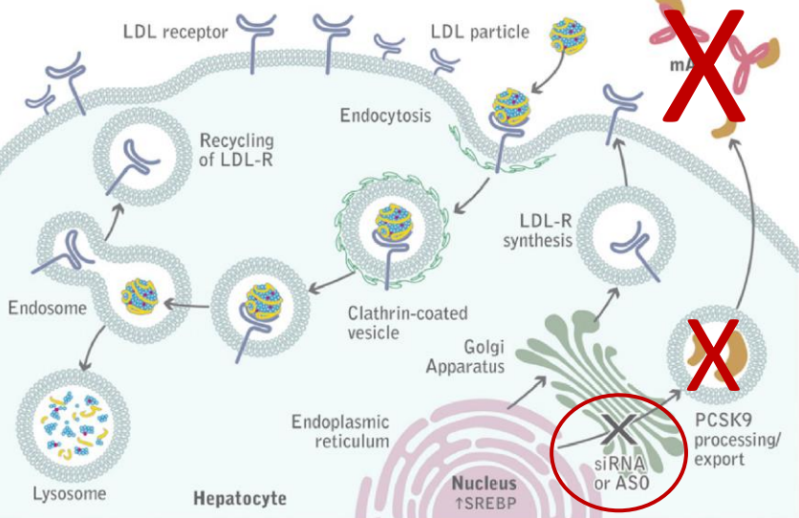
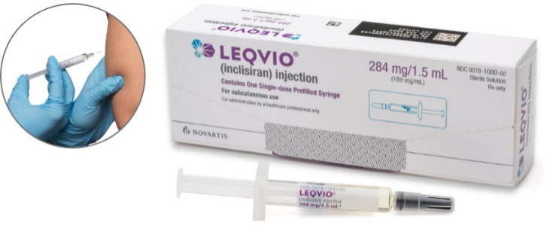
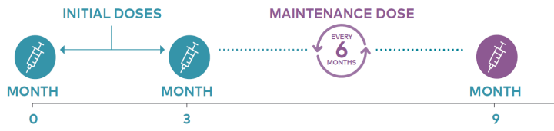
INCLISIRAN (NICE TA 733- 2021) ▼
It blocks production of PCSK9 at source via inhibiting siRNA
For CVD secondary prevention AND:
  LDL-C ≥ 2.6mmol/L despite max tolerated Tx with statins +/- ezetimibe OR alone or in combination with lipid lowering medication if statin intolerant/contra-indicated
Benefits:
Just as effective as PCSK9-I (LDL-lowering effect of 50% in addition to max oral therapy)
No known drug interactions
Very well tolerated: mild-moderate injection site-reactions
Twice yearly dosing after initial loading
Limitations:
Awaiting CVOT trial data/ safety data is now available (ORION-4)
SWL Formulary status: RED → administered by a HCP in lipid clinics
Contraindicated in Pregnancy and breastfeeding/avoid in severe liver or renal impairment (no data available)
Notes:
ORION-10 (48%) and ORION-11 trial (52% LDL-lowering effect)- NEJMed 2020;382:1507
CVD secondary preventions with hx of: ACS (MI or unstable angina), coronary or arterial revascularisations procedures, CHD, TIA/ischaemic stroke and PAD

Slide 17
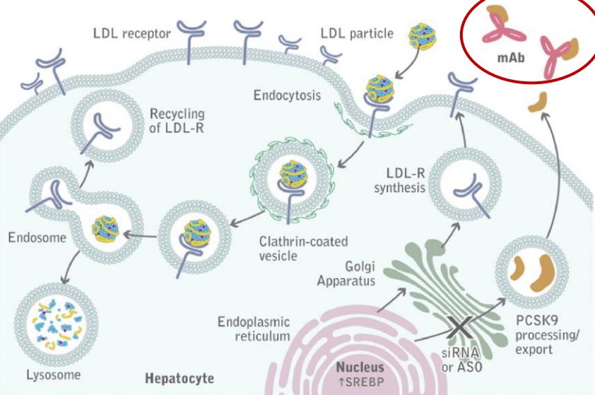
PCSK-9 INHIBITORS: ALIROCUMAB AND EVOLOCUMAB
PCSK9 breaks down LDL receptor, reducing LDL clearance, and increasing LDL concentration
Monoclonal antibodies (mABs) bind PCSK9 in the circulation, preventing breakdown of LDL receptor, hence increase LDL clearance which lower LDL and reduce CVD events
Strict NICE eligibility criteria
  Need at least two LDL readings above 3.5mmol/L for funding
Self-injectable pen with fortnightly administration
Most patients will achieve good results but still be well above target levels with high risk of recurrent CVD events
Formulary status: RED
Notes:
-Increased risk of immune system reactions with other mABs (biologics, or latent diseases)
-Requires at least 30% of LDL-reduction for therapy continuation

Slide 18
ICOSAPENT ETHYL (TA805) ▼
Recommended as an option for reducing the CVD risk in high-risk secondary prevention in patients already taking statins and have:
  Established CVD (with or without Diabetes)
  LDL‑C levels > 1.04mmol/L and ≤ 2.60 mmol/L AND fasting triglycerides ≥1.7mmol/L, despite maximum tolerated HI statins
Exclude secondary causes of hypertriglyceridaemia (e.g. poorly controlled diabetes, variant diets, alcohol excess), repeat with a fasting sample if LDL>4.5mmol/L
REDUCE-IT trial showed a significant 25% reduction in the primary composite CV outcome (CV death, nonfatal myocardial infarction (MI), stroke, coronary revascularization, or unstable angina) for IPE vs placebo
Main side effects: Increased incidence of AF/flutter, bleeding and gout
SWL RAG rating change: from Red to Amber 2 (lipid specialist initiation and stabilisation for at least 3 months)
Notes:
Page 11 SWL Lipid guidance update
Mechanism of action not fully understood, most likely multi-factorial including improved lipoprotein profile with reduction of triglyceride- rich lipoproteins
Reduce IT=ARR=4.8%, RRR=22%, NNT=21

Slide 19
Key take home messages
Screen and address CV risk factors: smoking, HPTN, obesity, alcohol, physical inactivity, poor diet: key to optimal CVD prevention, improve life expectancy and quality of life.
Treat comorbidities and secondary causes of dyslipidaemia at the same time as starting statin treatment: Check full lipids,HbA1C, TFTs, LFTs, renal profile→ Treat/manage secondary causes of high TC/TG (poorly/undiagnosed diabetes, alcohol excess, non-fatty liver, hypothyroidism, CKD stage 3, liver disease). If seen in outpatient clinic, please recheck lipid profile, statin adherence and relevant tests
Offer second-line therapies with ezetimibe +/- alternative statin choice or dose if statin intolerance; or bempedoic acid and ezetimibe (Nustendi)
Utilise local and national guidelines to intensify therapy using ‘’the lower LDL the better approach’’
Refer to lipid clinic if lipid targets not met: additional LLT-bempedoic acid, PCSK9 inhibitors/Inclisiran
Offer adherence and self-management support: lifetime QRISK, Heart UK resources, CVD diet checklist
Do not delay high intensity statin or other lipid lowering therapy if FH is suspected. Start treatment and refer to lipid clinic for genetic testing +/- cascade screening
Notes:
1. Provide individualised benefit vs risk discussion of LLTs based on co-morbidities and current meds (look for interactions). 2. Adherence? ‘’Statin holiday’’ then review symptoms and re-challenge when appropriate with non-HIST doses or statin regimens →Advise the person that any statin at any dose reduces CVD risk (any statin is better than no statin)
Reinforce patient education through patient leaflets (Heart UK, BHF, NHS resources)

Slide 20
Resources
Cardiovascular disease (CVD) resources, NHS England
Cholesterol, statins and you animations, Heart UK and the academic health sciences networks (AHSNs)
Cardiovascular Disease Prevention, Fingertips Public health data, Office for Health Improvement and Disparities
CVDPREVENT, NHS Benchmarking network
Lipid management pathways, The AHSN Network in partnership with the Accelerated Access Collaborative and NICE
Heart UK publications – for healthcare professionals and patients
Lipid modification, PrescQIPP e-learning courses (log-in required)
NICE clinical guideline for Cardiovascular disease: risk assessment and reduction, including lipid modification (CG181) - Updated May 2023
NHS Summary of national guidance for lipid management - Updated December 2022
Cardiovascular disease: risk assessment and reduction, including lipid modification [NG238]-Updated Dec 23
Notes:
Points to consider: Provide individualised benefit vs risk discussion of LLTs based on co-morbidities and current meds (look for interactions). Adherence? Re-challenge when appropriate with non-HIST doses or statin regimens (any statin is better than no statin)
Reinforce patient education through patient leaflets (Heart UK, BHF, NHS resources)

Slide 21
Case study- CV risk management and lipid optimisation clinic at SGH

Slide 22
Case study: AG 65 yo male
Referred to lipid clinic for optimisation
PMH: 1. Left subcortical infarct August 2020, -treated with thrombolysis and thrombectomy; 2. Incidental finding of asymptomatic NSVT on Holter, Hypertension, Hypercholesterolaemia, Chronic back pain, CKD; GORD, asthma
Family history:
  Uncle had MI in his 60s
  Father died when he was 2 (unclear cause); Has 3 brothers+ 1 sister; No known hx of strokes or MI in first degree relative
SHx:
  Non-smoker; Alcohol: 4/6 units a week; low intensity physical activity
  Diet: has a diet rich in rice, curry and some vegetable; Weight: 95.6kg (30.5kg/m2)
Allergies: Atorvastatin(at 20mg), rosuvastatin (at 20mg), pravastatin (myalgia), ramipril (cough)
DHx: Clopidogrel 75 mg OD; 2. Amlodipine 10 mg OD; 3. Bisoprolol 2.5 mg OD; 4. Candesartan 20mg ON; 5. Ezetimibe 10mg OD; 6. Lansoprazole 30mg OD
Nov 2021 Tchol: 4.9, LDL: 2.6, TG: 2.1,non-HDL:3.6; HDL 1.3, Lp(a)= 206mg/L
hba1c 39; Renal function: eGFR=50ml/min; Cr=120, urate 360umol/L, ALT 42, alb 41

Slide 23
What are the next steps in therapy to patient AG?
Consider bempedoic acid in addition to ezetimibe?
Offer injectable therapy
Trial of a low dose rosuvastatin (weekly)?

Slide 24
Case study 3: Treatment plan
1- add bempedoic acid to ezetimibe (Nustendi)- FBC, LFT normal
2-Review bloods in 3 months (aiming for LDL<1.8mmol/l; Non-HDL<2.5)
3- monitor BP/HR, renal function
4- Weight management programme in the community

Slide 25
Case study: F/Up- July 2023
Bempedoic acid (took it from July 22 until March 2023 but developed 3 episodes of gout and hyperuricaemia between January to March 2023, so this was stopped in April 2023)-
Tchol 5.4, LDL 3.2, non-HDL 4.2, TG 2.1,
hba1c 39; Renal function: eGFR=50ml/min; Cr=120, urate 523umol/L, ALT 42
What next?
1- add bempedoic acid to ezetimibe (Nustendi)- FBC normal
2-Offer injectable therapy
3- Trial of a low dose rosuvastatin (weekly)?

Slide 26
Inclisiran eligibility criteria NICE Technology Appraisal TA733
PCSK9-inhibitor eligibility criteria NICE TA393 Alirocumab and NICE TA394 Evolocumab
 | Without CVD | With CVD
Primary non-familial hypercholesterolaemia or mixed dyslipidaemia | Not recommended at any LDL concentration | 2.6 mmol/l or more, despite maximum tolerated lipid-lowering therapy, that is: 1. maximum tolerated statins with or without other lipid-lowering therapies or, 2. other lipid-lowering therapies when statins are not tolerated or are contraindicated
Primary heterozygous familial hypercholesterolaemia | Not recommended at any LDL concentration
CVD is defined as history of any of the following: • Acute coronary syndrome (such as myocardial infarction or unstable angina needing hospitalisation) • Coronary or other arterial revascularisation procedures (PCI/CABG) • Coronary heart disease • Ischaemia Stroke or Transient Ischaemic Attack (TIA) • Peripheral arterial disease (PAD)- inc. carotid and aortic disease
 | Without CVD | With CVD
Primary non-familial hypercholesterolaemia or mixed dyslipidaemia | Not recommended at any LDL concentration | High-risk (1) | Very high-risk (2)
 |  | LDL>4.0mmol/L for two readings at least 6 months apart | LDL>3.5 mmol/L for two readings at least 6 months apart
Primary heterozygous familial hypercholesterolaemia | LDL>5.0mmol/L at least 6 months apart | LDL>3.5 mmol/L
High risk: History of any of the following: ACS (such as myocardial infarction or unstable angina needing hospitalisation); coronary or other arterial revascularisation procedures (PCI/CABG); Coronary Heart Disease (CHD), ischaemic stroke or TIA Transient Ischaemic Attack (TIA); Peripheral Arterial Disease (PAD) Very high risk: Recurrent CV events or CV events in more than 1 vascular bed (that is, polyvascular disease)

Slide 27
Case study AG: F/Up- October 2023
Now on Inclisiran (second dose)
BP: 147/94mmHg (BP at home over 135/85 for more than 5 readings) ; HR: 84bpm
Tchol: 3.3, LDL 1.2, TG 1.4, HDL 1.4, non-HDL 1.9, HbA1C 42mmol/mol, ALT 56, GGT 66
No side-effects reported, lost 2kg, BMI 29kg/m2
What next?
1- add bempedoic acid to ezetimibe (Nustendi)- FBC normal
2-Offer injectable therapy

Slide 28
Case study: F/Up- October 2023
Treatment plan: CV risk optimisation
1- Continue Inclisiran (no S/E, LDL-lowering 54%)
2) BP optimisation: Candesartan 24mg daily, repeat BP+UE’s 2weeks after change;
3) Lifestyle intervention and dietary advice on portion sizes to reverse T2DM, aid further weight loss
4) investigate reasons for rising LFTs (?alcohol use, drug, NAFLD? USS)
5) ACR (?proteinuria) in CKD- ?SGLT2-I via renal team

