Slide 1

Mindset-XR Innovation Support Programme
London and the South East Roadshow Event
Scan the QR code for
today’s agenda
Thursday 23 October 2025

Slide 2
Holo-Log
Adam Wacey

Slide 3
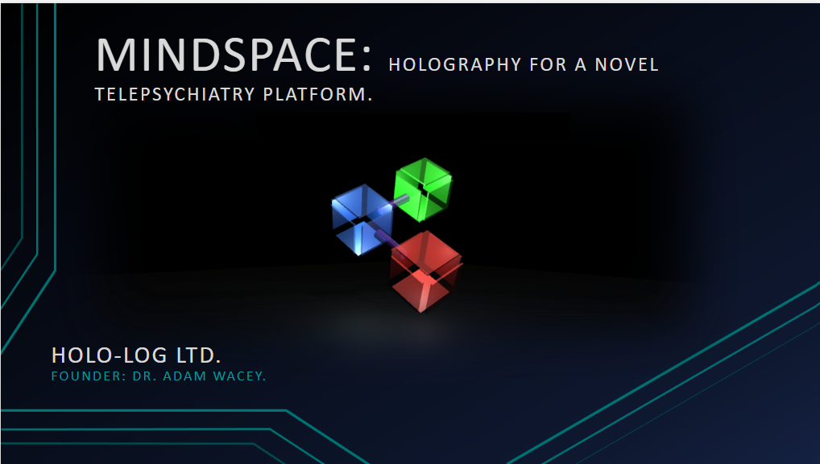

Slide 4
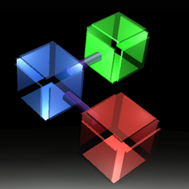

Holo-log: 3d video conferencing
We’ve spent last year fulfilling a MindSet II grant and this year taking that technology to another level again. And this next generation platform is named “MindSpace”.
At the centre of MindSpace is our single use, Holographic Telepsychiatry medical device.
  The device provides live, 3D, Holographic video streaming from a screen. There’s no need a headset or glasses so it’s a naturalistic device, built for communication. The Hologram provides around 8” of percieved depth and you can even look around corners.
  The UI is composed of 6 analogue buttons and two pots – that’s it. No touch screen or endless menus. Interaction is completely natural and intuitive, so it’s as easy to pick up as the first arcade games.
  And the main display provides a gorgeous, 3D, Holographic U.I. - a first we think, that immediately grabs attention and provides a “Wow” moment to even the most jaded digital native.
  To achieve this end has required multiple technical breakthroughs, we’ve invented our own novel camera and A.I. centric rending technology and that’s captured in our 3 Patents (2U.K. 1 USA).
Further, each of the Telepsychiatry medical device communicate with a remote, centralising system which ties all the remote systems together. So, it’s not just a technology or a device, it’s an entire platform for Telepsychiatry.
Commercial In Confidence © Holo-Log 2025

Slide 5
Telepsychiatry/TELETHERAPY
Before COVID-19:
  Use of Telepsychiatry was surprisingly limited, e.g. a study of ~200,000 patients in 2017 found the rate of telemedicine encounters of just 0.7% (Morreale et al. 2023).
During COVID-19:
  Mental healthcare practitioners and patients alike were forced to rapidly adapt to Telepsychiatry via Video-Conferencing platform, so that by 2021 adoption of Telepsychiatry was near universal (~98%, American Psychiatric Association 2021).
After COVID-19:
  Very few Clinicians/Patients are going back to exclusive in person treatment. Usually a few early in person visits then on-line sessions predominate.
Numerous studies have now assessed the cost/benefit of this revolution in therapeutic delivery:
  Patients described struggling to 'open up' to 'a stranger talking over a screen' (Biddle et al. 2023)
  Commenting 'I feel like we don't really know each other as well as if it was in person’.
  Practitioners questioned whether it was possible to establish & maintain comparable relationships to those built offline.
  The technology does not fully capture the richness of in-person interaction (Biddle et al. 2023).
The medium is disrupting the therapeutic relationship.
Our objective: create a new, better medium that has further neurophysiology traits of in person sessions with all the conveniences of remote calls?
Commercial In Confidence © Holo-Log 2025

Slide 6
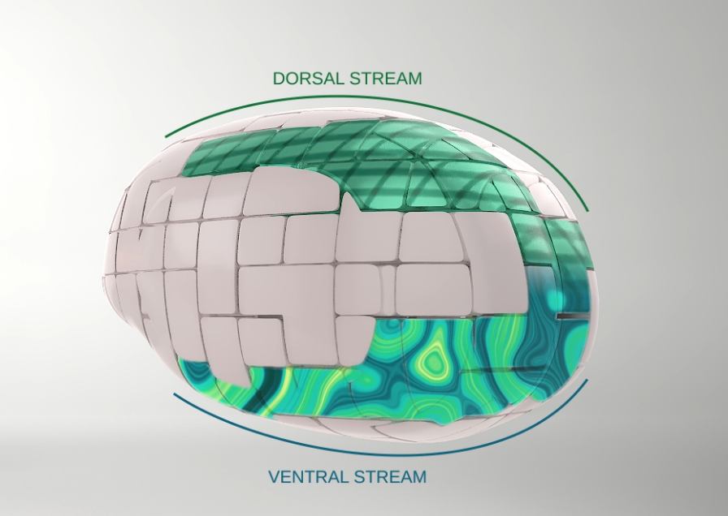
searching for A Better Medium: 2D visual perception v’s 3D.
There are 9 visual depth cues:
  Vergence
  Accommodation
  Stereopsis
  Occlusion
  Subtended visual angle of an object of known size
  Linear perspective
  Vertical position
  Haze or contrast, saturation, and colour, greater distance generally being associated with greater haze, desaturation, and a shift toward blue
  Change in size of textured pattern detail
IRL use all 9 whereas 2D visual processing uses the bottom 6
Commercial In Confidence © Holo-Log 2025
Notes:
Slide 4: Searching for the missing components: 2D visual perception v’s 3D perception. Click
Sagehorn used EEG to study visual perception. Showing images on a laboratory PC for 2D examples and VR and IRL examples to stimulate 3D perception. This showed: Click
EEG is an effective modality for differentiating the response of subjects to 2D and 3D stimuli. Click
The 2D response was different to 3D. Shown in figure 2 to the right. Click
Near identical spatial and temporal brain activation occurred between IRL and VR responses. Click
So, the brain is processing 2D information differently to 3D scenes. Are there other well-established facts about 3D and 2D visual processing that support Sagehorns observations? Certainly, firstly there are 9 visual depth cues: Click
Vergence, eyes crossing as objects get closer. Click
Accommodation, cilary muscles compressing the lense in the eye. Click
Stereopsis, matching disparity from retinal pictures. Click
Occlusion Click
Subtended visual angle of an object of known size Click
Linear perspective Click
Vertical position Click
Haze being greater at distance Click
Change in size of textured pattern detail Click
3D processing use all 9 whereas 2D visual processing uses the bottom 6. Click
Further there are 2, distinct, visual processing pathways. The ventral pathway or “what stream” and the dorsal Pathway or “where” stream. The location of each stream is shown in the figure to the right.
2D visual processing only uses the Ventral stream whereas 3D processing uses both Dorsal and Ventral stream.
So, the take-home message is there is a solid evidence base that holography will give a very different therapeutic experience to 2D Telephysciatry.
Click

Slide 7


