Slide 1
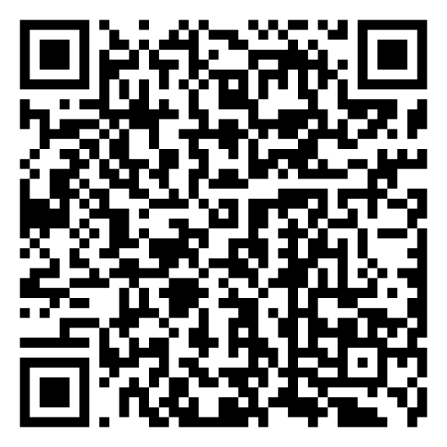
Mindset-XR Innovation Support Programme London and the South East Roadshow Event
Scan the QR code for today’s agenda
Thursday 23 October 2025

Slide 2
Intercultural Roots/EcoGPX Alex Boyd

Slide 3

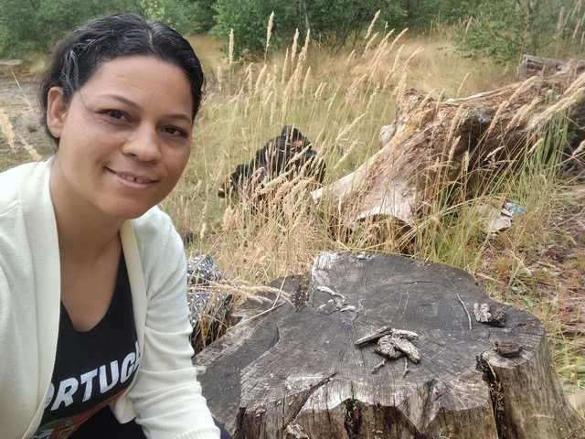
Extending Nature
Mindset-XR Funded Project Name:
Extending Nature: immersive XR experiences to build therapeutic nature-connectedness for adults living with GAD (Generalised Anxiety Disorder)
Project number:
10152790 (July 2025 - December 2026)
Competition:
Mindset extended reality (XR): Digital therapeutics for mental health
Extending Nature website - https://www.interculturalroots.org/project/extending-nature
Organisations:
Intercultural Roots for Public Health
EcoGPX Ltd
Contact:
Dr Alex Boyd - PhD, FRSA
alex@interculturalroots.org
alex@ecogpx.com
Summary
Extending Nature (XN) uses cutting-edge XR (extended reality) to deliver affordable, place-based therapeutic support via the PLACES by EcoGPX® mobile app for people experiencing anxiety. It empowers participants to engage in immersive ecosomatic practices—such as breath-work, grounding, and nature visualisation—through spatialised sound, 360° video, and AR/VR guidance. Developed with diverse artists and individuals with lived experience of anxiety, the app turns everyday green and blue natural spaces into restorative environments.
Image: Fatima Reszczynski, EcoGPX® Launchpad Coventry and Warwickshire, 2024 IRPH

