Slide 1
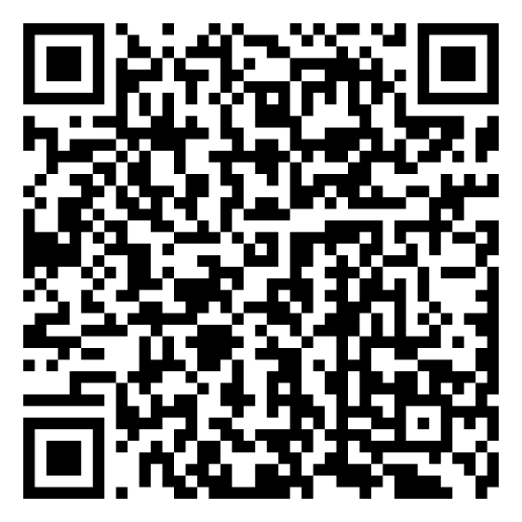
Mindset-XR Innovation Support Programme
London and the South East Roadshow Event
Scan the QR code for
today’s agenda
Thursday 23 October 2025

Slide 2
Neurotech
Jonah Dearlove

