Slide 1
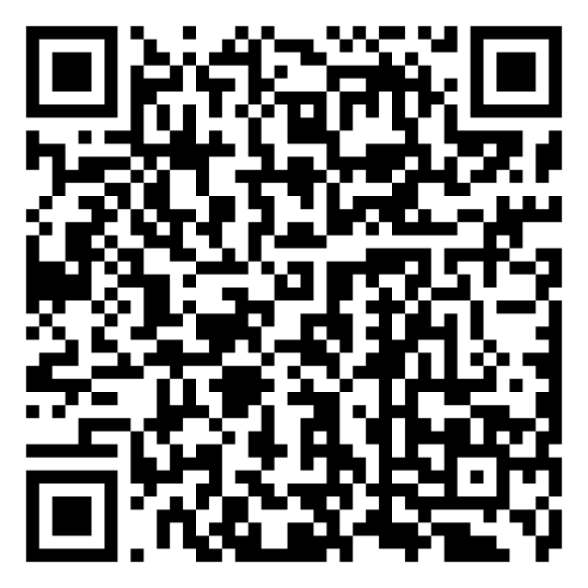
Mindset-XR Innovation Support Programme London and the South East Roadshow Event
Scan the QR code for today’s agenda
Thursday 23 October 2025

Slide 2
Play Well for Life Clare Koenig

Slide 3


Slide 4
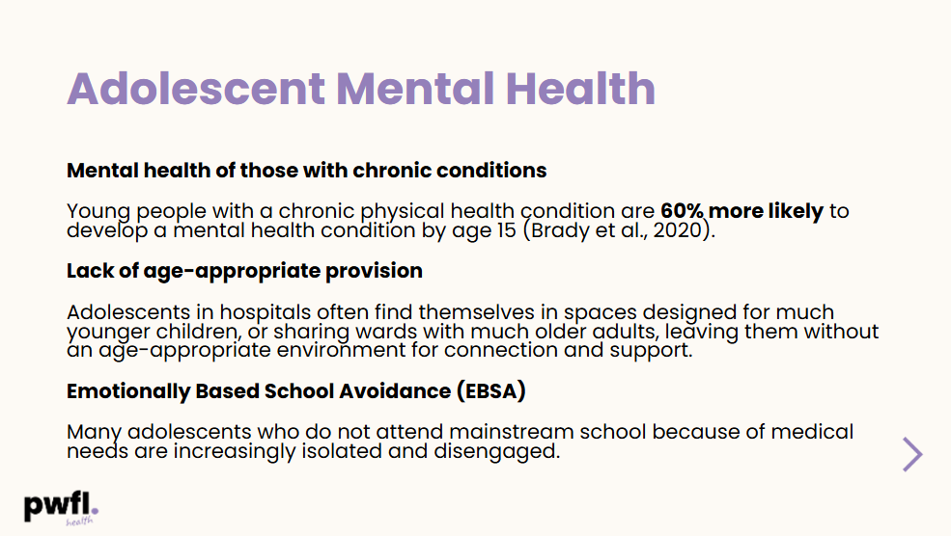

Slide 5


Slide 6
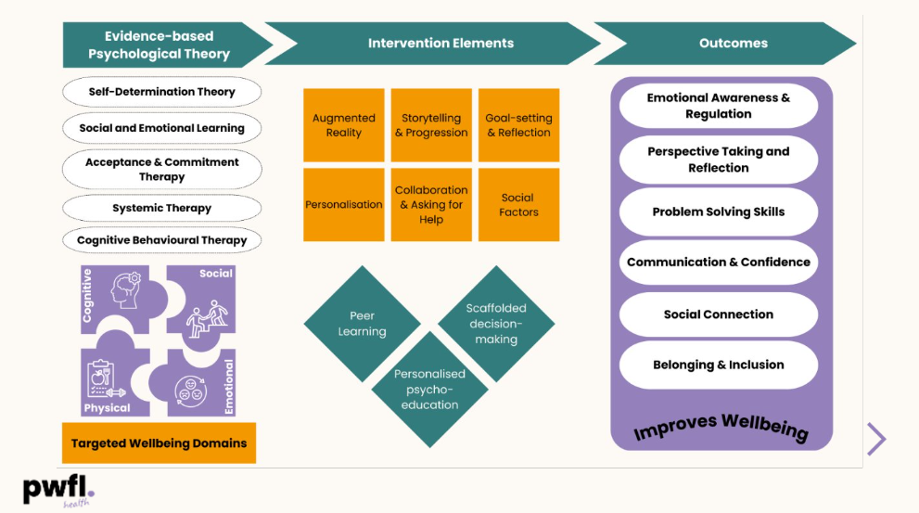

Slide 7


